Slide 1
BUILDING THINKING CLASSROOMS
Peter Liljedahl
@pgliljedahl

Slide 2
Liljedahl, P. (2014). The affordances of using visibly random groups in a mathematics classroom. In Y. Li, E. Silver, & S. Li (eds.), Transforming Mathematics Instruction: Multiple Approaches and Practices. (pp. 127-144). New York, NY: Springer.
Liljedahl, P. (2016). Building thinking classrooms: Conditions for problem solving. In P. Felmer, J. Kilpatrick, & E. Pekhonen (eds.), Posing and Solving Mathematical Problems: Advances and New Perspectives. (pp. 361-386). New York, NY: Springer.
Liljedahl, P. (2016). Flow: A Framework for Discussing Teaching. Proceedings of the 40th Conference of the International Group for the Psychology of Mathematics Education, Szeged, Hungary.
Liljedahl, P. (2017). Building Thinking Classrooms: A Story of Teacher Professional Development. The 1st International Forum on Professional Development for Teachers. Seoul, Korea.
Liljedahl, P. (2018). On the edges of flow: Student problem solving behavior. In S. Carreira, N. Amado, & K. Jones (eds.), Broadening the scope of research on mathematical problem solving: A focus on technology, creativity and affect. New York, NY: Springer.
Liljedahl, P. (2018). Building thinking classrooms. In A. Kajander, J. Holm, & E. Chernoff (eds.) Teaching and learning secondary school mathematics: Canadian perspectives in an international context. New York, NY: Springer.
Liljedahl, P. & Allan, D. (in press). Studenting: the behavior, the psychology, and the possibility. In B. Pieronkiewicz (ed.), Different perspectives on transgressions in mathematics and its education. Towarzystwo Autorów i Wydawców Prac Naukowych Universitas.
Liljedahl, P. (2020). Building Thinking Classrooms in Mathematics, Grades K-12: 14 Teaching Practices for Enhancing Learning. Thousand Oaks, CA: Corwin Press Inc.
Mike Pruner, MSc (2016). Observations in a Thinking Classroom.
Oana Chiru, MSc (2017). Occasioning Flow in the Mathematics Classroom: Optimal Experiences in Common Places.
Chris McGregor, MSc, (2018). Reduction of Mathematics Anxiety through use of Non-Permanent Vertical Surfaces and Group Discussion.
Maria Kerkoff, MSc (2018). Experiencing Mathematics through Problem Solving Tasks.
Beth Baldwin, MSc (2018). The Relationship Between Mathematics Students’ Self and Group Efficacies in a Thinking Classroom
Nikki Mann, MSc (2018). Relationship between Mindful Teaching Methods and Student Perception of their Retention of Mathematical Knowledge

Slide 3
18 YEARS AGO …

Slide 4
If 6 cats can kill 6 rats in 6 minutes, how many cats are required to kill 100 rats in 50 minutes?
- Lewis Carroll

Slide 5
17 YEARS AGO …

Slide 6
If 6 cats can kill 6 rats in 6 minutes, how many cats are required to kill 100 rats in 50 minutes?
- Lewis Carroll

Slide 7
If 6 cats can kill 6 rats in 6 minutes, how many cats are required to kill 100 rats in 50 minutes?
- Lewis Carroll
DISASTER!

Slide 8
STUDENTING

Slide 10
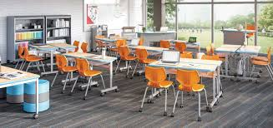
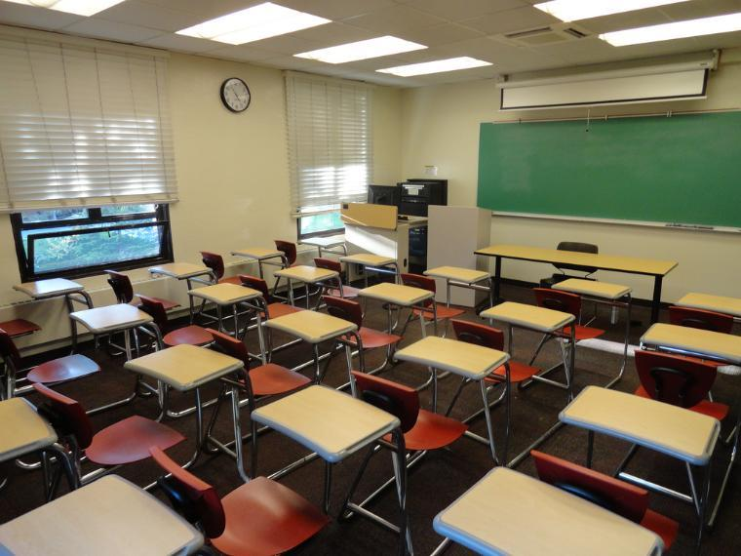
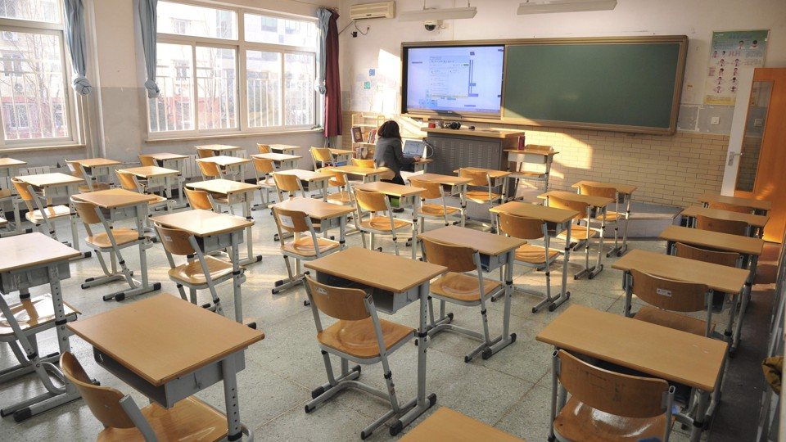
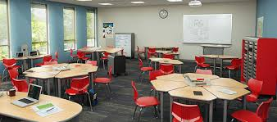
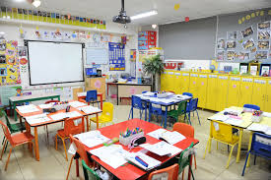
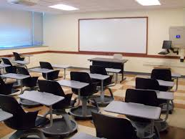
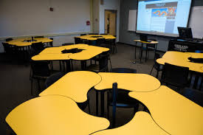
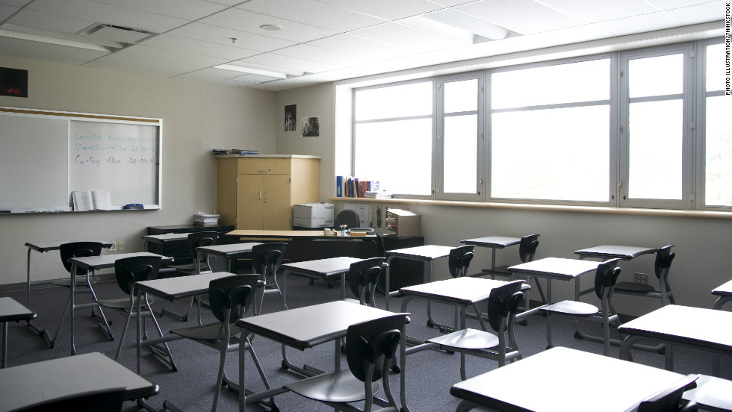
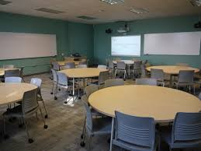
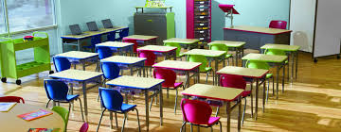

Slide 11
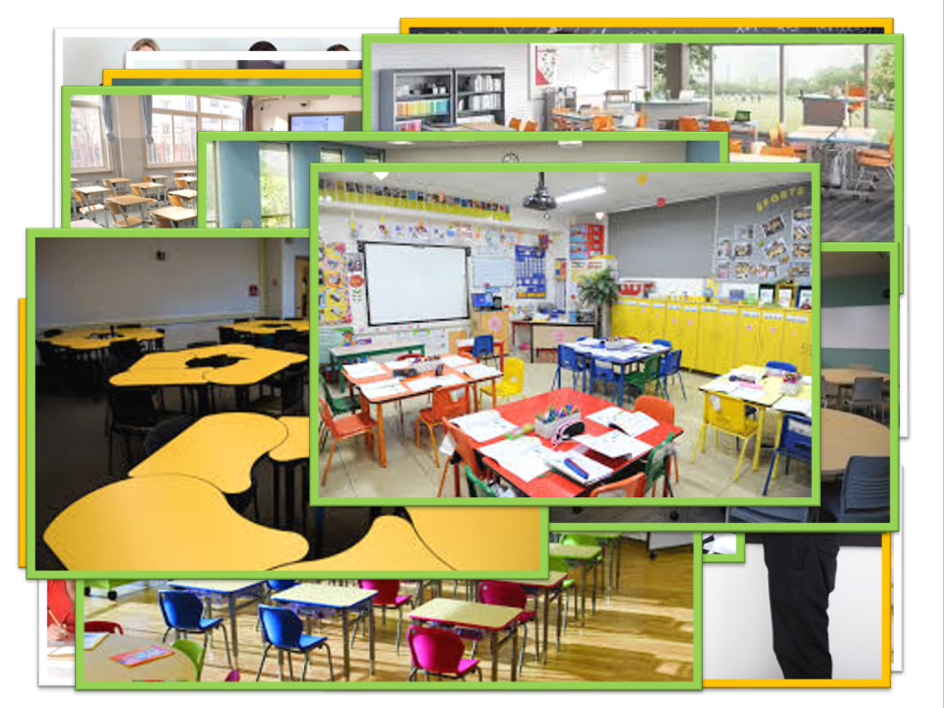
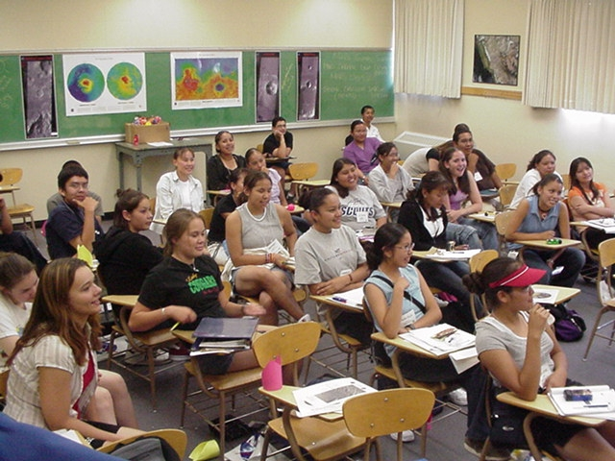

Slide 12
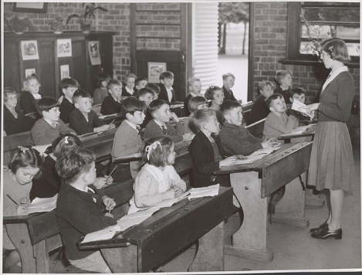
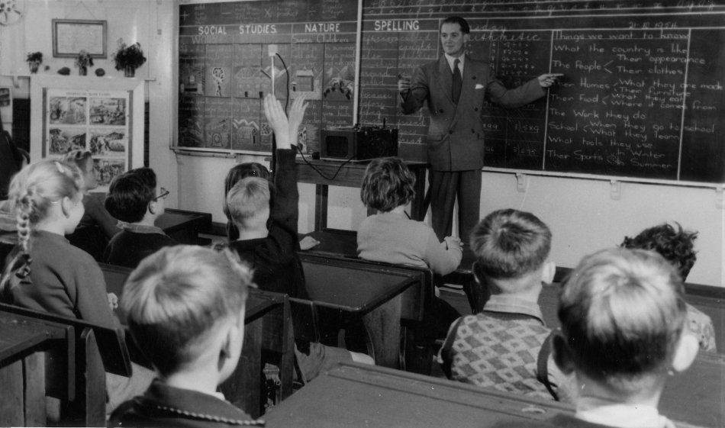
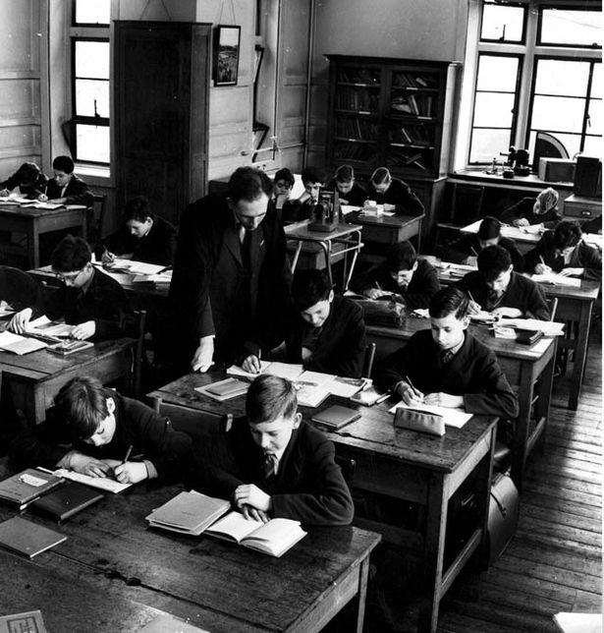
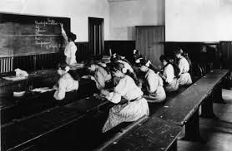

Slide 13
INSTITUTIONAL NORMS

Slide 14
NON-NEGOTIATED NORMS

Slide 15
STUDENTS
NOT THINKING
INSTITUTIONAL NORMS

Slide 16
400+ TEACHERS | 13 YEARS | 2 WEEK CYCLES

Slide 17
RENEGOTIATING THE
NON-NEGOTIATED NORMS
400+ TEACHERS | 13 YEARS | 2 WEEK CYCLES

Slide 18
CLASSROOM PRACTICES
1 | What are the types of tasks we use?
2 | How we form collaborative groups?
3 | Where students work?
4 | How we arrange the furniture in our classroom?
5 | How we answer questions?
6 | When, where, and how tasks are given?
7 | What homework looks like?
8 | How we foster student autonomy?
9 | How we use hints and extensions?
10 | How we consolidate a lesson?
11 | How we give notes?
12 | What we choose to evaluate?
13 | How we use formative assessment?
14 | How we grade?

Slide 19
CLASSROOM PRACTICES |  | OPTIMAL PRACTICES FOR THINKING
1 | What are the types of tasks we use?
2 | How we form collaborative groups?
3 | Where students work?
4 | How we arrange the furniture in our classroom?
5 | How we answer questions?
6 | When, where, and how tasks are given?
7 | What homework looks like?
8 | How we foster student autonomy?
9 | How we use hints and extensions?
10 | How we consolidate a lesson?
11 | How we give notes?
12 | What we choose to evaluate?
13 | How we use formative assessment?
14 | How we grade?

Slide 20
CLASSROOM PRACTICES |  | OPTIMAL PRACTICES FOR THINKING
1 | What are the types of tasks we use?
2 | How we form collaborative groups?
3 | Where students work?
4 | How we arrange the furniture in our classroom?
5 | How we answer questions?
6 | When, where, and how tasks are given?
7 | What homework looks like?
8 | How we foster student autonomy?
9 | How we use hints and extensions?
10 | How we consolidate a lesson?
11 | How we give notes?
12 | What we choose to evaluate?
13 | How we use formative assessment?
14 | How we grade?

Slide 21
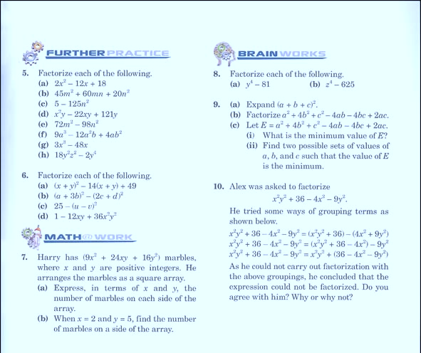
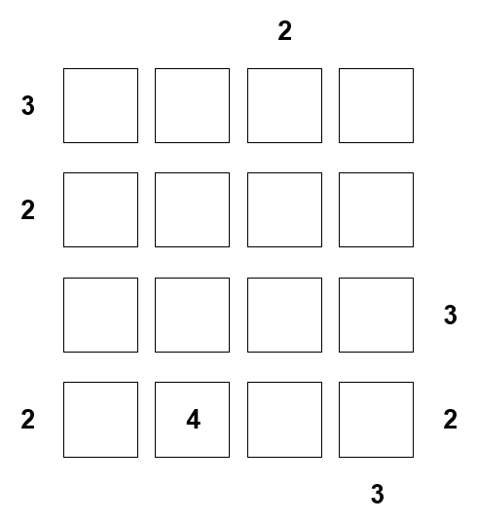
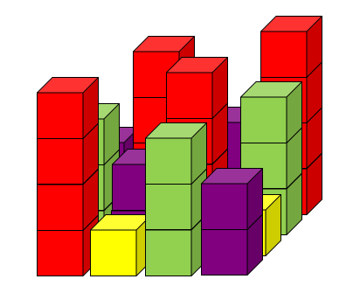
CLASSROOM PRACTICES |  | OPTIMAL PRACTICES FOR THINKING
1 | What are the types of tasks we use? | Use thinking tasks
2 | How we form collaborative groups?
3 | Where students work?
4 | How we arrange the furniture in our classroom?
5 | How we answer questions?
6 | When, where, and how tasks are given?
7 | What homework looks like?
8 | How we foster student autonomy?
9 | How we use hints and extensions?
10 | How we consolidate a lesson?
11 | How we give notes?
12 | What we choose to evaluate?
13 | How we use formative assessment?
14 | How we grade?

Slide 22
CLASSROOM PRACTICES |  | OPTIMAL PRACTICES FOR THINKING
1 | What are the types of tasks we use? | Use thinking tasks
2 | How we form collaborative groups?
3 | Where students work?
4 | How we arrange the furniture in our classroom?
5 | How we answer questions?
6 | When, where, and how tasks are given?
7 | What homework looks like?
8 | How we foster student autonomy?
9 | How we use hints and extensions?
10 | How we consolidate a lesson?
11 | How we give notes?
12 | What we choose to evaluate?
13 | How we use formative assessment?
14 | How we grade?

Slide 23
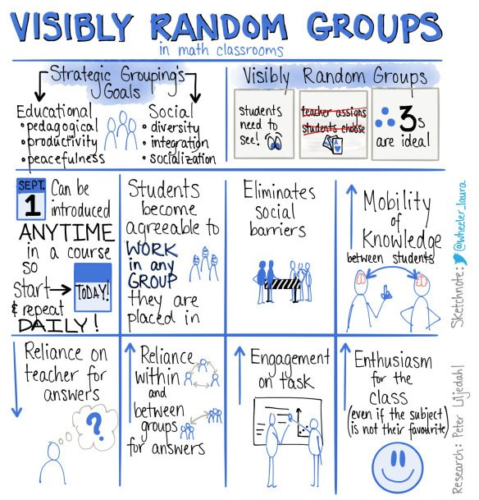
CLASSROOM PRACTICES |  | OPTIMAL PRACTICES FOR THINKING
1 | What are the types of tasks we use? | Use thinking tasks
2 | How we form collaborative groups? | Form frequent visibly random groupings
3 | Where students work?
4 | How we arrange the furniture in our classroom?
5 | How we answer questions?
6 | When, where, and how tasks are given?
7 | What homework looks like?
8 | How we foster student autonomy?
9 | How we use hints and extensions?
10 | How we consolidate a lesson?
11 | How we give notes?
12 | What we choose to evaluate?
13 | How we use formative assessment?
14 | How we grade?

Slide 24
CLASSROOM PRACTICES |  | OPTIMAL PRACTICES FOR THINKING
1 | What are the types of tasks we use? | Use thinking tasks
2 | How we form collaborative groups? | Form frequent visibly random groupings
3 | Where students work?
4 | How we arrange the furniture in our classroom?
5 | How we answer questions?
6 | When, where, and how tasks are given?
7 | What homework looks like?
8 | How we foster student autonomy?
9 | How we use hints and extensions?
10 | How we consolidate a lesson?
11 | How we give notes?
12 | What we choose to evaluate?
13 | How we use formative assessment?
14 | How we grade?

Slide 25
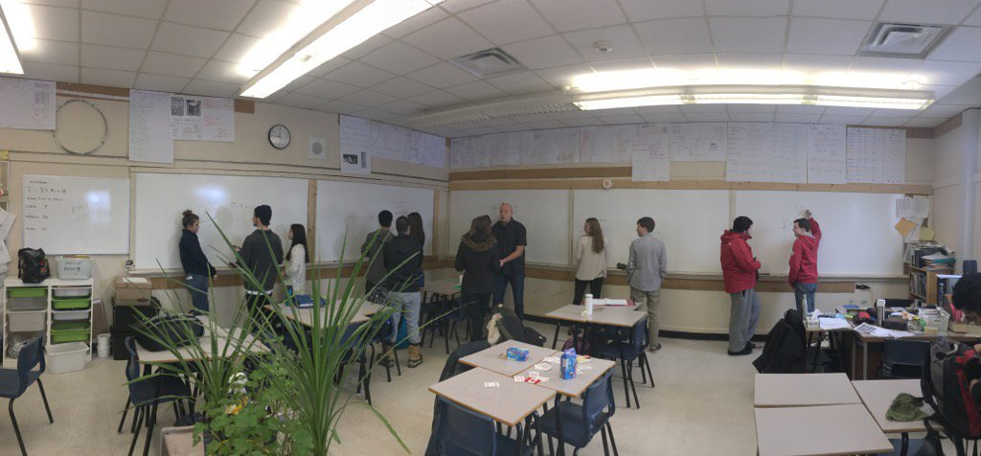
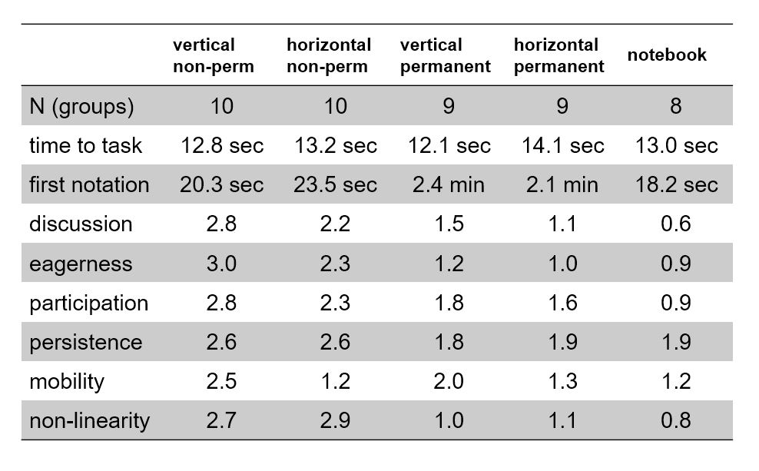
CLASSROOM PRACTICES |  | OPTIMAL PRACTICES FOR THINKING
1 | What are the types of tasks we use? | Use thinking tasks
2 | How we form collaborative groups? | Form frequent visibly random groupings
3 | Where students work? | Use vertical non-permanent surfaces
4 | How we arrange the furniture in our classroom?
5 | How we answer questions?
6 | When, where, and how tasks are given?
7 | What homework looks like?
8 | How we foster student autonomy?
9 | How we use hints and extensions?
10 | How we consolidate a lesson?
11 | How we give notes?
12 | What we choose to evaluate?
13 | How we use formative assessment?
14 | How we grade?

Slide 26
CLASSROOM PRACTICES |  | OPTIMAL PRACTICES FOR THINKING
1 | What are the types of tasks we use? | Use thinking tasks
2 | How we form collaborative groups? | Form frequent visibly random groupings
3 | Where students work? | Use vertical non-permanent surfaces
4 | How we arrange the furniture in our classroom?
5 | How we answer questions?
6 | When, where, and how tasks are given?
7 | What homework looks like?
8 | How we foster student autonomy?
9 | How we use hints and extensions?
10 | How we consolidate a lesson?
11 | How we give notes?
12 | What we choose to evaluate?
13 | How we use formative assessment?
14 | How we grade?

Slide 27
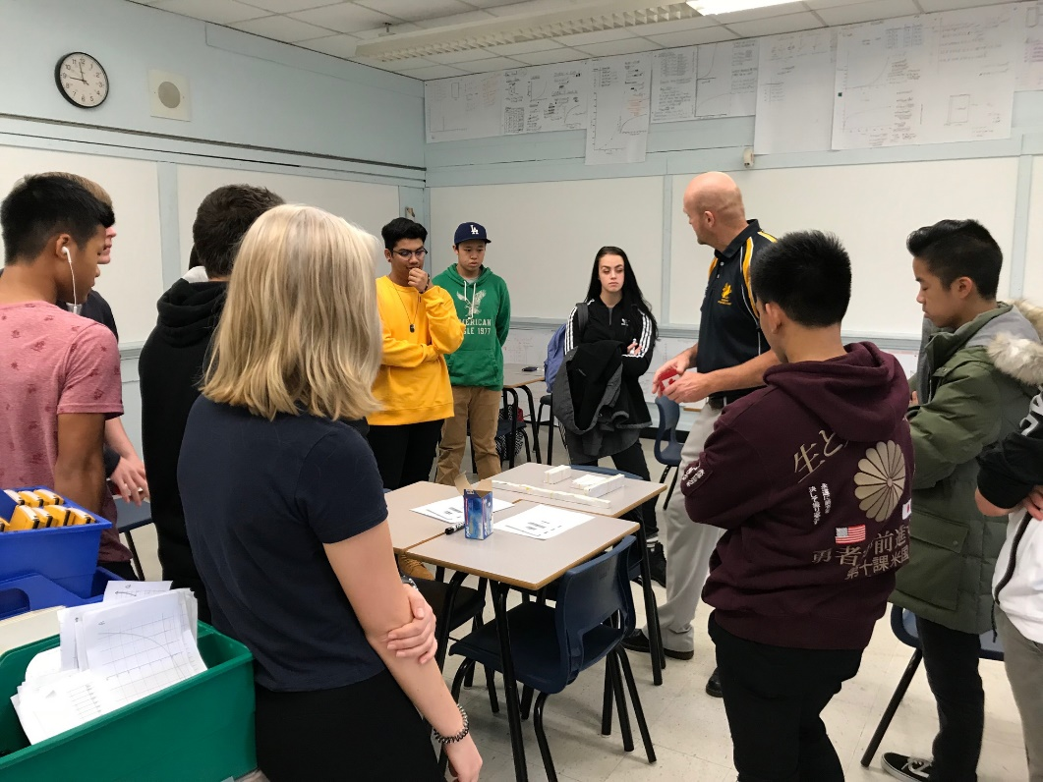
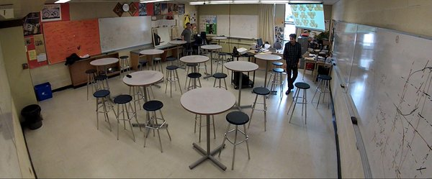
CLASSROOM PRACTICES |  | OPTIMAL PRACTICES FOR THINKING
1 | What are the types of tasks we use? | Use thinking tasks
2 | How we form collaborative groups? | Form frequent visibly random groupings
3 | Where students work? | Use vertical non-permanent surfaces
4 | How we arrange the furniture in our classroom? | Defront the classroom
5 | How we answer questions?
6 | When, where, and how tasks are given?
7 | What homework looks like?
8 | How we foster student autonomy?
9 | How we use hints and extensions?
10 | How we consolidate a lesson?
11 | How we give notes?
12 | What we choose to evaluate?
13 | How we use formative assessment?
14 | How we grade?

Slide 28
CLASSROOM PRACTICES |  | OPTIMAL PRACTICES FOR THINKING
1 | What are the types of tasks we use? | Use thinking tasks
2 | How we form collaborative groups? | Form frequent visibly random groupings
3 | Where students work? | Use vertical non-permanent surfaces
4 | How we arrange the furniture in our classroom? | Defront the classroom
5 | How we answer questions?
6 | When, where, and how tasks are given?
7 | What homework looks like?
8 | How we foster student autonomy?
9 | How we use hints and extensions?
10 | How we consolidate a lesson?
11 | How we give notes?
12 | What we choose to evaluate?
13 | How we use formative assessment?
14 | How we grade?
PROXIMITY QUESTIONS
STOP THINKING QUESTIONS
KEEP THINKING QUESTIONS

Slide 29
CLASSROOM PRACTICES |  | OPTIMAL PRACTICES FOR THINKING
1 | What are the types of tasks we use? | Use thinking tasks
2 | How we form collaborative groups? | Form frequent visibly random groupings
3 | Where students work? | Use vertical non-permanent surfaces
4 | How we arrange the furniture in our classroom? | Defront the classroom
5 | How we answer questions?
6 | When, where, and how tasks are given?
7 | What homework looks like?
8 | How we foster student autonomy?
9 | How we use hints and extensions?
10 | How we consolidate a lesson?
11 | How we give notes?
12 | What we choose to evaluate?
13 | How we use formative assessment?
14 | How we grade?
PROXIMITY QUESTIONS
STOP THINKING QUESTIONS
KEEP THINKING QUESTIONS

Slide 30
CLASSROOM PRACTICES |  | OPTIMAL PRACTICES FOR THINKING
1 | What are the types of tasks we use? | Use thinking tasks
2 | How we form collaborative groups? | Form frequent visibly random groupings
3 | Where students work? | Use vertical non-permanent surfaces
4 | How we arrange the furniture in our classroom? | Defront the classroom
5 | How we answer questions? | Only answer keep thinking questions
6 | When, where, and how tasks are given?
7 | What homework looks like?
8 | How we foster student autonomy?
9 | How we use hints and extensions?
10 | How we consolidate a lesson?
11 | How we give notes?
12 | What we choose to evaluate?
13 | How we use formative assessment?
14 | How we grade?

Slide 31
CLASSROOM PRACTICES |  | OPTIMAL PRACTICES FOR THINKING
1 | What are the types of tasks we use? | Use thinking tasks
2 | How we form collaborative groups? | Form frequent visibly random groupings
3 | Where students work? | Use vertical non-permanent surfaces
4 | How we arrange the furniture in our classroom? | Defront the classroom
5 | How we answer questions? | Only answer keep thinking questions
6 | When, where, and how tasks are given?
7 | What homework looks like?
8 | How we foster student autonomy?
9 | How we use hints and extensions?
10 | How we consolidate a lesson?
11 | How we give notes?
12 | What we choose to evaluate?
13 | How we use formative assessment?
14 | How we grade?
HOW
textbook
board/screen
handout/worksheet

Slide 32
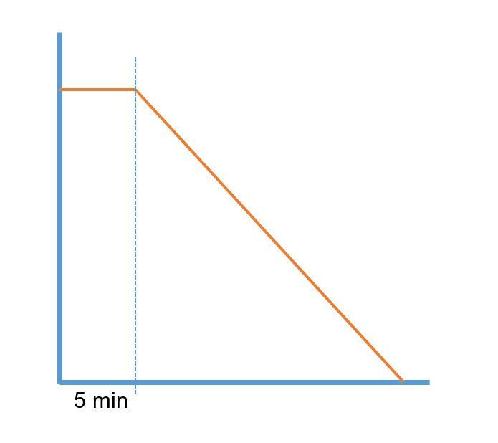
CLASSROOM PRACTICES |  | OPTIMAL PRACTICES FOR THINKING
1 | What are the types of tasks we use? | Use thinking tasks
2 | How we form collaborative groups? | Form frequent visibly random groupings
3 | Where students work? | Use vertical non-permanent surfaces
4 | How we arrange the furniture in our classroom? | Defront the classroom
5 | How we answer questions? | Only answer keep thinking questions
6 | When, where, and how tasks are given?
7 | What homework looks like?
8 | How we foster student autonomy?
9 | How we use hints and extensions?
10 | How we consolidate a lesson?
11 | How we give notes?
12 | What we choose to evaluate?
13 | How we use formative assessment?
14 | How we grade?
WHEN
verbally
HOW
WHERE
board/screen
handout/worksheet
textbook

Slide 33
CLASSROOM PRACTICES |  | OPTIMAL PRACTICES FOR THINKING
1 | What are the types of tasks we use? | Use thinking tasks
2 | How we form collaborative groups? | Form frequent visibly random groupings
3 | Where students work? | Use vertical non-permanent surfaces
4 | How we arrange the furniture in our classroom? | Defront the classroom
5 | How we answer questions? | Only answer keep thinking questions
6 | When, where, and how tasks are given? | Give tasks early, standing, and verbally
7 | What homework looks like?
8 | How we foster student autonomy?
9 | How we use hints and extensions?
10 | How we consolidate a lesson?
11 | How we give notes?
12 | What we choose to evaluate?
13 | How we use formative assessment?
14 | How we grade?

Slide 34
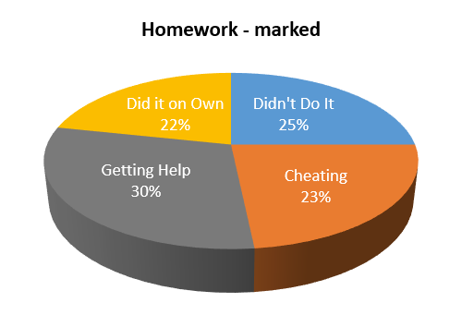
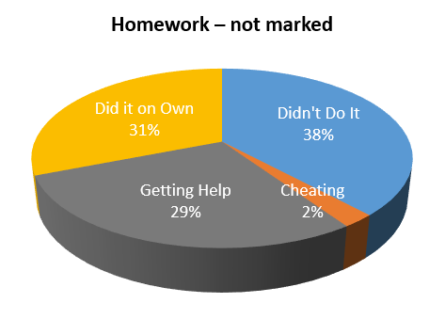
CLASSROOM PRACTICES |  | OPTIMAL PRACTICES FOR THINKING
1 | What are the types of tasks we use? | Use thinking tasks
2 | How we form collaborative groups? | Form frequent visibly random groupings
3 | Where students work? | Use vertical non-permanent surfaces
4 | How we arrange the furniture in our classroom? | Defront the classroom
5 | How we answer questions? | Only answer keep thinking questions
6 | When, where, and how tasks are given? | Give tasks early, standing, and verbally
7 | What homework looks like?
8 | How we foster student autonomy?
9 | How we use hints and extensions?
10 | How we consolidate a lesson?
11 | How we give notes?
12 | What we choose to evaluate?
13 | How we use formative assessment?
14 | How we grade?

Slide 35
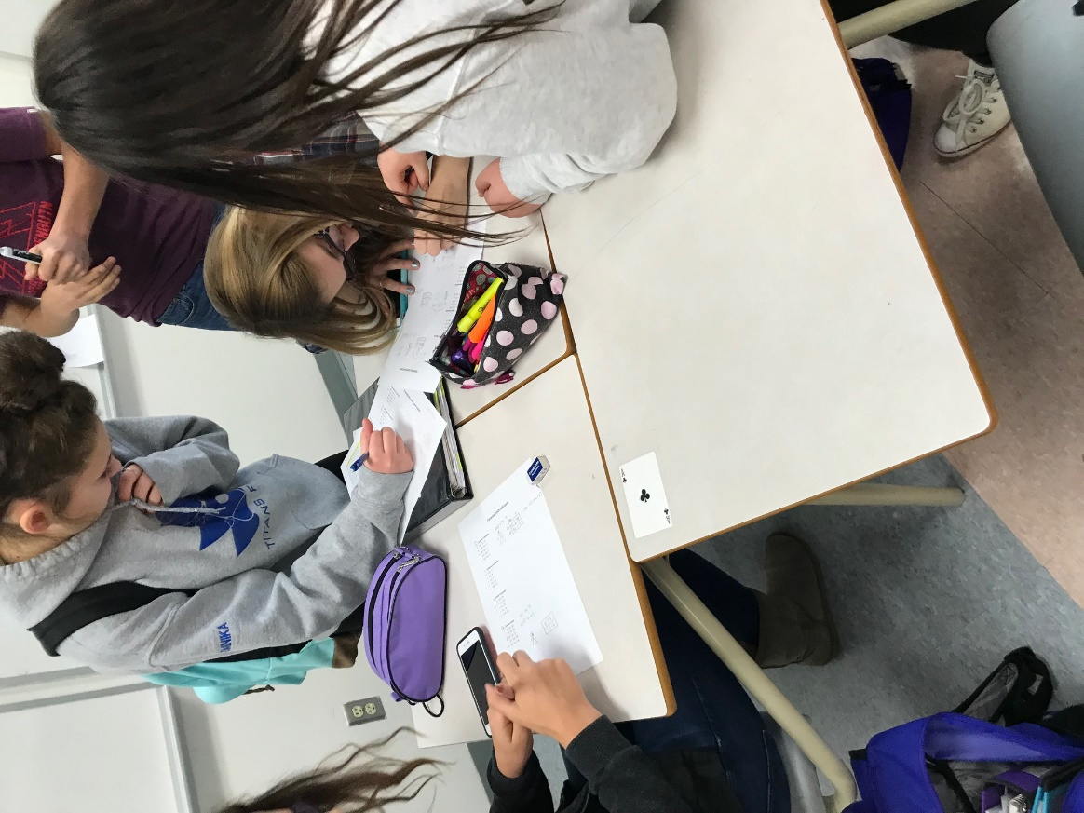
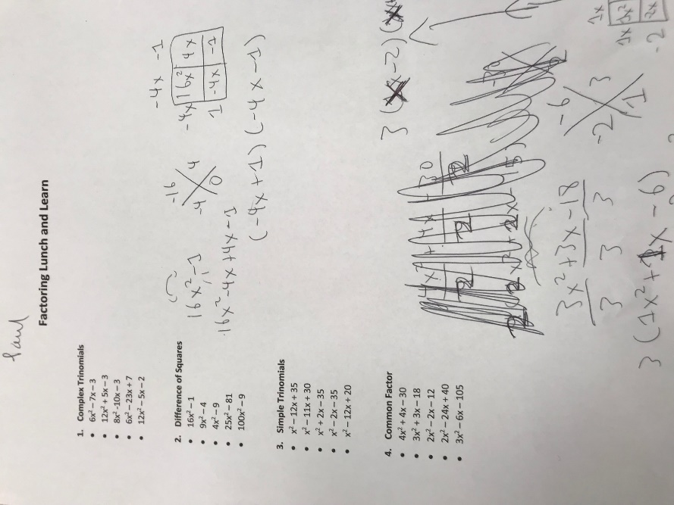
CLASSROOM PRACTICES |  | OPTIMAL PRACTICES FOR THINKING
1 | What are the types of tasks we use? | Use thinking tasks
2 | How we form collaborative groups? | Form frequent visibly random groupings
3 | Where students work? | Use vertical non-permanent surfaces
4 | How we arrange the furniture in our classroom? | Defront the classroom
5 | How we answer questions? | Only answer keep thinking questions
6 | When, where, and how tasks are given? | Give tasks early, standing, and verbally
7 | What homework looks like? | Give check your understanding questions
8 | How we foster student autonomy?
9 | How we use hints and extensions?
10 | How we consolidate a lesson?
11 | How we give notes?
12 | What we choose to evaluate?
13 | How we use formative assessment?
14 | How we grade?

Slide 36
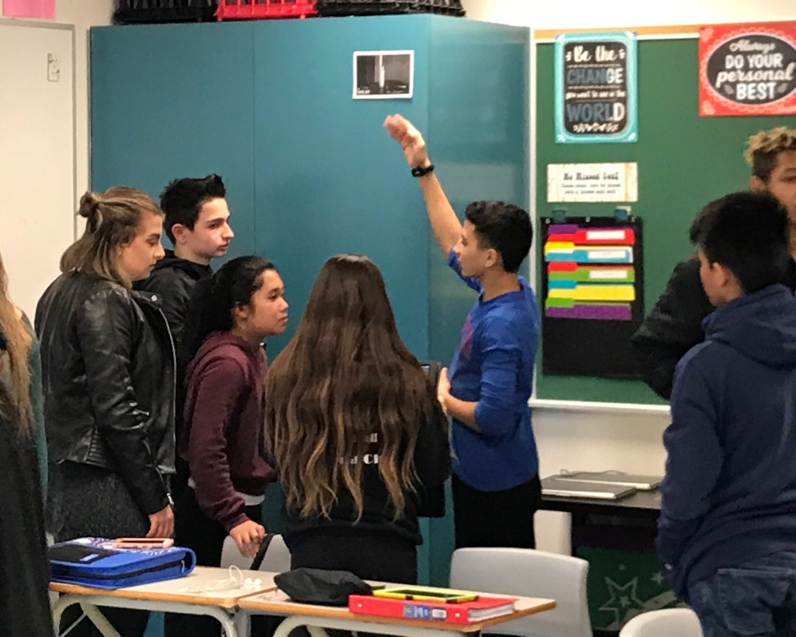
CLASSROOM PRACTICES |  | OPTIMAL PRACTICES FOR THINKING
1 | What are the types of tasks we use? | Use thinking tasks
2 | How we form collaborative groups? | Form frequent visibly random groupings
3 | Where students work? | Use vertical non-permanent surfaces
4 | How we arrange the furniture in our classroom? | Defront the classroom
5 | How we answer questions? | Only answer keep thinking questions
6 | When, where, and how tasks are given? | Give tasks early, standing, and verbally
7 | What homework looks like? | Give check your understanding questions
8 | How we foster student autonomy?
9 | How we use hints and extensions?
10 | How we consolidate a lesson?
11 | How we give notes?
12 | What we choose to evaluate?
13 | How we use formative assessment?
14 | How we grade?

Slide 37
CLASSROOM PRACTICES |  | OPTIMAL PRACTICES FOR THINKING
1 | What are the types of tasks we use? | Use thinking tasks
2 | How we form collaborative groups? | Form frequent visibly random groupings
3 | Where students work? | Use vertical non-permanent surfaces
4 | How we arrange the furniture in our classroom? | Defront the classroom
5 | How we answer questions? | Only answer keep thinking questions
6 | When, where, and how tasks are given? | Give tasks early, standing, and verbally
7 | What homework looks like? | Give check your understanding questions
8 | How we foster student autonomy? | Be intentionally less helpful
9 | How we use hints and extensions?
10 | How we consolidate a lesson?
11 | How we give notes?
12 | What we choose to evaluate?
13 | How we use formative assessment?
14 | How we grade?

Slide 38
CLASSROOM PRACTICES |  | OPTIMAL PRACTICES FOR THINKING
1 | What are the types of tasks we use? | Use thinking tasks
2 | How we form collaborative groups? | Form frequent visibly random groupings
3 | Where students work? | Use vertical non-permanent surfaces
4 | How we arrange the furniture in our classroom? | Defront the classroom
5 | How we answer questions? | Only answer keep thinking questions
6 | When, where, and how tasks are given? | Give tasks early, standing, and verbally
7 | What homework looks like? | Give check your understanding questions
8 | How we foster student autonomy? | Be intentionally less helpful
9 | How we use hints and extensions?
10 | How we consolidate a lesson?
11 | How we give notes?
12 | What we choose to evaluate?
13 | How we use formative assessment?
14 | How we grade?

Slide 39
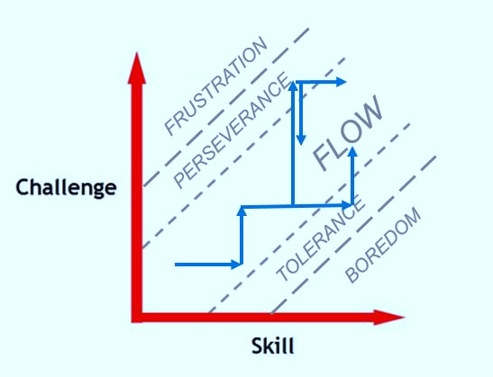
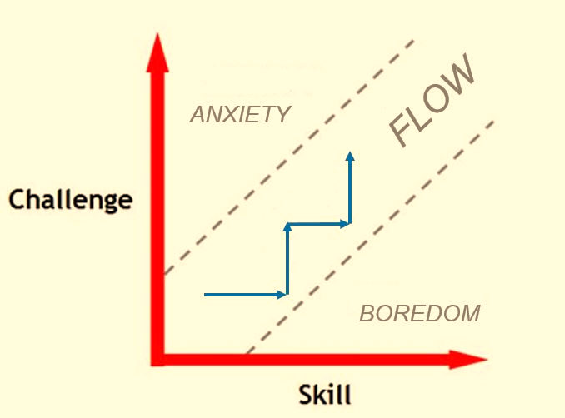
CLASSROOM PRACTICES |  | OPTIMAL PRACTICES FOR THINKING
1 | What are the types of tasks we use? | Use thinking tasks
2 | How we form collaborative groups? | Form frequent visibly random groupings
3 | Where students work? | Use vertical non-permanent surfaces
4 | How we arrange the furniture in our classroom? | Defront the classroom
5 | How we answer questions? | Only answer keep thinking questions
6 | When, where, and how tasks are given? | Give tasks early, standing, and verbally
7 | What homework looks like? | Give check your understanding questions
8 | How we foster student autonomy? | Be intentionally less helpful
9 | How we use hints and extensions? | Create and manage flow
10 | How we consolidate a lesson?
11 | How we give notes?
12 | What we choose to evaluate?
13 | How we use formative assessment?
14 | How we grade?

Slide 40
CLASSROOM PRACTICES |  | OPTIMAL PRACTICES FOR THINKING
1 | What are the types of tasks we use? | Use thinking tasks
2 | How we form collaborative groups? | Form frequent visibly random groupings
3 | Where students work? | Use vertical non-permanent surfaces
4 | How we arrange the furniture in our classroom? | Defront the classroom
5 | How we answer questions? | Only answer keep thinking questions
6 | When, where, and how tasks are given? | Give tasks early, standing, and verbally
7 | What homework looks like? | Give check your understanding questions
8 | How we foster student autonomy? | Be intentionally less helpful
9 | How we use hints and extensions? | Create and manage flow
10 | How we consolidate a lesson?
11 | How we give notes?
12 | What we choose to evaluate?
13 | How we use formative assessment?
14 | How we grade?

Slide 41
CLASSROOM PRACTICES |  | OPTIMAL PRACTICES FOR THINKING
1 | What are the types of tasks we use? | Use thinking tasks
2 | How we form collaborative groups? | Form frequent visibly random groupings
3 | Where students work? | Use vertical non-permanent surfaces
4 | How we arrange the furniture in our classroom? | Defront the classroom
5 | How we answer questions? | Only answer keep thinking questions
6 | When, where, and how tasks are given? | Give tasks early, standing, and verbally
7 | What homework looks like? | Give check your understanding questions
8 | How we foster student autonomy? | Be intentionally less helpful
9 | How we use hints and extensions? | Create and manage flow
10 | How we consolidate a lesson? | Consolidate from the bottom
11 | How we give notes?
12 | What we choose to evaluate?
13 | How we use formative assessment?
14 | How we grade?

Slide 42
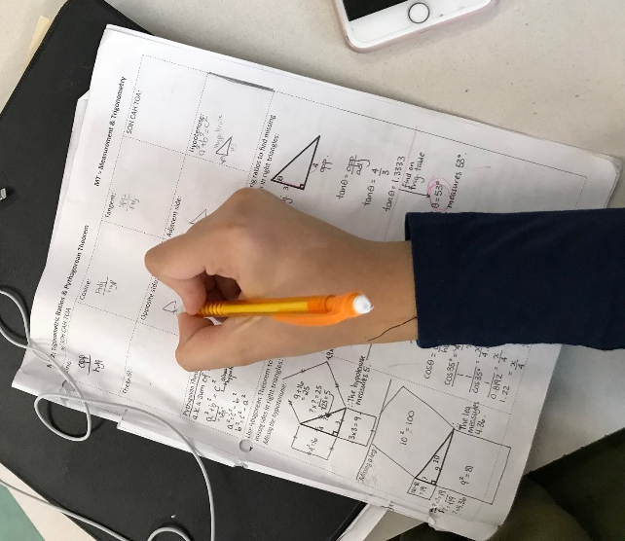
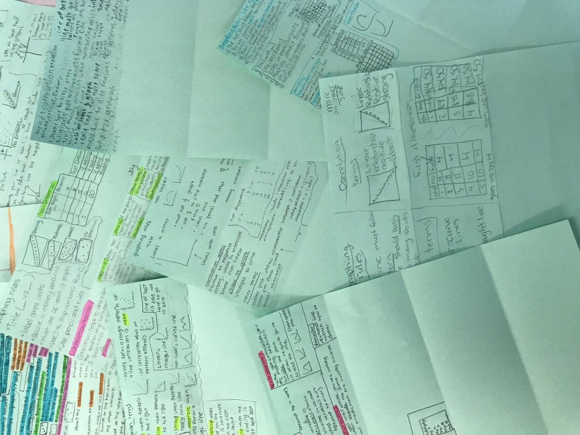
CLASSROOM PRACTICES |  | OPTIMAL PRACTICES FOR THINKING
1 | What are the types of tasks we use? | Use thinking tasks
2 | How we form collaborative groups? | Form frequent visibly random groupings
3 | Where students work? | Use vertical non-permanent surfaces
4 | How we arrange the furniture in our classroom? | Defront the classroom
5 | How we answer questions? | Only answer keep thinking questions
6 | When, where, and how tasks are given? | Give tasks early, standing, and verbally
7 | What homework looks like? | Give check your understanding questions
8 | How we foster student autonomy? | Be intentionally less helpful
9 | How we use hints and extensions? | Create and manage flow
10 | How we consolidate a lesson? | Consolidate from the bottom
11 | How we give notes?
12 | What we choose to evaluate?
13 | How we use formative assessment?
14 | How we grade?

Slide 43
CLASSROOM PRACTICES |  | OPTIMAL PRACTICES FOR THINKING
1 | What are the types of tasks we use? | Use thinking tasks
2 | How we form collaborative groups? | Form frequent visibly random groupings
3 | Where students work? | Use vertical non-permanent surfaces
4 | How we arrange the furniture in our classroom? | Defront the classroom
5 | How we answer questions? | Only answer keep thinking questions
6 | When, where, and how tasks are given? | Give tasks early, standing, and verbally
7 | What homework looks like? | Give check your understanding questions
8 | How we foster student autonomy? | Be intentionally less helpful
9 | How we use hints and extensions? | Create and manage flow
10 | How we consolidate a lesson? | Consolidate from the bottom
11 | How we give notes? | Use meaningful notes
12 | What we choose to evaluate?
13 | How we use formative assessment?
14 | How we grade?

Slide 44
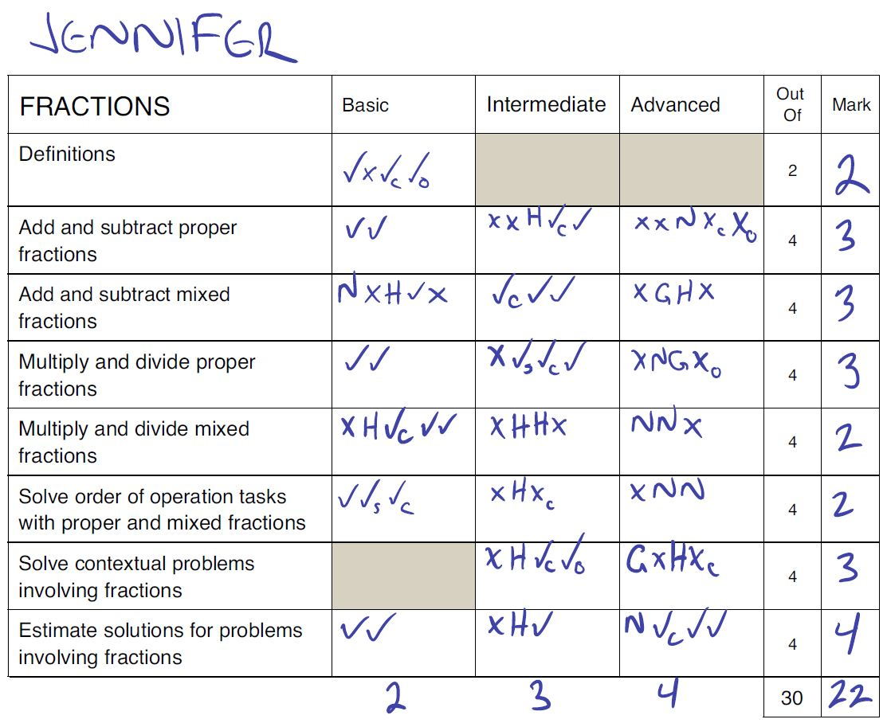
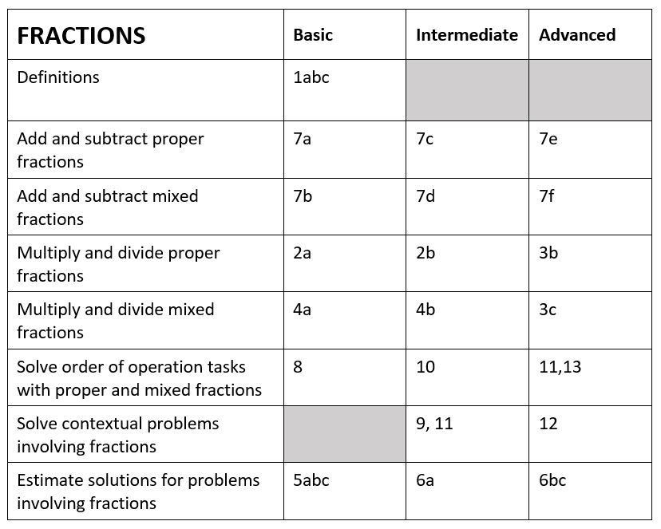
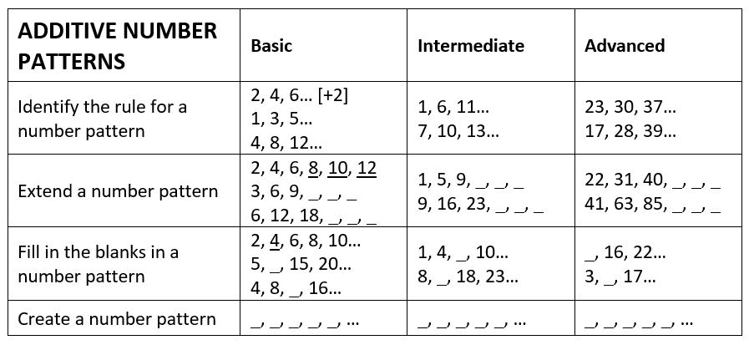
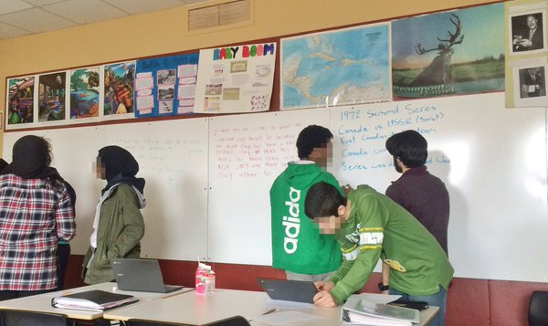
CLASSROOM PRACTICES |  | OPTIMAL PRACTICES FOR THINKING
1 | What are the types of tasks we use? | Use thinking tasks
2 | How we form collaborative groups? | Form frequent visibly random groupings
3 | Where students work? | Use vertical non-permanent surfaces
4 | How we arrange the furniture in our classroom? | Defront the classroom
5 | How we answer questions? | Only answer keep thinking questions
6 | When, where, and how tasks are given? | Give tasks early, standing, and verbally
7 | What homework looks like? | Give check your understanding questions
8 | How we foster student autonomy? | Be intentionally less helpful
9 | How we use hints and extensions? | Create and manage flow
10 | How we consolidate a lesson? | Consolidate from the bottom
11 | How we give notes? | Use meaningful notes
12 | What we choose to evaluate?
13 | How we use formative assessment?
14 | How we grade?

Slide 45
CLASSROOM PRACTICES |  | OPTIMAL PRACTICES FOR THINKING
1 | What are the types of tasks we use? | Use thinking tasks
2 | How we form collaborative groups? | Form frequent visibly random groupings
3 | Where students work? | Use vertical non-permanent surfaces
4 | How we arrange the furniture in our classroom? | Defront the classroom
5 | How we answer questions? | Only answer keep thinking questions
6 | When, where, and how tasks are given? | Give tasks early, standing, and verbally
7 | What homework looks like? | Give check your understanding questions
8 | How we foster student autonomy? | Be intentionally less helpful
9 | How we use hints and extensions? | Create and manage flow
10 | How we consolidate a lesson? | Consolidate from the bottom
11 | How we give notes? | Use meaningful notes
12 | What we choose to evaluate? | Evaluate what you value
13 | How we use formative assessment? | Communicate to students where they are and where they are going
14 | How we grade? | Report out based on data (not points)

Slide 46
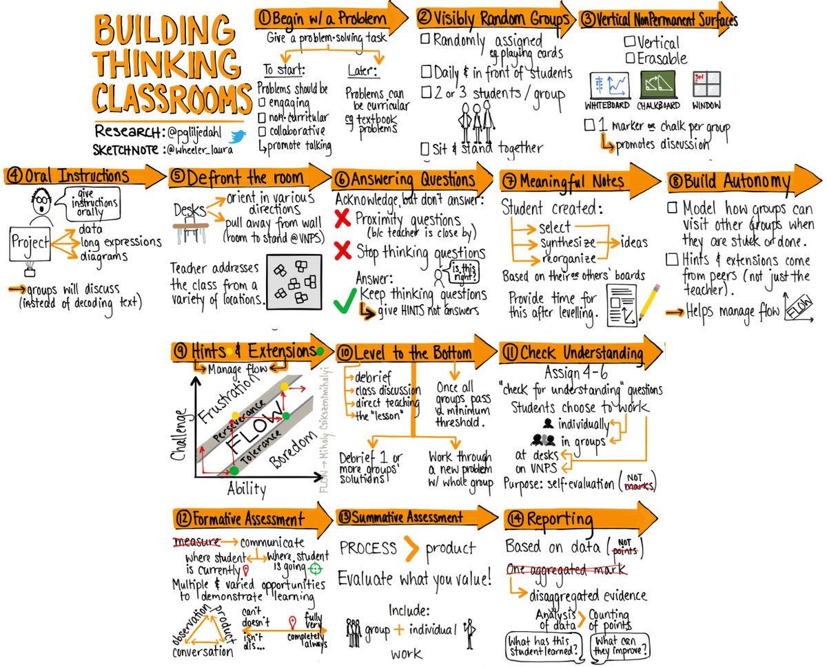
CLASSROOM PRACTICES |  | OPTIMAL PRACTICES FOR THINKING
1 | What are the types of tasks we use? | Use thinking tasks
2 | How we form collaborative groups? | Form frequent visibly random groupings
3 | Where students work? | Use vertical non-permanent surfaces
4 | How we arrange the furniture in our classroom? | Defront the classroom
5 | How we answer questions? | Only answer keep thinking questions
6 | When, where, and how tasks are given? | Give tasks early, standing, and verbally
7 | What homework looks like? | Give check your understanding questions
8 | How we foster student autonomy? | Be intentionally less helpful
9 | How we use hints and extensions? | Create and manage flow
10 | How we consolidate a lesson? | Consolidate from the bottom
11 | How we give notes? | Use meaningful notes
12 | What we choose to evaluate? | Evaluate what you value
13 | How we use formative assessment? | Communicate to students where they are and where they are going
14 | How we grade? | Report out based on data (not points)

Slide 47
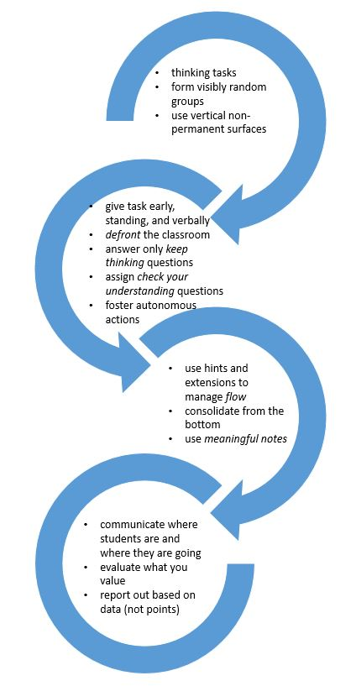
WHERE TO START?

Slide 48
begin lessons with good problems
frequently form visibly random groups
use vertical non-permanent surfaces

Slide 49
give task early,
standing, and verbally
defront the classroom
answer only keep thinking questions
assign check your understanding questions
foster autonomous actions

Slide 50
use hints and extensions to manage flow
consolidate from the bottom
use meaningful notes

Slide 51
communicate where students are and where they are going
evaluate what you value
report out based on data (not points)

Slide 52
BUILDING THINKING CLASSROOMS

Slide 53
good tasks
use vertical non-permanent surfaces
frequently form visibly random groups
give task early, standing, and verbally
defront the classroom
answer only keep thinking questions
build autonomy
consolidate from the bottom
use hints and extensions to manage flow
BUILDING THINKING CLASSROOMS
year II
use meaningful notes
give check your understanding questions
communicate where a student is and where they are going
evaluate what you value
report out based on data (not points)

Slide 55
THANK YOU!
liljedahl@sfu.ca
www.peterliljedahl.com/presentations
@pgliljedahl | #thinkingclassroom
https://makemathmoments.com/episode21/
https://tinyurl.com/y68xopcq

