Slide 1
building thinking classrooms

Slide 2
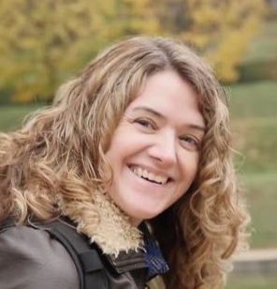
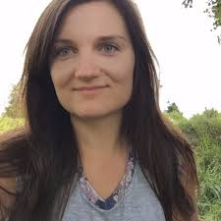
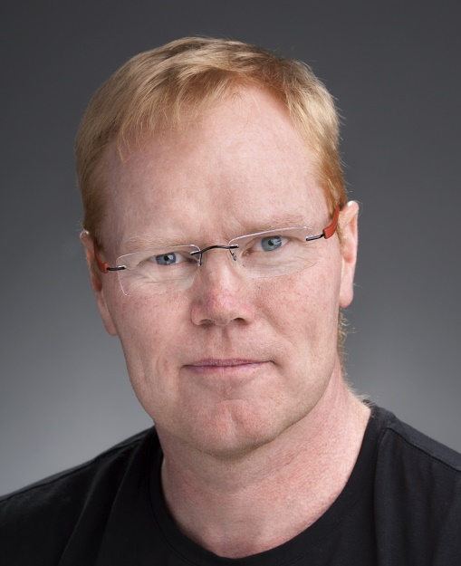

Annette Rouleau
arouleau@sfu.ca
@annetterouleau
Judy Larsen
Judy.Larsen@ufv.ca
@JudyLarsen3
Peter Liljedahl
liljedahl@sfu.ca
@pgliljedahl
www.peterliljedahl.com/presentations

Slide 3
PROBLEM
$1 $2 $3 $4 $5 $6
$7 $8 $9 $10 $11 $12

Slide 4
PROBLEM
$1 $2 $3 $4 $5 $6
$7 $8 $9 $10 $11 $12

Slide 5
PROBLEM
X
X
X
X
X
$1 $2 $3 $4 $5 $6
$7 $8 $9 $10 $11 $12

Slide 6
PROBLEM
X
X
X
X
X
$1 $2 $3 $4 $5 $6
$7 $8 $9 $10 $11 $12

Slide 7
PROBLEM
X
X
X
X
X
X
$1 $2 $3 $4 $5 $6
$7 $8 $9 $10 $11 $12

Slide 8
PROBLEM
$1 $2 $3 $4 $5 $6
$7 $8 $9 $10 $11 $12

Slide 9
What did you notice about your experience doing this problem?
What did you notice about us while you were doing this problem?

Slide 10
Liljedahl, P. (2016). Building thinking classrooms: Conditions for problem solving. In P. Felmer, J. Kilpatrick, & E. Pekhonen (eds.), Posing and Solving Mathematical Problems: Advances and New Perspectives. (pp. 361-386). New York, NY: Springer.
Liljedahl, P. (2014). The affordances of using visibly random groups in a mathematics classroom. In Y. Li, E. Silver, & S. Li (eds.), Transforming Mathematics Instruction: Multiple Approaches and Practices. (pp. 127-144). New York, NY: Springer.
Liljedahl, P. (2016). Flow: A Framework for Discussing Teaching. Proceedings of the 40th Conference of the International Group for the Psychology of Mathematics Education, Szeged, Hungary.
Liljedahl, P. (in press). On the edges of flow: Student problem solving behavior. In S. Carreira, N. Amado, & K. Jones (eds.), Broadening the scope of research on mathematical problem solving: A focus on technology, creativity and affect. New York, NY: Springer.
Liljedahl, P. (in press). On the edges of flow: Student engagement in problem solving. Proceedings of the 10th Congress of the European Society for Research in Mathematics Education. Dublin, Ireland.
Liljedahl, P. (in press). Building Thinking Classrooms: A Story of Teacher Professional Development. The 1st International Forum on Professional Development for Teachers. Seoul, Korea.
Liljedahl, P. (under review). Building thinking classrooms. In A. Kajander, J. Holm, & E. Chernoff (eds.) Teaching and learning secondary school mathematics: Canadian perspectives in an international context. New York, NY: Springer.

Slide 11
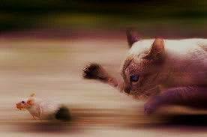
If 6 cats can kill 6 rats in 6 minutes, how many cats are required to kill 100 rats in 50 minutes?
- Lewis Carroll

Slide 12
If 6 cats can kill 6 rats in 6 minutes, how many cats are required to kill 100 rats in 50 minutes?
- Lewis Carroll
DISASTER!

Slide 13

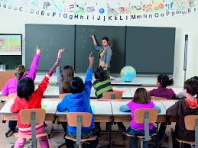


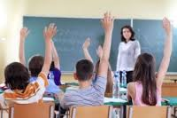
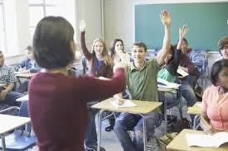


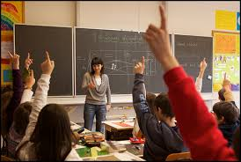



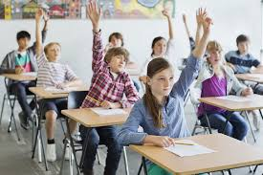
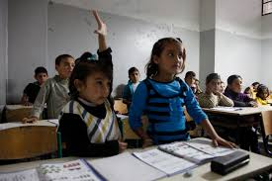

Slide 14
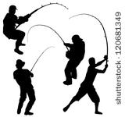
CASTING ABOUT (n = 400+)

Slide 15
VARIABLE
problems
how we give the problem
how we answer questions
room organization
how groups are formed
student work space
autonomy
how we give notes
hints and extensions
how we level
assessment

Slide 16
VARIABLE | POSITIVE EFFECT
problems | begin with good problems
how we give the problem | oral vs. written
how we answer questions | 3 types of questions
room organization | defront the room
how groups are formed | visibly random groups
student work space | vertical non-permanent surfaces
autonomy | create space and push them into it
how we give notes | use mindful notes
hints and extensions | managing flow
how we level | level to the bottom
assessment | 4 purposes

Slide 17
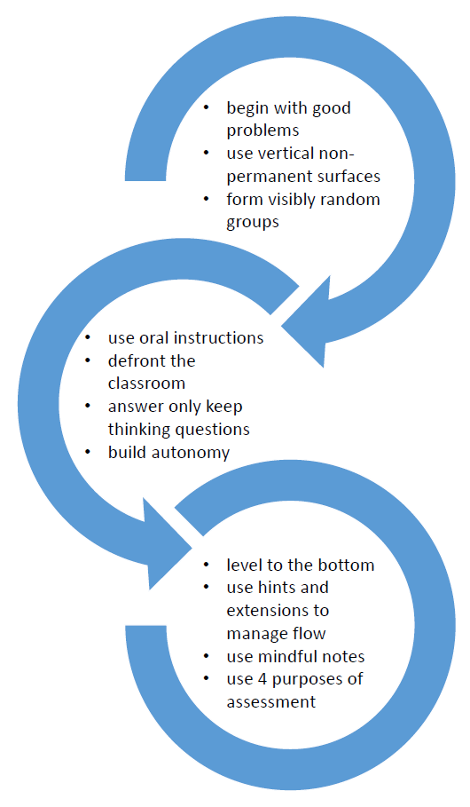

Slide 18
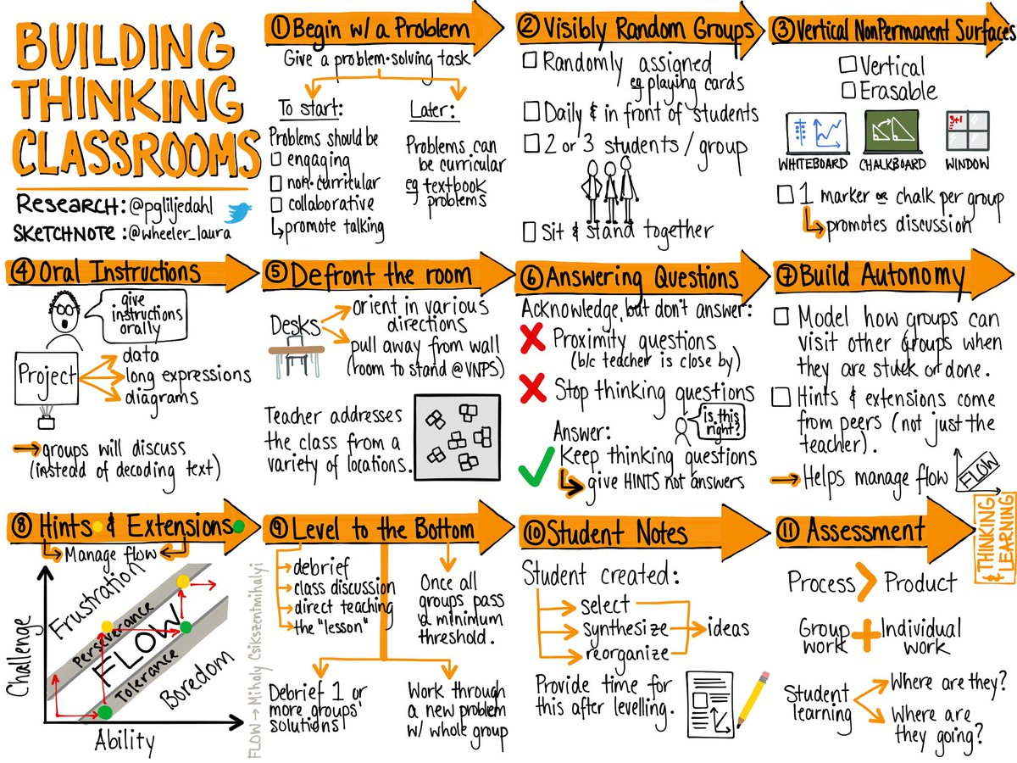

Slide 20
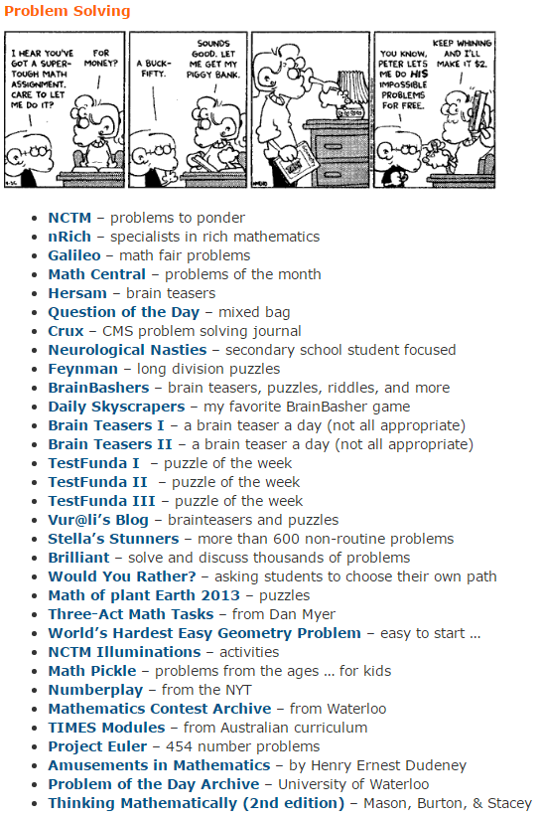
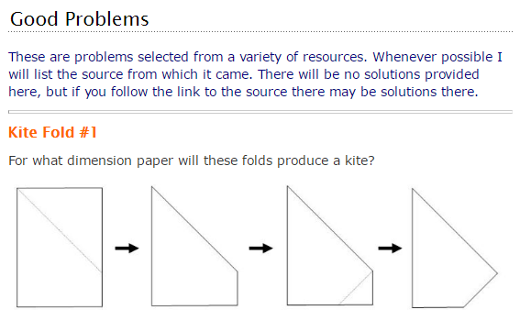

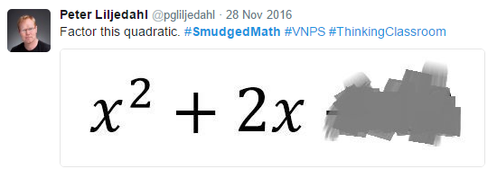
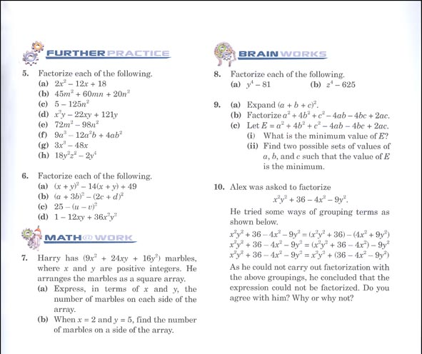
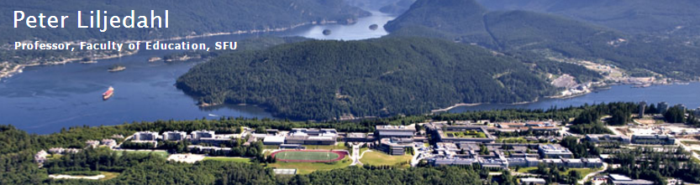
GOOD PROBLEMS
http://www.peterliljedahl.com/teachers/good-problem

Slide 21
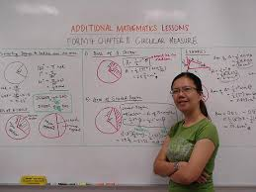
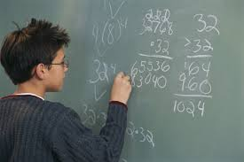
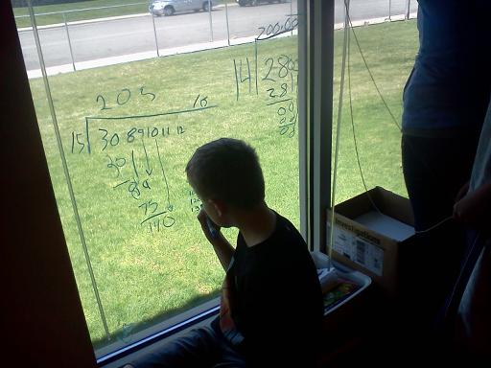
VERTICAL NON-PERMANENT SURFACES

Slide 22
PROXIES FOR ENGAGEMENT
time to task
time to first mathematical notation
amount of discussion
eagerness to start
participation
persistence
knowledge mobility
non-linearity of work
0 - 3

Slide 23
 | vertical non-perm | horizontal non-perm | vertical permanent | horizontal permanent | notebook
N (groups) | 10 | 10 | 9 | 9 | 8
time to task | 12.8 sec | 13.2 sec | 12.1 sec | 14.1 sec | 13.0 sec
first notation | 20.3 sec | 23.5 sec | 2.4 min | 2.1 min | 18.2 sec
discussion | 2.8 | 2.2 | 1.5 | 1.1 | 0.6
eagerness | 3.0 | 2.3 | 1.2 | 1.0 | 0.9
participation | 2.8 | 2.3 | 1.8 | 1.6 | 0.9
persistence | 2.6 | 2.6 | 1.8 | 1.9 | 1.9
mobility | 2.5 | 1.2 | 2.0 | 1.3 | 1.2
non-linearity | 2.7 | 2.9 | 1.0 | 1.1 | 0.8

Slide 24
 | vertical non-perm | horizontal non-perm | vertical permanent | horizontal permanent | notebook
N (groups) | 10 | 10 | 9 | 9 | 8
time to task | 12.8 sec | 13.2 sec | 12.1 sec | 14.1 sec | 13.0 sec
first notation | 20.3 sec | 23.5 sec | 2.4 min | 2.1 min | 18.2 sec
discussion | 2.8 | 2.2 | 1.5 | 1.1 | 0.6
eagerness | 3.0 | 2.3 | 1.2 | 1.0 | 0.9
participation | 2.8 | 2.3 | 1.8 | 1.6 | 0.9
persistence | 2.6 | 2.6 | 1.8 | 1.9 | 1.9
mobility | 2.5 | 1.2 | 2.0 | 1.3 | 1.2
non-linearity | 2.7 | 2.9 | 1.0 | 1.1 | 0.8

Slide 25
 | vertical non-perm | horizontal non-perm | vertical permanent | horizontal permanent | notebook
N (groups) | 10 | 10 | 9 | 9 | 8
time to task | 12.8 sec | 13.2 sec | 12.1 sec | 14.1 sec | 13.0 sec
first notation | 20.3 sec | 23.5 sec | 2.4 min | 2.1 min | 18.2 sec
discussion | 2.8 | 2.2 | 1.5 | 1.1 | 0.6
eagerness | 3.0 | 2.3 | 1.2 | 1.0 | 0.9
participation | 2.8 | 2.3 | 1.8 | 1.6 | 0.9
persistence | 2.6 | 2.6 | 1.8 | 1.9 | 1.9
mobility | 2.5 | 1.2 | 2.0 | 1.3 | 1.2
non-linearity | 2.7 | 2.9 | 1.0 | 1.1 | 0.8

Slide 26
 | vertical non-perm | horizontal non-perm | vertical permanent | horizontal permanent | notebook
N (groups) | 10 | 10 | 9 | 9 | 8
time to task | 12.8 sec | 13.2 sec | 12.1 sec | 14.1 sec | 13.0 sec
first notation | 20.3 sec | 23.5 sec | 2.4 min | 2.1 min | 18.2 sec
discussion | 2.8 | 2.2 | 1.5 | 1.1 | 0.6
eagerness | 3.0 | 2.3 | 1.2 | 1.0 | 0.9
participation | 2.8 | 2.3 | 1.8 | 1.6 | 0.9
persistence | 2.6 | 2.6 | 1.8 | 1.9 | 1.9
mobility | 2.5 | 1.2 | 2.0 | 1.3 | 1.2
non-linearity | 2.7 | 2.9 | 1.0 | 1.1 | 0.8
#VNPS

Slide 27
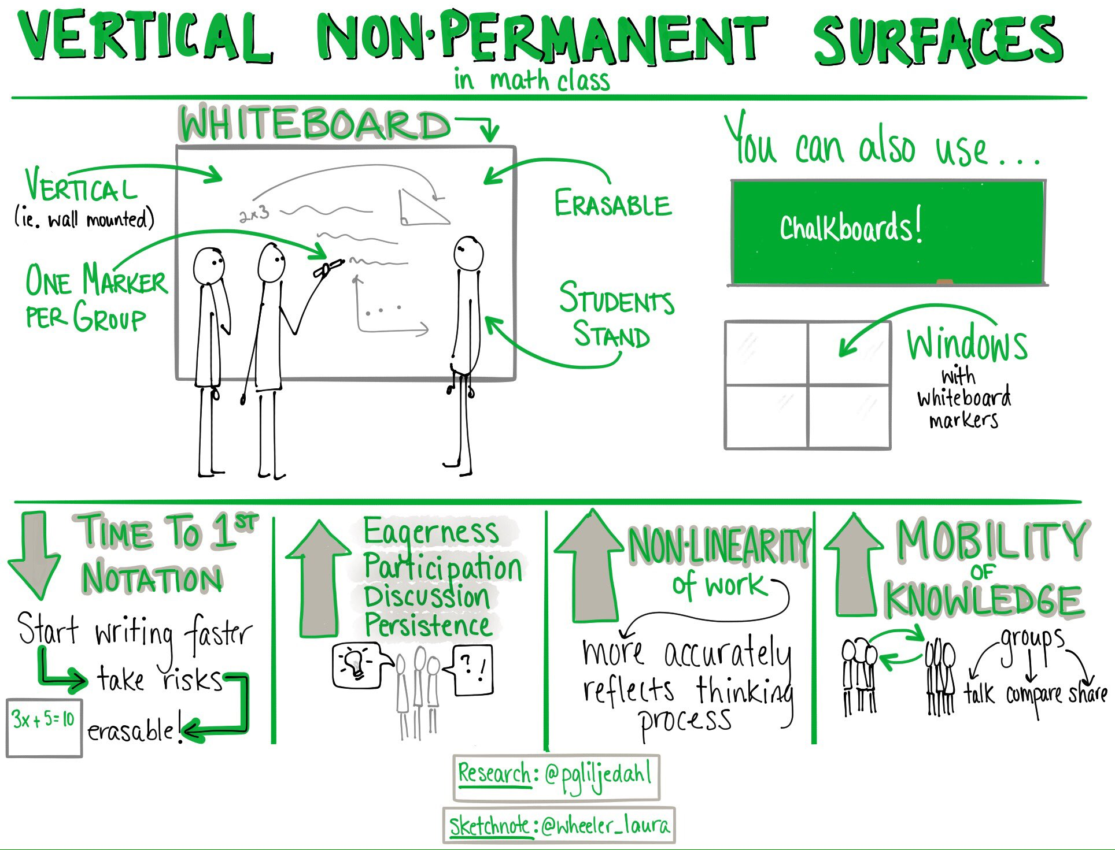

Slide 28
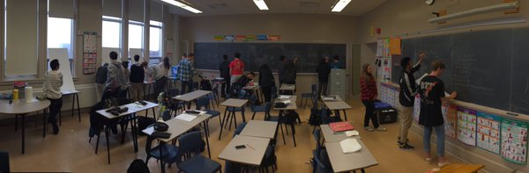
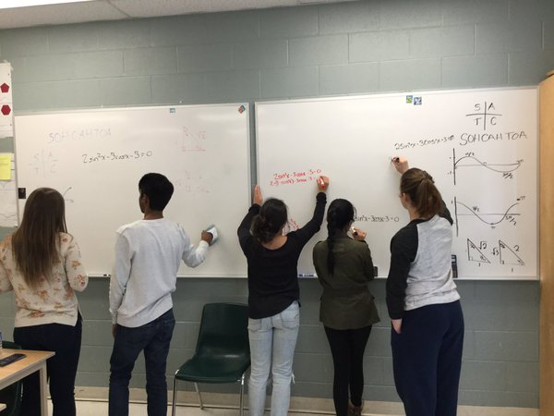
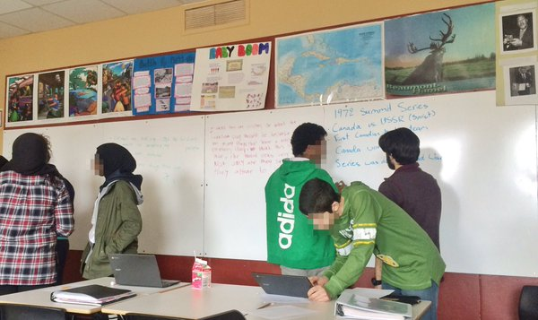
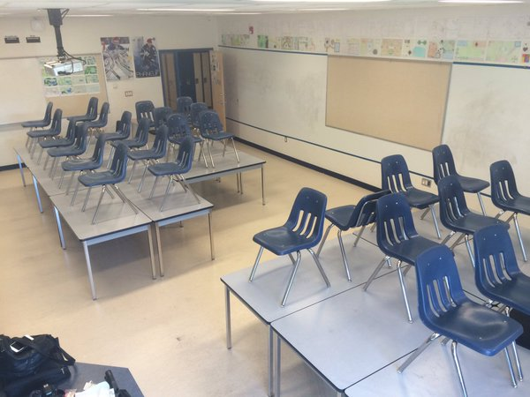
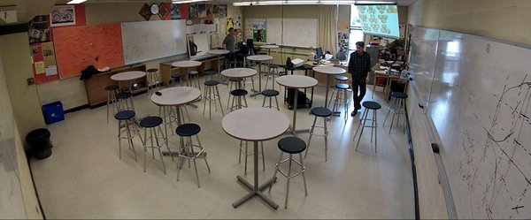
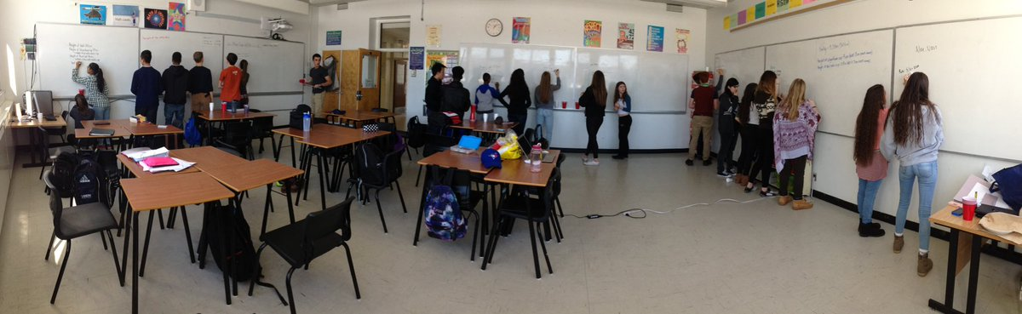

Slide 29
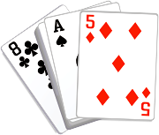
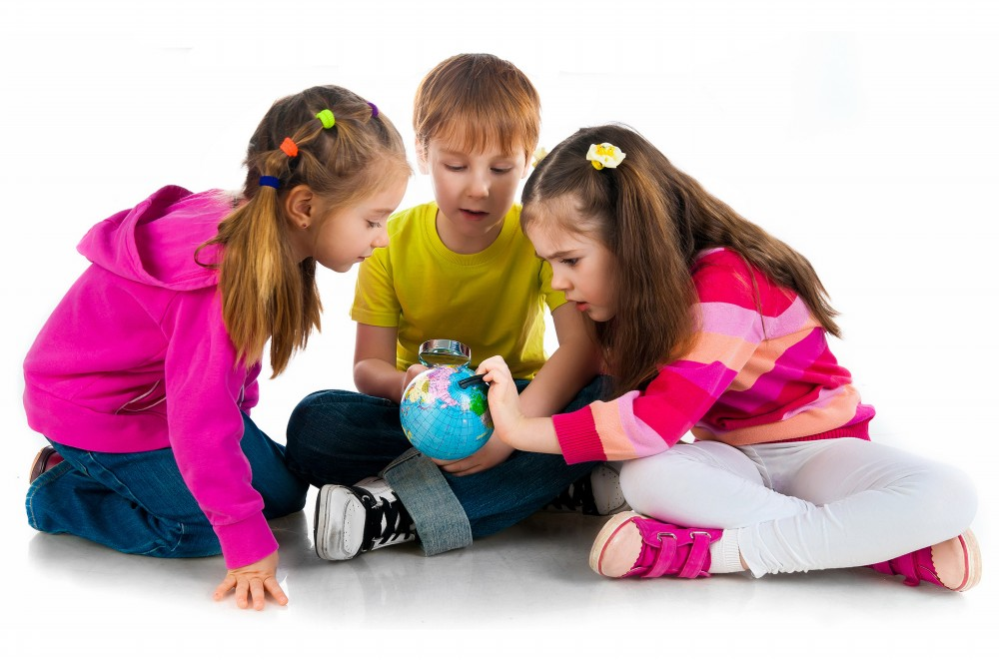
VISIBLY RANDOM GROUPS

Slide 30
students become agreeable to work in any group they are placed in
there is an elimination of social barriers within the classroom
mobility of knowledge between students increases
reliance on co-constructed intra- and inter-group answers increases
reliance on the teacher for answers decreases
engagement in classroom tasks increase
students become more enthusiastic about mathematics class

Slide 31
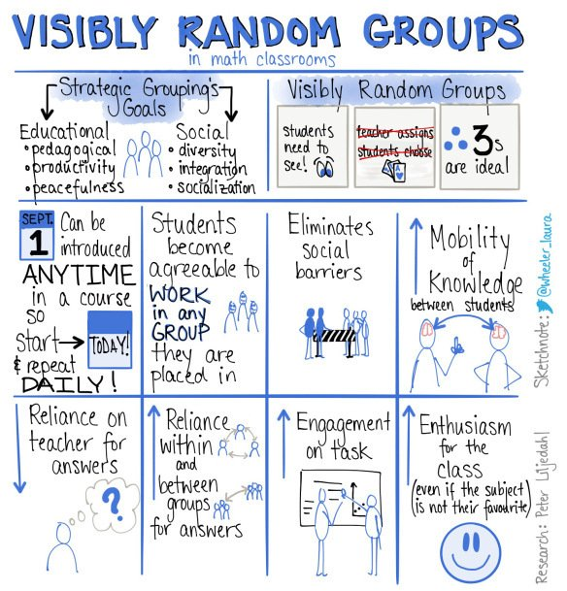

Slide 32
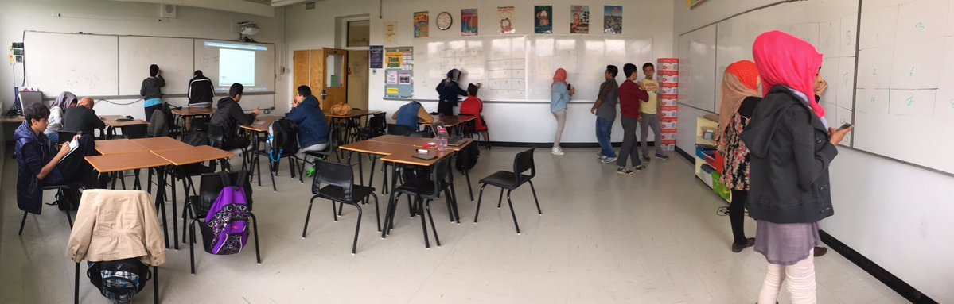
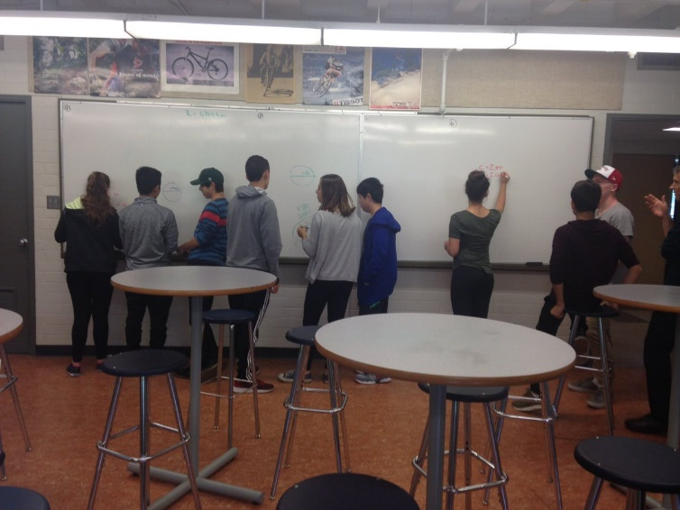
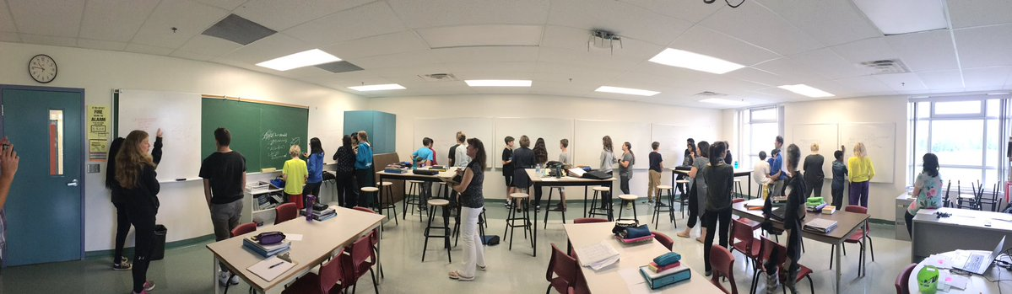

Slide 36

THANK YOU
Annette Rouleau
arouleau@sfu.ca
@annetterouleau
Judy Larsen
Judy.Larsen@ufv.ca
@JudyLarsen3
Peter Liljedahl
liljedahl@sfu.ca
@pgliljedahl
www.peterliljedahl.com/presentations
Global Math Department

