Slide 1
building thinking classrooms
Peter Liljedahl

Slide 2



www.peterliljedahl.com/presentations
liljedahl@sfu.ca
@pgliljedahl

Slide 3
Liljedahl, P. (2014). The affordances of using visibly random groups in a mathematics classroom. In Y. Li, E. Silver, & S. Li (eds.), Transforming Mathematics Instruction: Multiple Approaches and Practices. (pp. 127-144). New York, NY: Springer.
Liljedahl, P. (2016). Building thinking classrooms: Conditions for problem solving. In P. Felmer, J. Kilpatrick, & E. Pekhonen (eds.), Posing and Solving Mathematical Problems: Advances and New Perspectives. (pp. 361-386). New York, NY: Springer.
Liljedahl, P. (2016). Flow: A Framework for Discussing Teaching. Proceedings of the 40th Conference of the International Group for the Psychology of Mathematics Education, Szeged, Hungary.
Liljedahl, P. (2017). Building Thinking Classrooms: A Story of Teacher Professional Development. The 1st International Forum on Professional Development for Teachers. Seoul, Korea.
Liljedahl, P. (in press). On the edges of flow: Student problem solving behavior. In S. Carreira, N. Amado, & K. Jones (eds.), Broadening the scope of research on mathematical problem solving: A focus on technology, creativity and affect. New York, NY: Springer.
Liljedahl, P. (in press). On the edges of flow: Student engagement in problem solving. Proceedings of the 10th Congress of the European Society for Research in Mathematics Education. Dublin, Ireland.
Liljedahl, P. (in press). Building thinking classrooms. In A. Kajander, J. Holm, & E. Chernoff (eds.) Teaching and learning secondary school mathematics: Canadian perspectives in an international context. New York, NY: Springer.

Slide 4
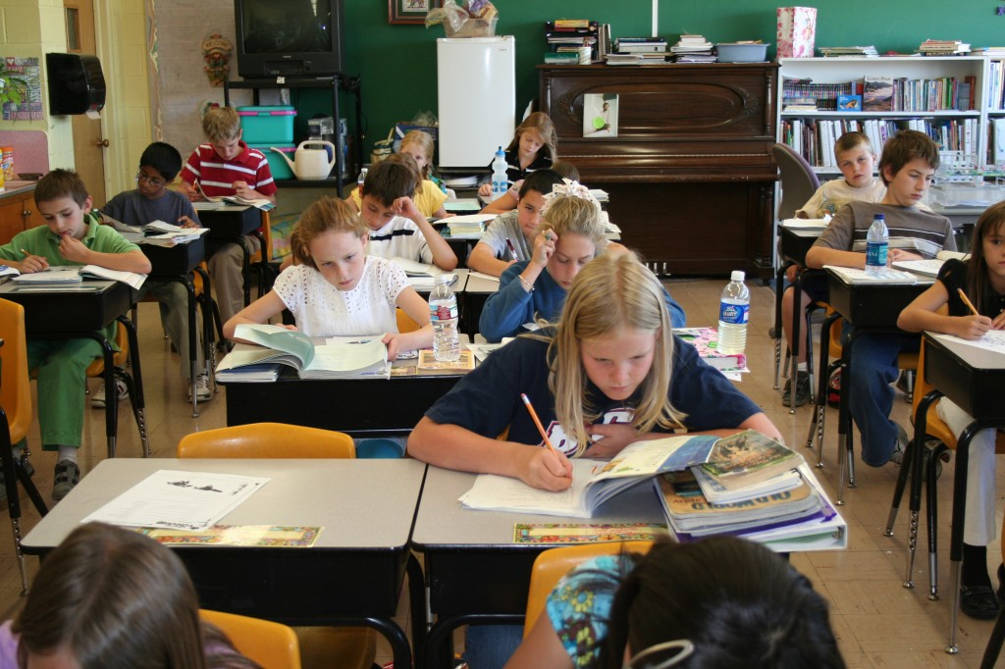
JANE’S CLASS – 13 YEARS AGO

Slide 5
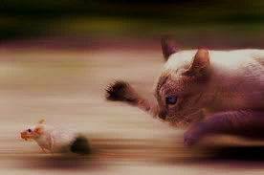
If 6 cats can kill 6 rats in 6 minutes, how many cats are required to kill 100 rats in 50 minutes?
- Lewis Carroll

Slide 6
If 6 cats can kill 6 rats in 6 minutes, how many cats are required to kill 100 rats in 50 minutes?
- Lewis Carroll
DISASTER!

Slide 7
THREE REALIZATIONS!

Slide 8
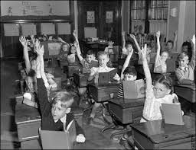

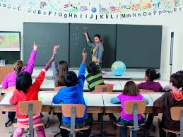


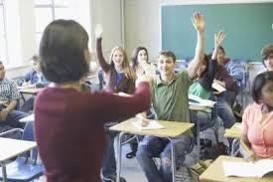

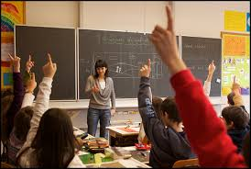






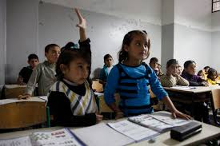
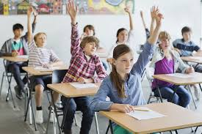

Students are not thinking!
THREE REALIZATIONS!
Teachers are planning their teaching on the assumption that students either cannot or will not think.

Slide 9
Students are not thinking!
INSTITUTIONAL NORMS
THREE REALIZATIONS!
Teachers are planning their teaching on the assumption that students either cannot or will not think.

Slide 10
Students are not thinking!
NON-NEGOTIATED NORMS
THREE REALIZATIONS!
Teachers are planning their teaching on the assumption that students either cannot or will not think.

Slide 11

RENEGOTIATING THE
NON-NEGOTIATED NORMS
ACTION RESEARCH ON STEROIDS (n = 400+)

Slide 12
VARIABLE
problems
how we give the problem
how we answer questions
room organization
how groups are formed
student work space
autonomy
how we give notes
hints and extensions
how we level
assessment

Slide 13
VARIABLE | POSITIVE EFFECT
problems | begin with good problems
how we give the problem | oral vs. written
how we answer questions | 3 types of questions
room organization | defront the room
how groups are formed | visibly random groups
student work space | vertical non-permanent surfaces
autonomy | create space and push them into it
how we give notes | use mindful notes
hints and extensions | managing flow
how we level | level to the bottom
assessment | 4 purposes

Slide 14
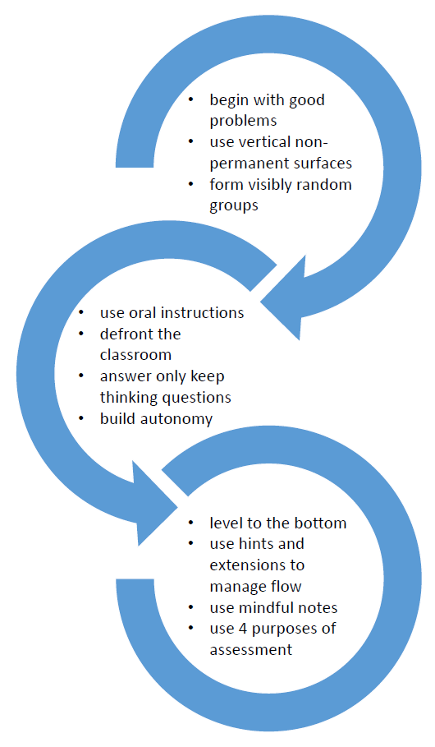
HEIRARCHY OF IMPLEMENTATION

Slide 15
begin with good problems
use vertical non-permanent surfaces
form visibly random groups

Slide 16
use oral instructions
defront the classroom
answer only keep thinking questions
build autonomy

Slide 17
level to the bottom
use hints and extensions to manage flow
use mindful notes
use 4 purposes of assessment

Slide 18
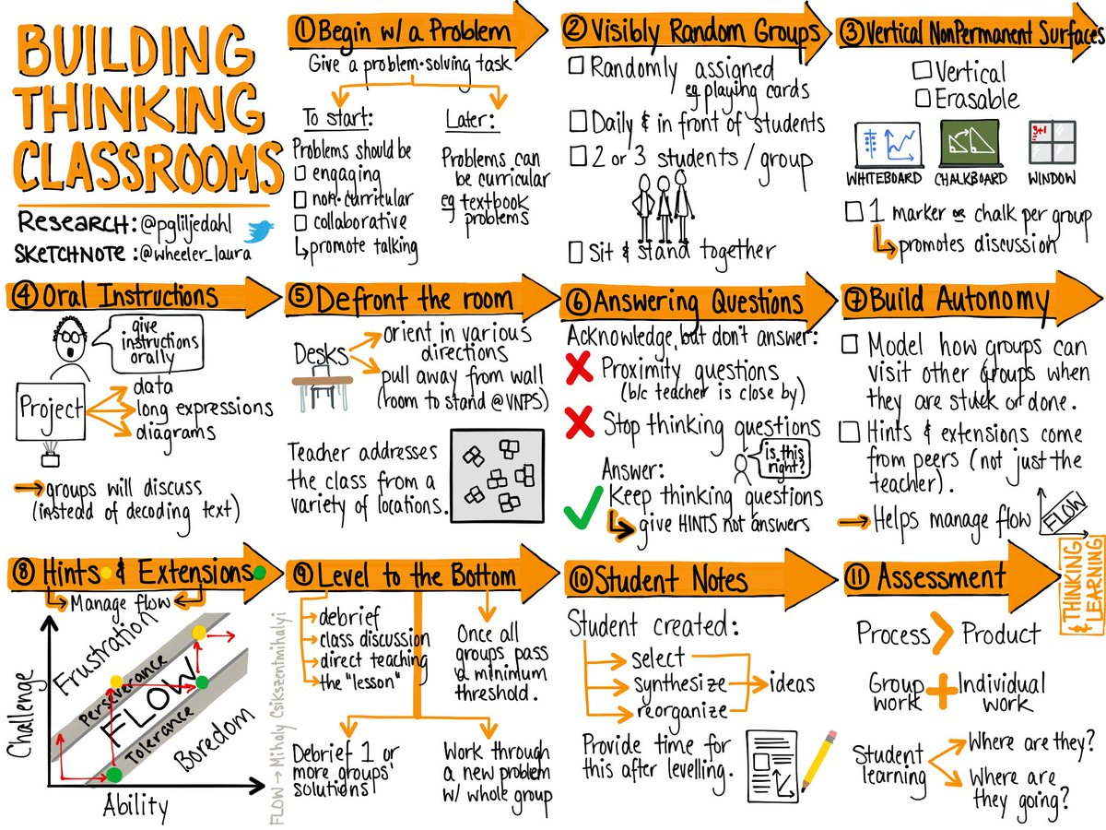

Slide 19
begin with good problems
use vertical non-permanent surfaces
form visibly random groups

Slide 20
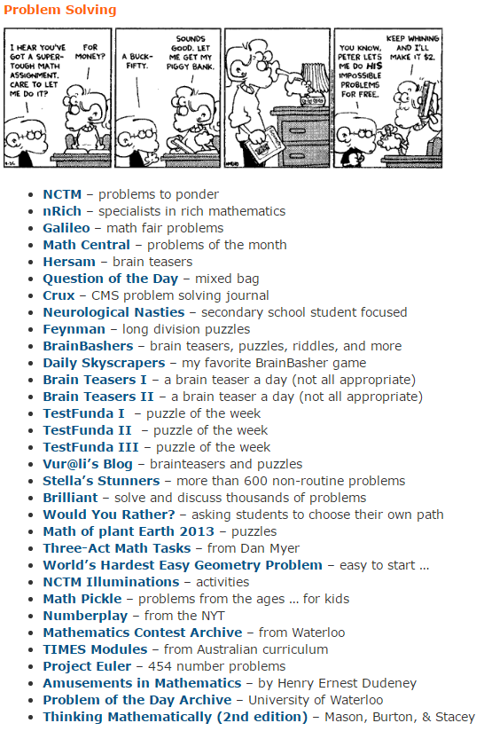
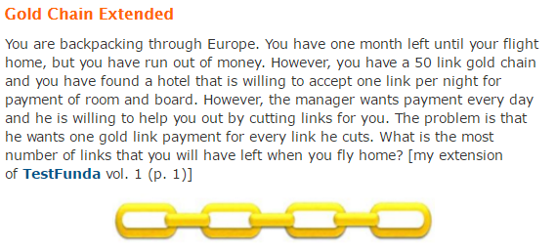
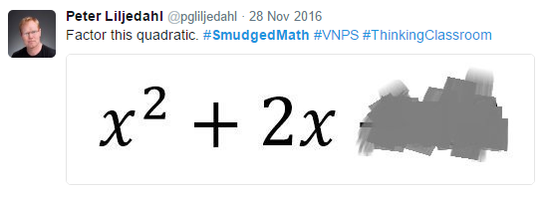
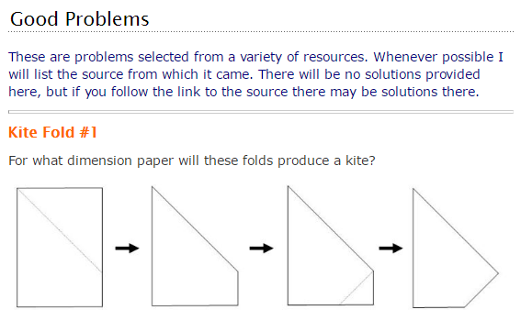
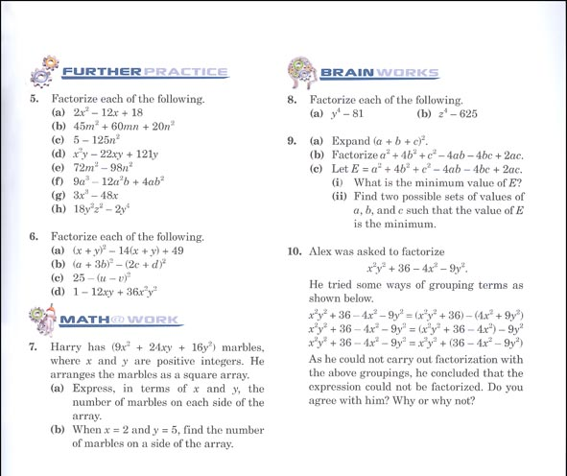

GOOD PROBLEMS
http://www.peterliljedahl.com/teachers/good-problem

Slide 21
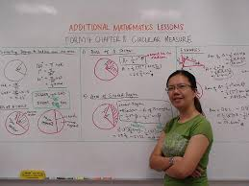
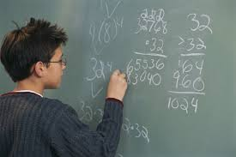
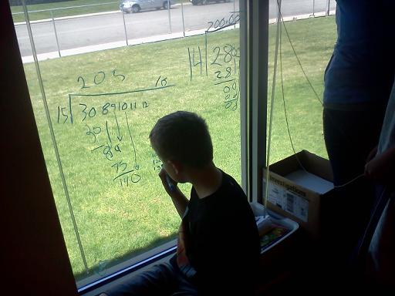
VERTICAL NON-PERMANENT SURFACES

Slide 22
PROXIES FOR ENGAGEMENT
time to task
time to first mathematical notation
amount of discussion
eagerness to start
participation
persistence
knowledge mobility
non-linearity of work
0 - 3

Slide 23
 | vertical non-perm | horizontal non-perm | vertical permanent | horizontal permanent | notebook
N (groups) | 10 | 10 | 9 | 9 | 8
time to task | 12.8 sec | 13.2 sec | 12.1 sec | 14.1 sec | 13.0 sec
first notation | 20.3 sec | 23.5 sec | 2.4 min | 2.1 min | 18.2 sec
discussion | 2.8 | 2.2 | 1.5 | 1.1 | 0.6
eagerness | 3.0 | 2.3 | 1.2 | 1.0 | 0.9
participation | 2.8 | 2.3 | 1.8 | 1.6 | 0.9
persistence | 2.6 | 2.6 | 1.8 | 1.9 | 1.9
mobility | 2.5 | 1.2 | 2.0 | 1.3 | 1.2
non-linearity | 2.7 | 2.9 | 1.0 | 1.1 | 0.8

Slide 24
 | vertical non-perm | horizontal non-perm | vertical permanent | horizontal permanent | notebook
N (groups) | 10 | 10 | 9 | 9 | 8
time to task | 12.8 sec | 13.2 sec | 12.1 sec | 14.1 sec | 13.0 sec
first notation | 20.3 sec | 23.5 sec | 2.4 min | 2.1 min | 18.2 sec
discussion | 2.8 | 2.2 | 1.5 | 1.1 | 0.6
eagerness | 3.0 | 2.3 | 1.2 | 1.0 | 0.9
participation | 2.8 | 2.3 | 1.8 | 1.6 | 0.9
persistence | 2.6 | 2.6 | 1.8 | 1.9 | 1.9
mobility | 2.5 | 1.2 | 2.0 | 1.3 | 1.2
non-linearity | 2.7 | 2.9 | 1.0 | 1.1 | 0.8

Slide 25
 | vertical non-perm | horizontal non-perm | vertical permanent | horizontal permanent | notebook
N (groups) | 10 | 10 | 9 | 9 | 8
time to task | 12.8 sec | 13.2 sec | 12.1 sec | 14.1 sec | 13.0 sec
first notation | 20.3 sec | 23.5 sec | 2.4 min | 2.1 min | 18.2 sec
discussion | 2.8 | 2.2 | 1.5 | 1.1 | 0.6
eagerness | 3.0 | 2.3 | 1.2 | 1.0 | 0.9
participation | 2.8 | 2.3 | 1.8 | 1.6 | 0.9
persistence | 2.6 | 2.6 | 1.8 | 1.9 | 1.9
mobility | 2.5 | 1.2 | 2.0 | 1.3 | 1.2
non-linearity | 2.7 | 2.9 | 1.0 | 1.1 | 0.8

Slide 26
 | vertical non-perm | horizontal non-perm | vertical permanent | horizontal permanent | notebook
N (groups) | 10 | 10 | 9 | 9 | 8
time to task | 12.8 sec | 13.2 sec | 12.1 sec | 14.1 sec | 13.0 sec
first notation | 20.3 sec | 23.5 sec | 2.4 min | 2.1 min | 18.2 sec
discussion | 2.8 | 2.2 | 1.5 | 1.1 | 0.6
eagerness | 3.0 | 2.3 | 1.2 | 1.0 | 0.9
participation | 2.8 | 2.3 | 1.8 | 1.6 | 0.9
persistence | 2.6 | 2.6 | 1.8 | 1.9 | 1.9
mobility | 2.5 | 1.2 | 2.0 | 1.3 | 1.2
non-linearity | 2.7 | 2.9 | 1.0 | 1.1 | 0.8
#VNPS

Slide 27
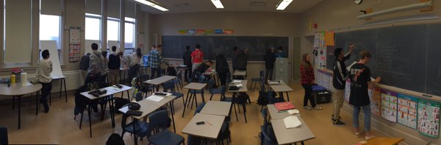
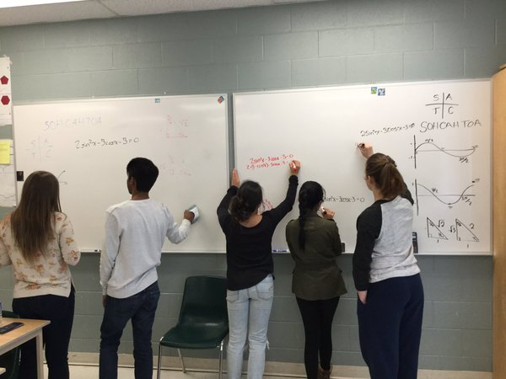
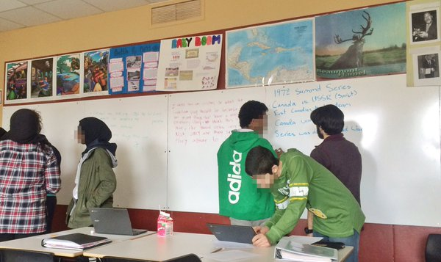
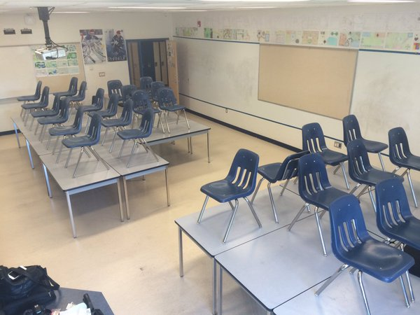
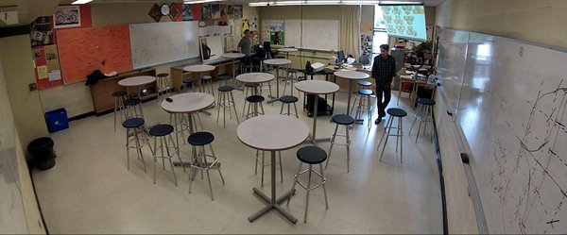
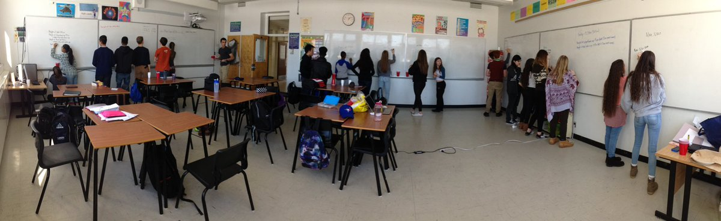

Slide 28
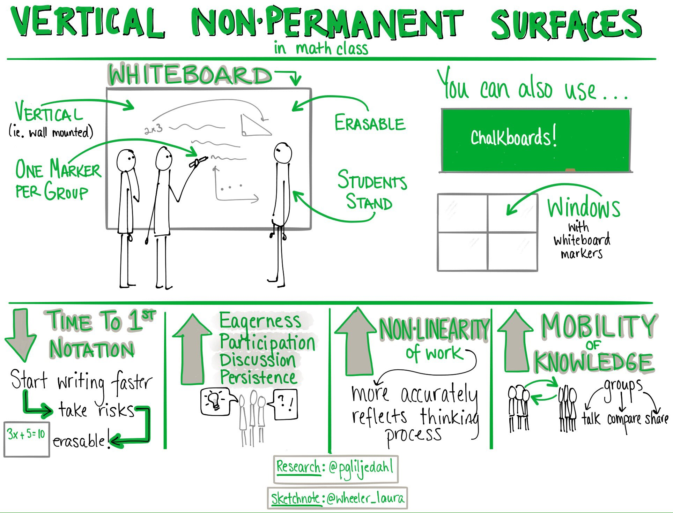

Slide 29
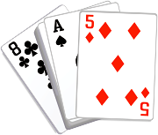

VISIBLY RANDOM GROUPS

Slide 30
students become agreeable to work in any group they are placed in
there is an elimination of social barriers within the classroom
mobility of knowledge between students increases
reliance on co-constructed intra- and inter-group answers increases
reliance on the teacher for answers decreases
engagement in classroom tasks increase
students become more enthusiastic about mathematics class

Slide 31
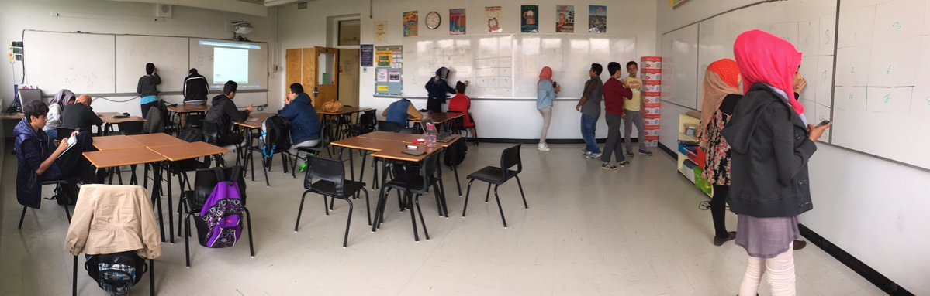
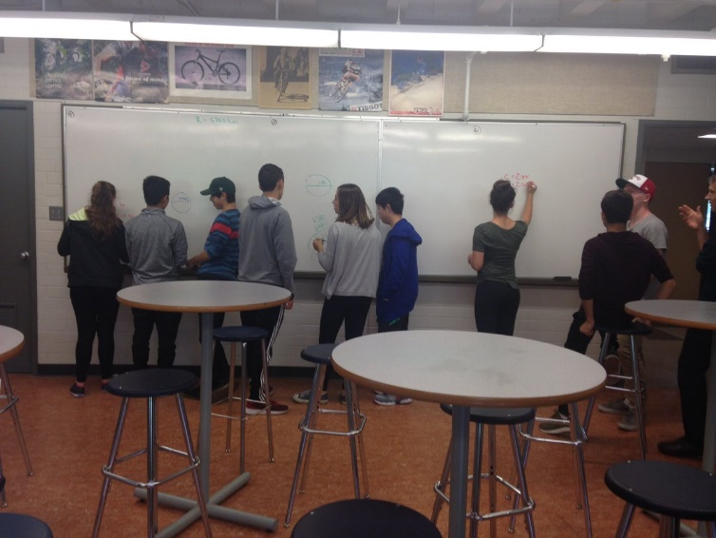
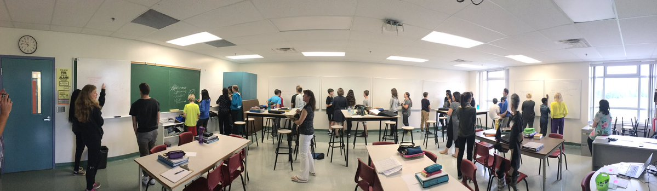

Slide 32
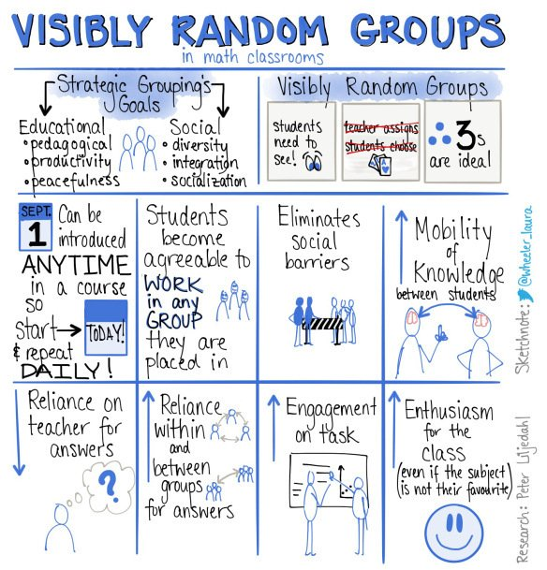

Slide 33
BUILDING THINKING CLASSROOMS

Slide 34
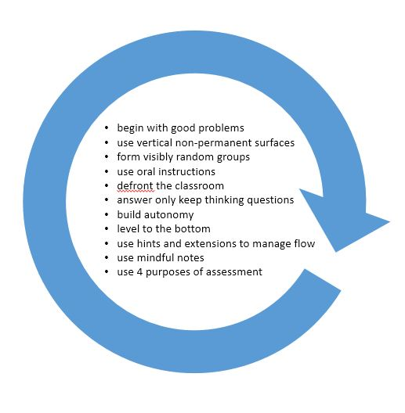
IMPLEMENTATION – years 2 & 3

Slide 35
?
begin with good problems
use vertical non-permanent surfaces
form visibly random groups
use oral instructions
defront the classroom
answer only keep thinking questions
build autonomy
level to the bottom
use hints and extensions to manage flow
use mindful notes
use 4 purposes of assessment

Slide 36
BUILD AUTONOMY
begin with good problems
use vertical non-permanent surfaces
form visibly random groups
use oral instructions
defront the classroom
answer only keep thinking questions
level to the bottom
use hints and extensions to manage flow
use mindful notes
use 4 purposes of assessment

Slide 37
SEQUENCING
begin with good problems
use vertical non-permanent surfaces
form visibly random groups
use oral instructions
defront the classroom
answer only keep thinking questions
build autonomy
level to the bottom
use hints and extensions to manage flow
use mindful notes
use 4 purposes of assessment

Slide 38


THANK YOU!
liljedahl@sfu.ca
www.peterliljedahl.com/presentations
@pgliljedahl | #vnps | #thinkingclassroom
Global Math Department

