Slide 1
BUILDING THINKING CLASSROOMS
- Peter Liljedahl

Slide 2
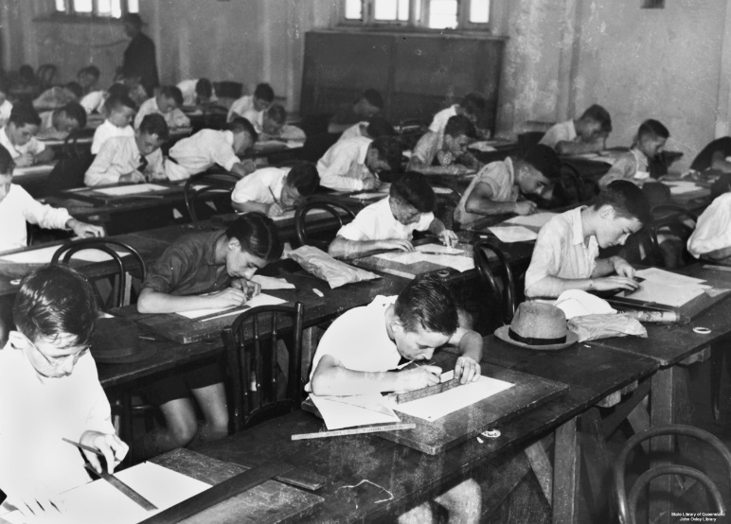
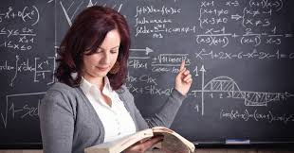
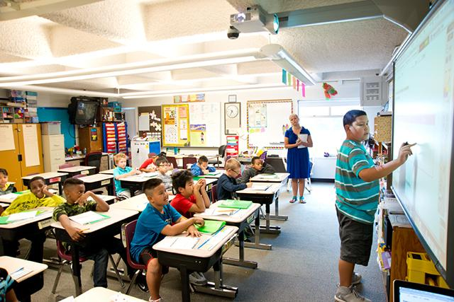
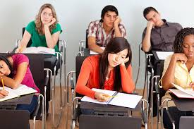
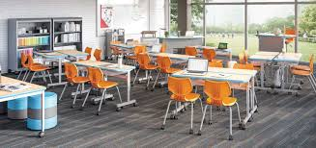
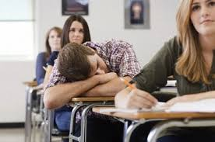
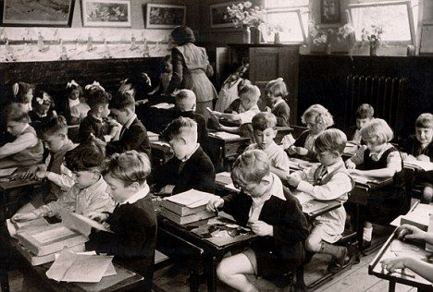
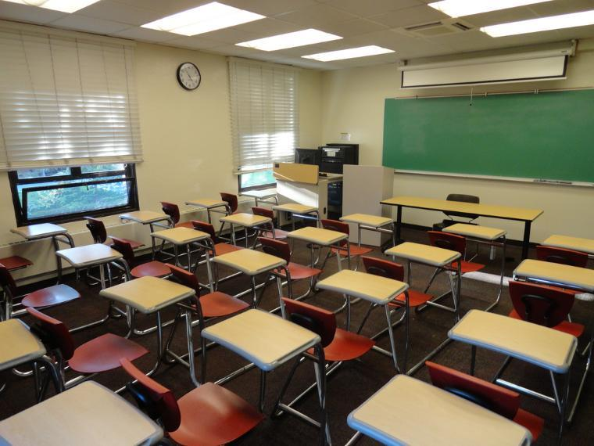
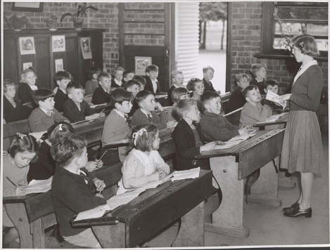
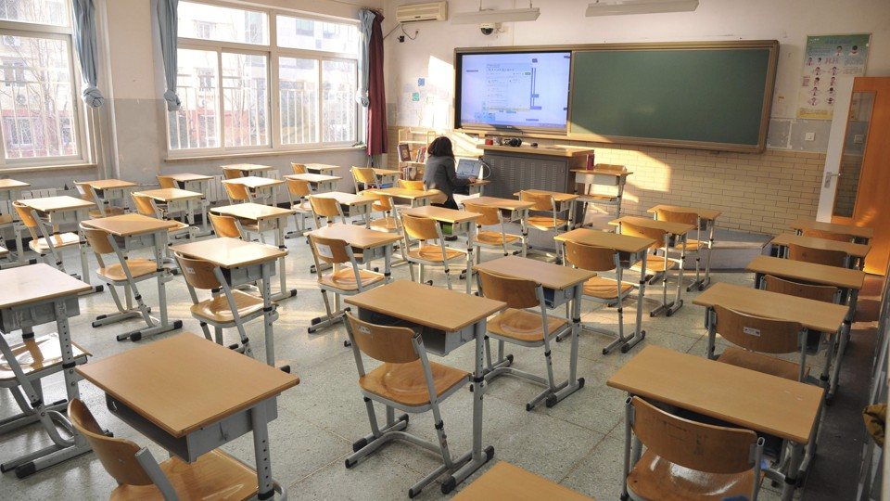
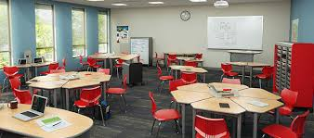
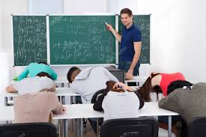
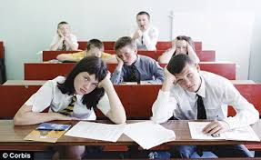
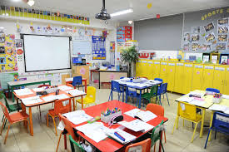
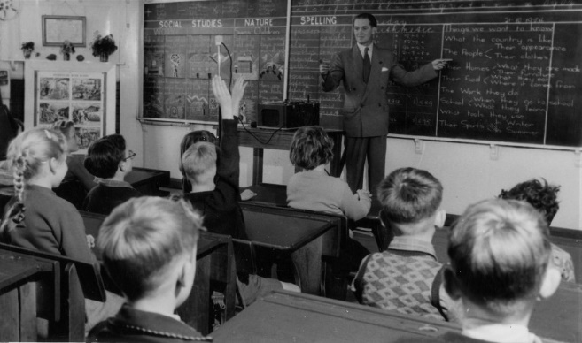
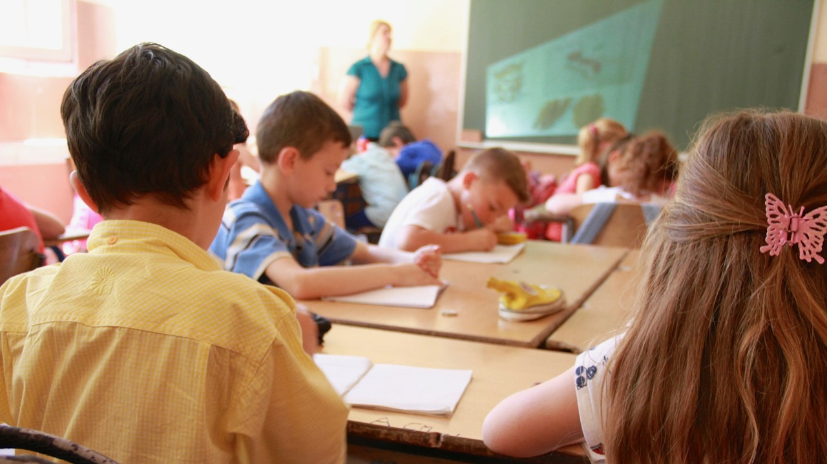
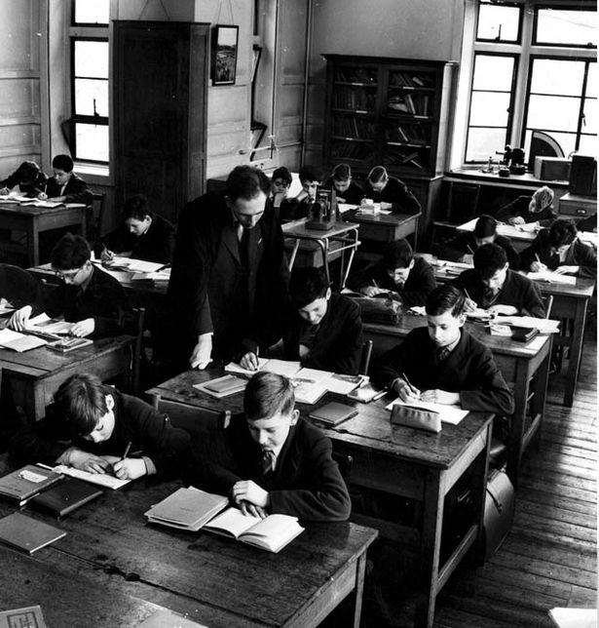
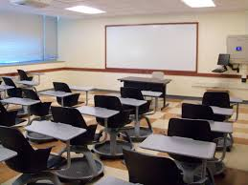
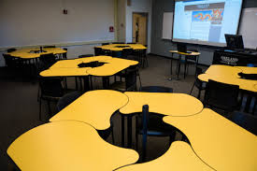
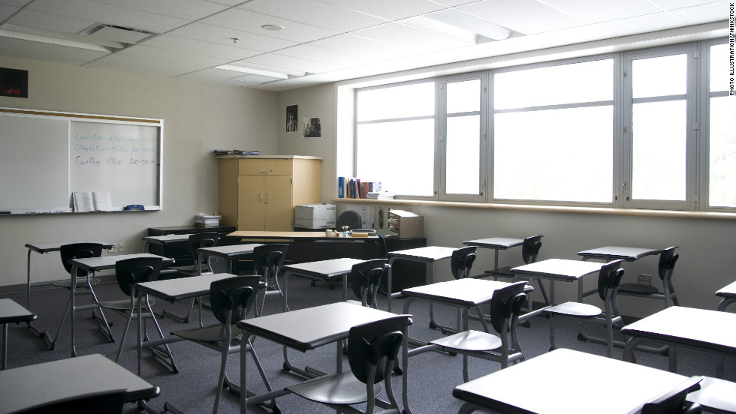
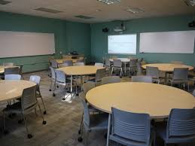
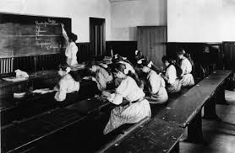
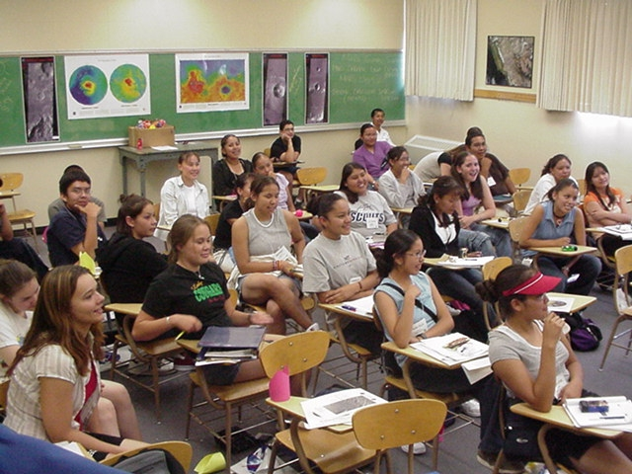
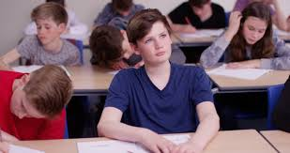
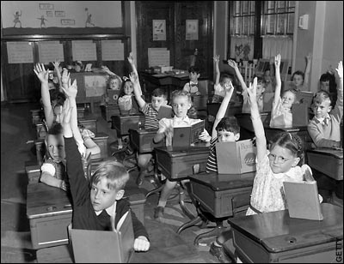
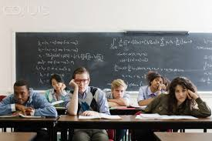
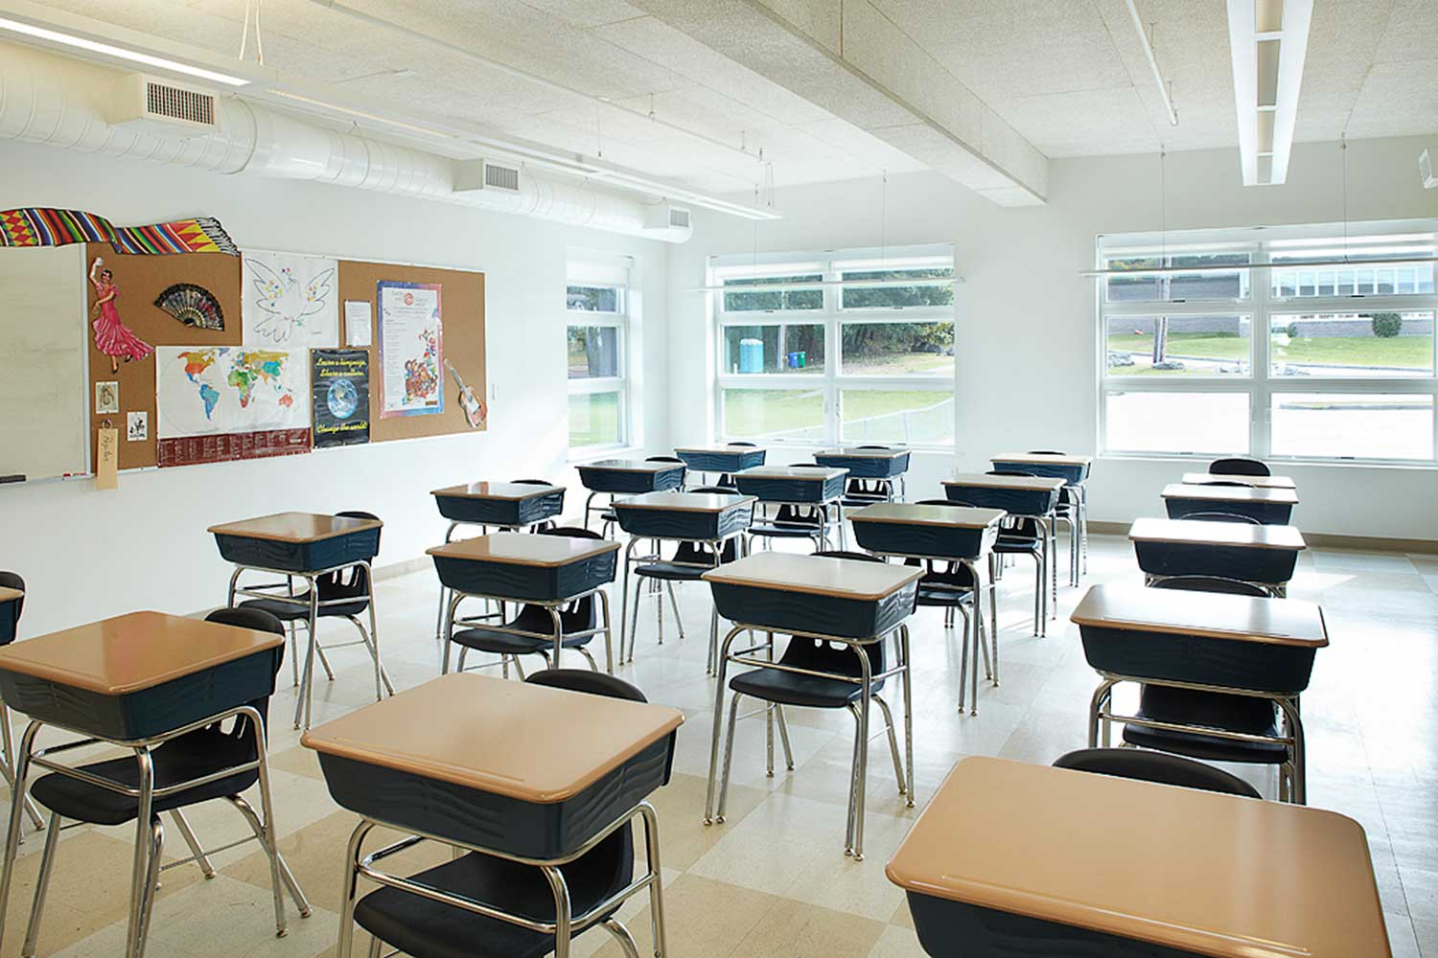
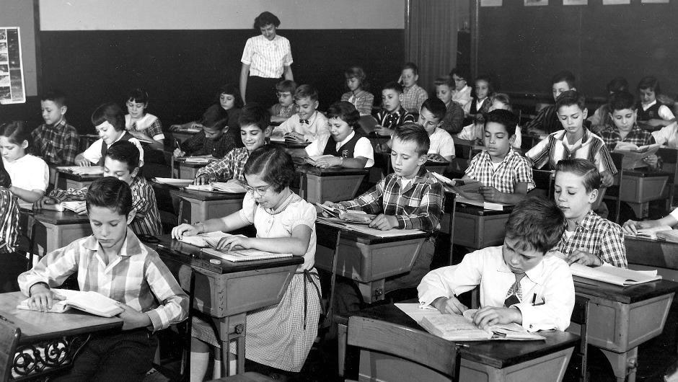
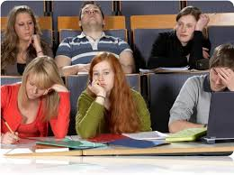
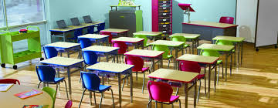
15 YEARS AGO …

Slide 3
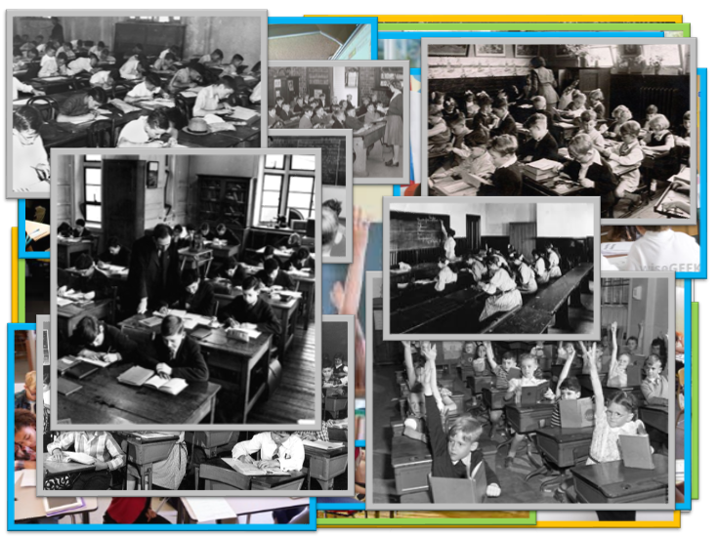
INSTITUTIONAL NORMS

Slide 4
NON-NEGOTIATED NORMS

Slide 5
400+ TEACHERS | 15 YEARS | 2+ WEEK CYCLES

Slide 6
RENEGOTIATING THE
NON-NEGOTIATED NORMS
400+ TEACHERS | 15 YEARS | 2+ WEEK CYCLES

Slide 7
OPPORTUNITIES FOR THINKING
1 | problems
2 | how we give the problem
3 | how we answer questions
4 | room organization
5 | how groups are formed
6 | student work space
7 | autonomy
8 | how we give notes
9 | what homework looks like
10 | hints and extensions
11 | how we consolidate
12 | formative assessment
13 | summative assessment
14 | reporting out

Slide 8
OPPORTUNITIES FOR THINKING |  | OPTIMAL PRACTICES FOR THINKING
1 | problems
2 | how we give the problem
3 | how we answer questions
4 | room organization
5 | how groups are formed
6 | student work space
7 | autonomy
8 | how we give notes
9 | what homework looks like
10 | hints and extensions
11 | how we consolidate
12 | formative assessment
13 | summative assessment
14 | reporting out

Slide 9
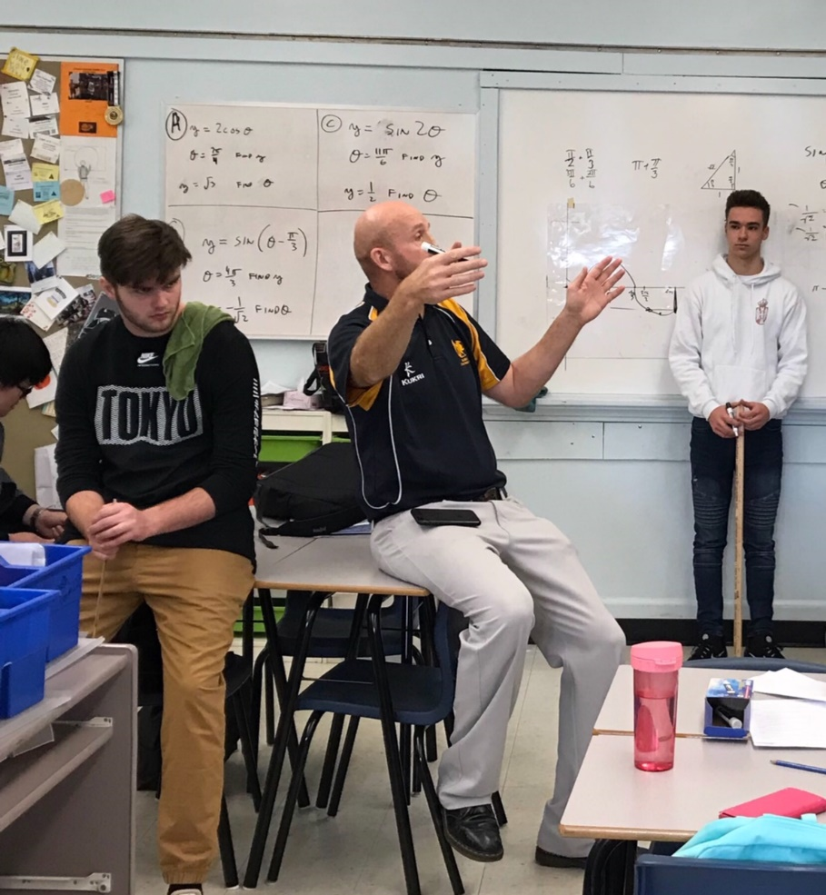
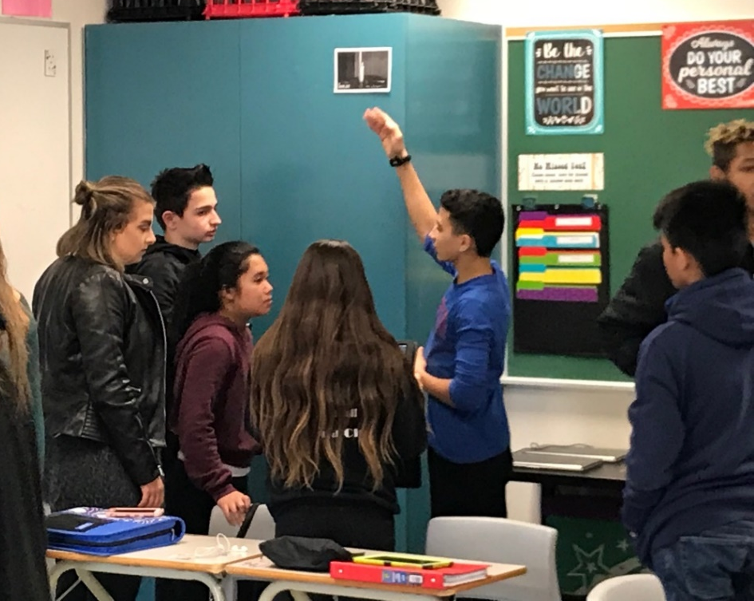
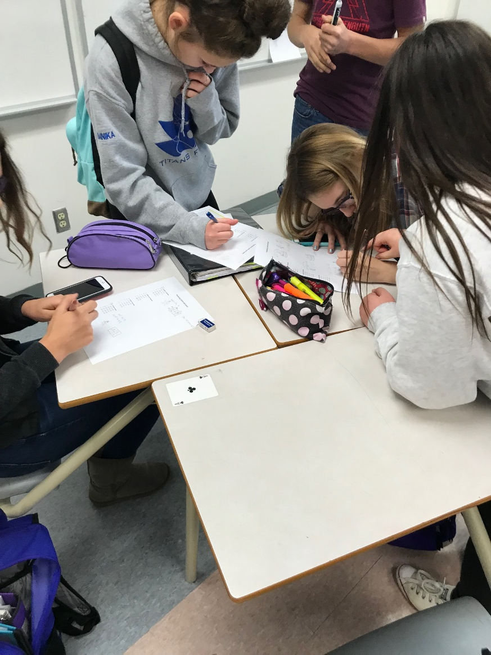
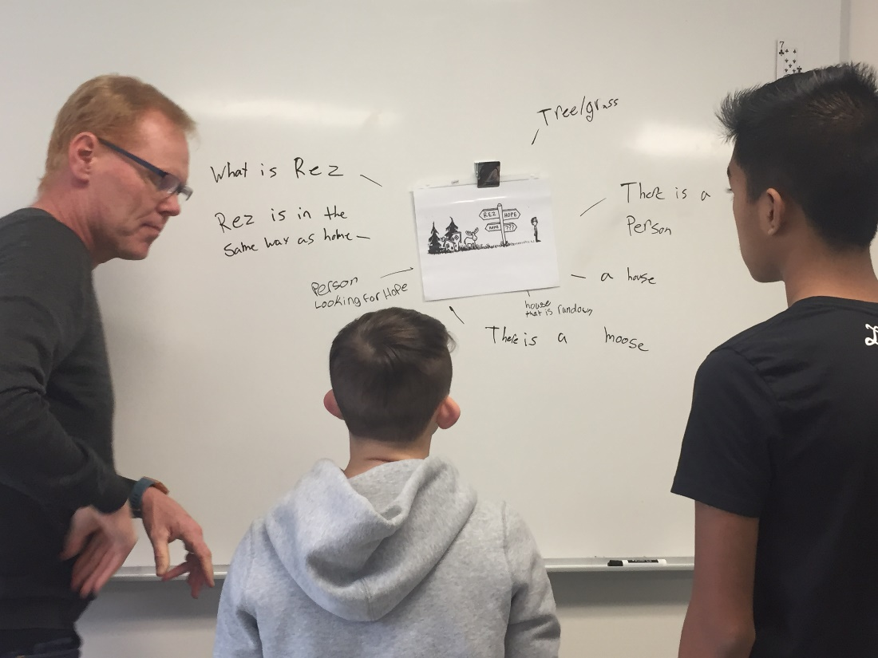
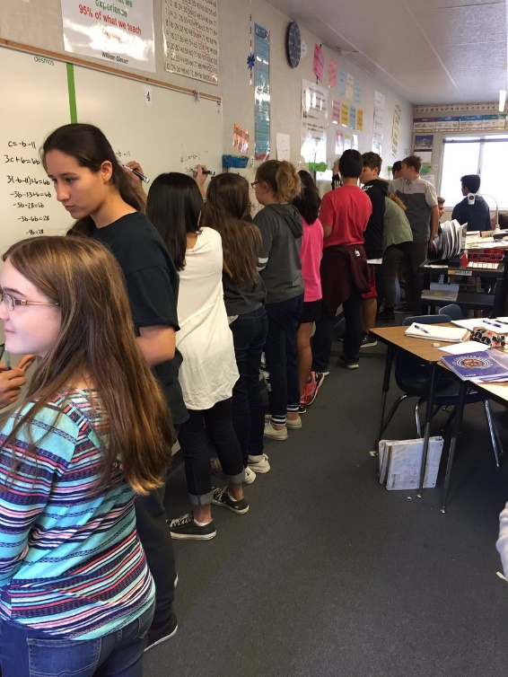
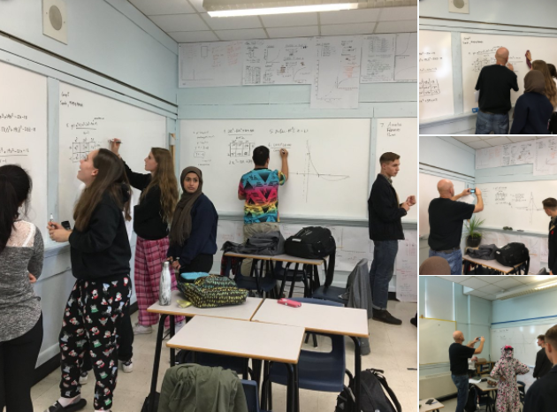
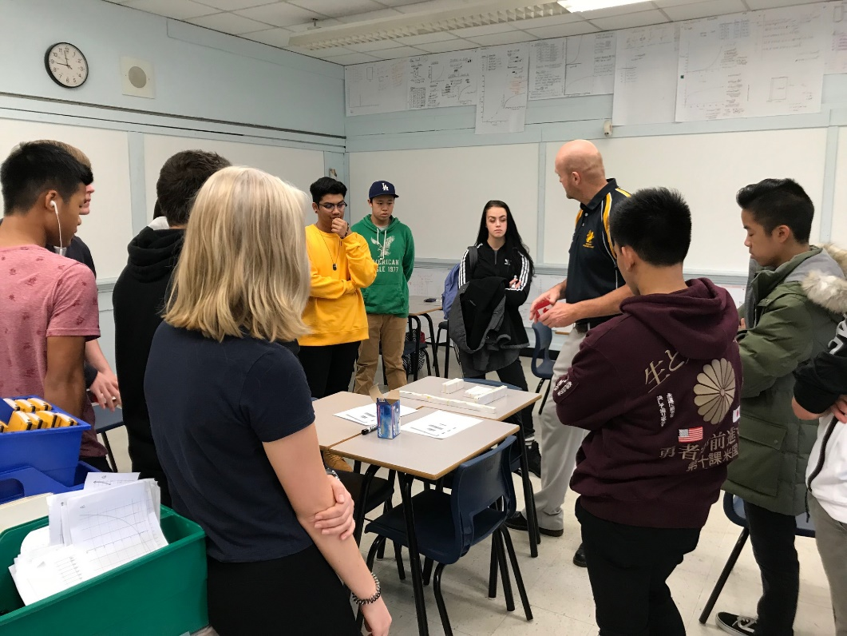
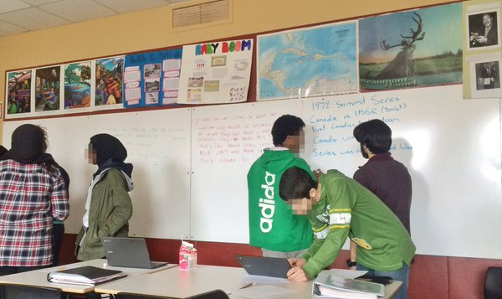
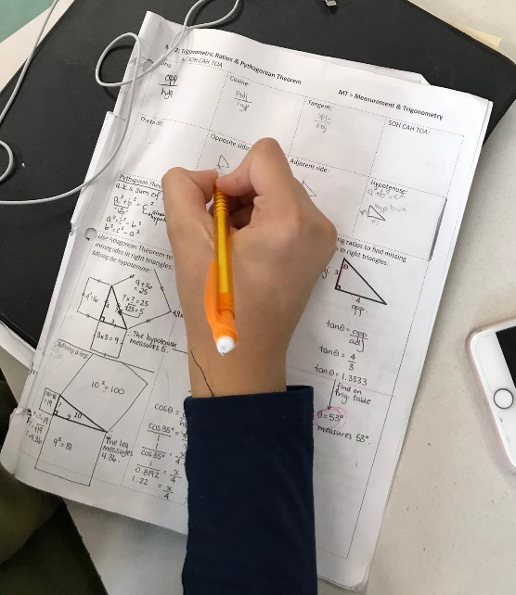
OPPORTUNITIES FOR THINKING |  | OPTIMAL PRACTICES FOR THINKING
1 | problems | begin lessons with good problems
2 | how we give the problem | use verbal instructions
3 | how we answer questions | answer only keep thinking questions
4 | room organization | defront the classroom
5 | how groups are formed | form visibly random groups
6 | student work space | use vertical non-permanent surfaces
7 | autonomy | foster autonomous actions
8 | how we give notes | have students do meaningful notes
9 | what homework looks like | use check your understanding questions
10 | hints and extensions | manage flow
11 | how we consolidate | consolidate from the bottom
12 | formative assessment | show where they are and where they are going
13 | summative assessment | evaluate what you value
14 | reporting out | report out based on data (not points)

Slide 10
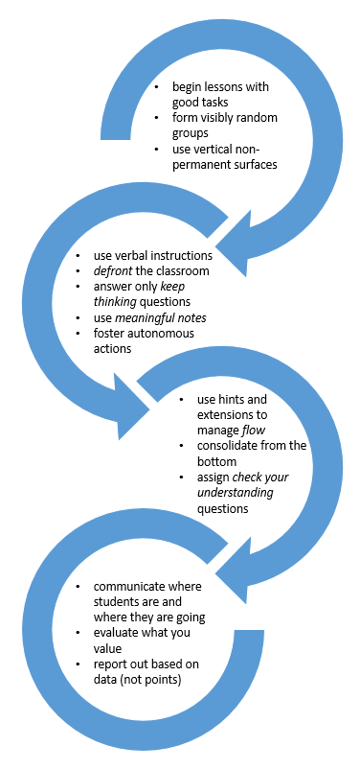
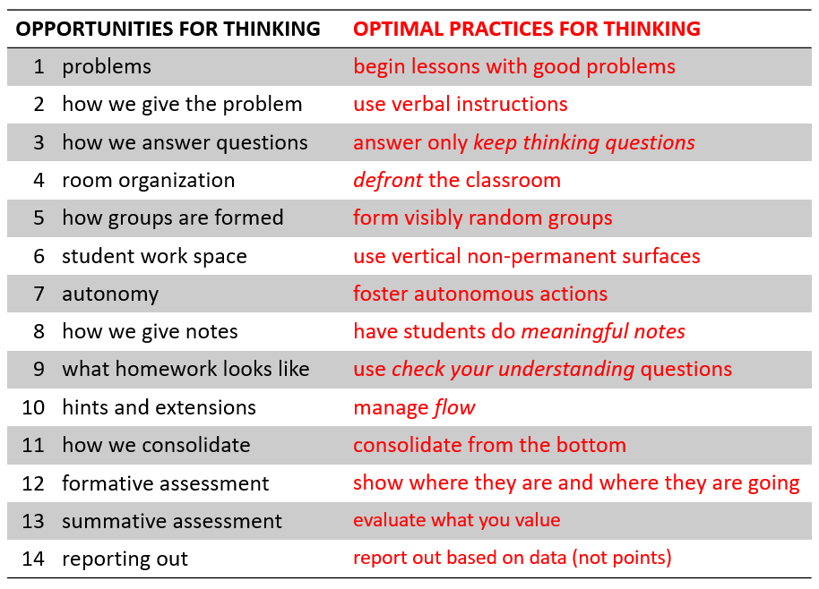
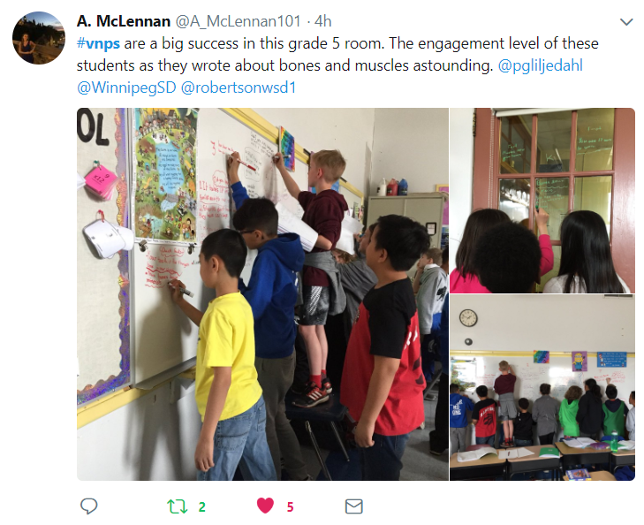
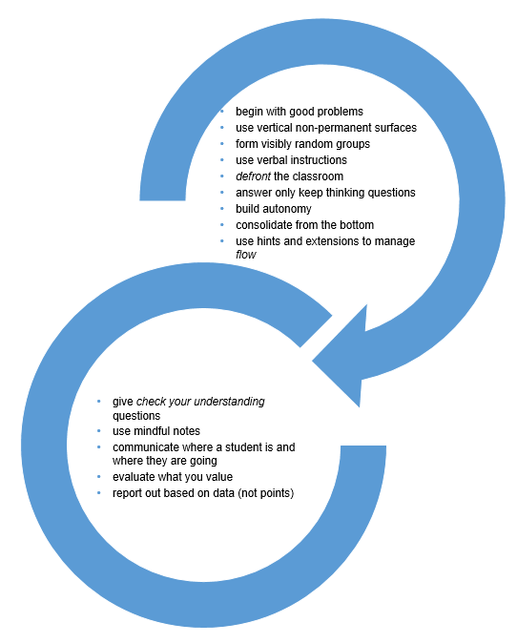
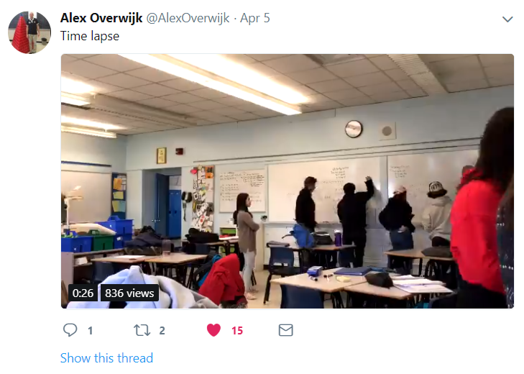
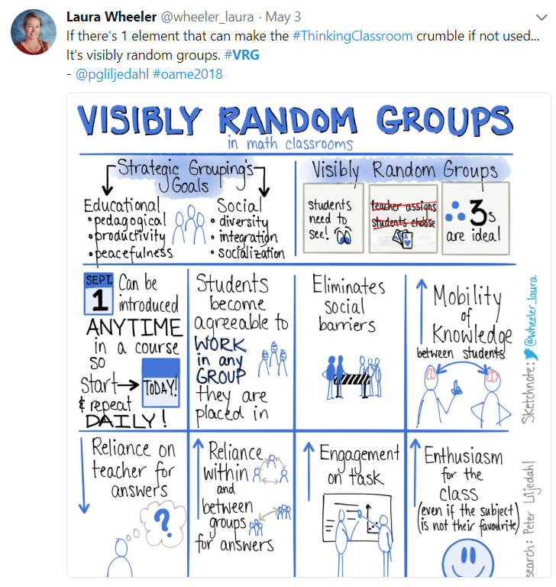
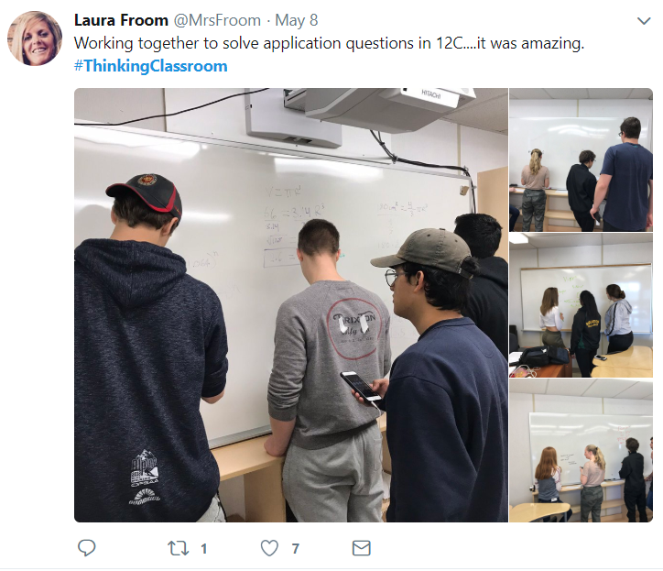

Slide 12
Liljedahl, P. (2014). The affordances of using visibly random groups in a mathematics classroom. In Y. Li, E. Silver, & S. Li (eds.), Transforming Mathematics Instruction: Multiple Approaches and Practices. (pp. 127-144). New York, NY: Springer.
Liljedahl, P. (2016). Building thinking classrooms: Conditions for problem solving. In P. Felmer, J. Kilpatrick, & E. Pekhonen (eds.), Posing and Solving Mathematical Problems: Advances and New Perspectives. (pp. 361-386). New York, NY: Springer.
Liljedahl, P. (2016). Flow: A Framework for Discussing Teaching. Proceedings of the 40th Conference of the International Group for the Psychology of Mathematics Education, Szeged, Hungary.
Liljedahl, P. (2017). Building Thinking Classrooms: A Story of Teacher Professional Development. The 1st International Forum on Professional Development for Teachers. Seoul, Korea.
Liljedahl, P. (in press). On the edges of flow: Student problem solving behavior. In S. Carreira, N. Amado, & K. Jones (eds.), Broadening the scope of research on mathematical problem solving: A focus on technology, creativity and affect. New York, NY: Springer.
Liljedahl, P. (in press). On the edges of flow: Student engagement in problem solving. Proceedings of the 10th Congress of the European Society for Research in Mathematics Education. Dublin, Ireland.
Liljedahl, P. (in press). Building thinking classrooms. In A. Kajander, J. Holm, & E. Chernoff (eds.) Teaching and learning secondary school mathematics: Canadian perspectives in an international context. New York, NY: Springer.
Maria Kerkhoff, MSc, (2018). Experiencing Mathematics through Problem Solving Tasks.
Chris McGregor, MSc, (2018). Reduction of Mathematics Anxiety through use of Non-Permanent Vertical Surfaces and Group Discussion.
Oana Chiru, MSc (2017). Occasioning Flow in the Mathematics Classroom: Optimal Experiences in Common Places.
Mike Pruner, MSc (2016). Observations in a Thinking Classroom.

Slide 13
#thinkingclassrooms and BC
BURNABY
COQUITLAM
CRANBROOK
KIMBERLEY
DAWSON CREEK
DELTA
KAMLOOPS
KELOWNA
MAPLE RIDGE
NORTH VANCOUVER
OLIVER
PENTICTON
QUESNEL
SALT SPRING
SURREY
VANCOUVER
VERNON

Slide 14
THANK YOU!
liljedahl@sfu.ca
www.peterliljedahl.com/presentations
@pgliljedahl | #vnps | #thinkingclassroom
Global Math Department

