Slide 1
NOW YOU TRY ONE
n=32
STUDENTING
catching up on notes (n=0)

Slide 2
THE LESSON: TAKING NOTES
don’t keep up
n=16
don’t
n=3
yes
n=3
don’t use notes
n=27

Slide 3
THE LESSON: TAKING NOTES
don’t keep up
n=16
don’t
n=3
yes
n=3
don’t use notes
n=27
USE NOTES TO STUDY

Slide 4
THINGS I (WE) TRIED
tasks
hints and extensions
how we give the problem
how we answer questions
how we level
room organization
how groups are formed
student work space
how we give notes
assessment
…

Slide 5
FINDINGS
VARIABLE | POSITIVE EFFECT
tasks | good tasks
hints and extensions | managing flow
how we give the problem | oral vs. written
how we answer questions | 3 types of questions
how we level | level to the bottom
room organization | defronting the room
how groups are formed | visibly random groups
student work space | vertical non-permanent surfaces
how we give notes | don't
assessment | 4 purposes
…

Slide 6
FINDINGS – BIGGEST IMPACT
levelling
assessment
flow
answering questions
oral instructions
defronting the room
good tasks
vertical non-permanent surfaces
visibly random groups

Slide 7
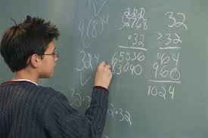
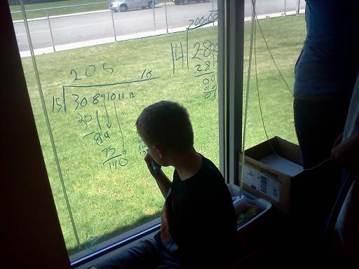
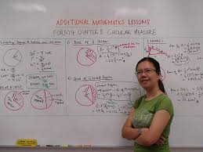
VERTICAL NON-PERMANENT SURFACES

Slide 8
EFFECT ON STUDENTS
PROXIES FOR ENGAGEMENT
time to task
time to first mathematical notation
amount of discussion
eagerness to start
participation
persistence
knowledge mobility
non-linearity of work
0 - 3

Slide 9
EFFECT ON STUDENTS
 | vertical non-perm | horizontal non-perm | vertical permanent | horizontal permanent | notebook
N (groups) | 10 | 10 | 9 | 9 | 8
time to task | 12.8 sec | 13.2 sec | 12.1 sec | 14.1 sec | 13.0 sec
first notation | 20.3 sec | 23.5 sec | 2.4 min | 2.1 min | 18.2 sec
discussion | 2.8 | 2.2 | 1.5 | 1.1 | 0.6
eagerness | 3.0 | 2.3 | 1.2 | 1.0 | 0.9
participation | 2.8 | 2.3 | 1.8 | 1.6 | 0.9
persistence | 2.6 | 2.6 | 1.8 | 1.9 | 1.9
mobility | 2.5 | 1.2 | 2.0 | 1.3 | 1.2
non-linearity | 2.7 | 2.9 | 1.0 | 1.1 | 0.8

Slide 10
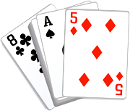
VISIBLY RANDOM GROUPS

Slide 11
EFFECT ON STUDENTS
students become agreeable to work in any group they are placed in
there is an elimination of social barriers within the classroom
mobility of knowledge between students increases
reliance on the teacher for answers decreases
reliance on co-constructed intra- and inter-group answers increases
engagement in classroom tasks increase
students become more enthusiastic about mathematics class

Slide 12
WHAT NEXT?
levelling
assessment
flow
answering questions
oral instructions
defronting the room
good tasks
vertical non-permanent surfaces
visibly random groups

Slide 13
`
THANK YOU!
liljedahl@sfu.ca
www.peterliljedahl.com/presentations
#VNPS

