Slide 1
BUILDING THINKING CLASSROOMS
- Peter Liljedahl

Slide 2
www.peterliljedahl.com/presentations
liljedahl@sfu.ca
@pgliljedahl

Slide 3
Liljedahl, P. (2014). The affordances of using visibly random groups in a mathematics classroom. In Y. Li, E. Silver, & S. Li (eds.), Transforming Mathematics Instruction: Multiple Approaches and Practices. (pp. 127-144). New York, NY: Springer.
Liljedahl, P. (2016). Building thinking classrooms: Conditions for problem solving. In P. Felmer, J. Kilpatrick, & E. Pekhonen (eds.), Posing and Solving Mathematical Problems: Advances and New Perspectives. (pp. 361-386). New York, NY: Springer.
Liljedahl, P. (2016). Flow: A Framework for Discussing Teaching. Proceedings of the 40th Conference of the International Group for the Psychology of Mathematics Education, Szeged, Hungary.
Liljedahl, P. (2017). Building Thinking Classrooms: A Story of Teacher Professional Development. The 1st International Forum on Professional Development for Teachers. Seoul, Korea.
Liljedahl, P. (in press). On the edges of flow: Student problem solving behavior. In S. Carreira, N. Amado, & K. Jones (eds.), Broadening the scope of research on mathematical problem solving: A focus on technology, creativity and affect. New York, NY: Springer.
Liljedahl, P. (in press). On the edges of flow: Student engagement in problem solving. Proceedings of the 10th Congress of the European Society for Research in Mathematics Education. Dublin, Ireland.
Liljedahl, P. (in press). Building thinking classrooms. In A. Kajander, J. Holm, & E. Chernoff (eds.) Teaching and learning secondary school mathematics: Canadian perspectives in an international context. New York, NY: Springer.
Chris McGregor, MSc, (2018). Reduction of Mathematics Anxiety through use of Non-Permanent Vertical Surfaces and Group Discussion.
Oana Chiru, MSc (2017). Occasioning Flow in the Mathematics Classroom: Optimal Experiences in Common Places.
Mike Pruner, MSc (2016). Observations in a Thinking Classroom.

Slide 4
JANE’S CLASS – 15 YEARS AGO

Slide 5
If 6 cats can kill 6 rats in 6 minutes, how many cats are required to kill 100 rats in 50 minutes?
- Lewis Carroll

Slide 6
DISASTER!
If 6 cats can kill 6 rats in 6 minutes, how many cats are required to kill 100 rats in 50 minutes?
- Lewis Carroll

Slide 7
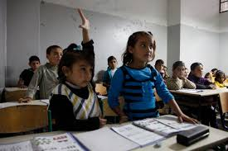
Students did no thinking.
Jane was planning her teaching on the assumption that students either cannot or will not think.

Slide 8
Students were not thinking.
INSTITUTIONAL NORMS
Jane was planning her teaching on the assumption that students either cannot or will not think.

Slide 9
Students were not thinking.
NON-NEGOTIATED NORMS
Jane was planning her teaching on the assumption that students either cannot or will not think.

Slide 10
ACTION RESEARCH ON STEROIDS (n = 400+)

Slide 11
RENEGOTIATING THE
NON-NEGOTIATED NORMS
ACTION RESEARCH ON STEROIDS (n = 400+)

Slide 12
OPPORTUNITIES FOR THINKING
1 | problems
2 | how we give the problem
3 | how we answer questions
4 | room organization
5 | how groups are formed
6 | student work space
7 | autonomy
8 | how we give notes
9 | what homework looks like
10 | hints and extensions
11 | how we level
12 | formative assessment
13 | summative assessment
14 | reporting out

Slide 13
OPPORTUNITIES FOR THINKING |  | OPTIMAL PRACTICES FOR THINKING
1 | problems
2 | how we give the problem
3 | how we answer questions
4 | room organization
5 | how groups are formed
6 | student work space
7 | autonomy
8 | how we give notes
9 | what homework looks like
10 | hints and extensions
11 | how we level
12 | formative assessment
13 | summative assessment
14 | reporting out

Slide 14
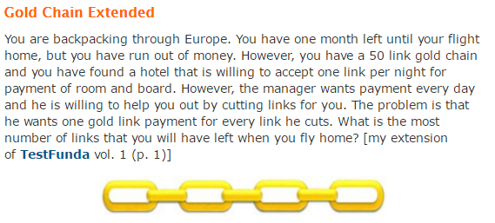
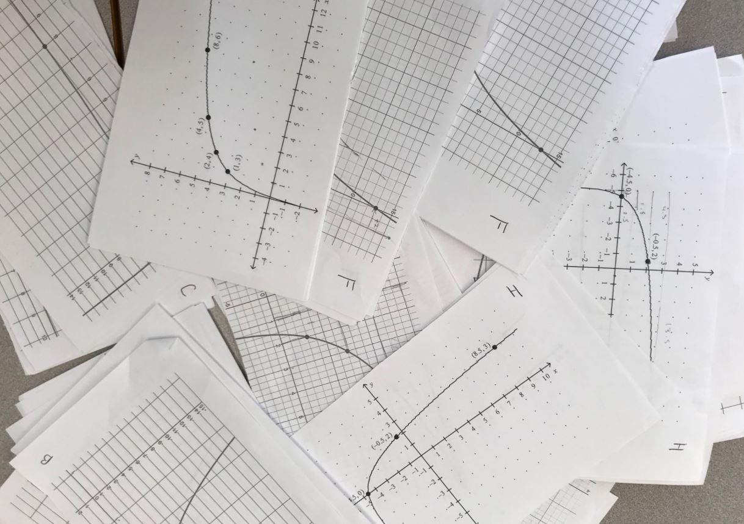
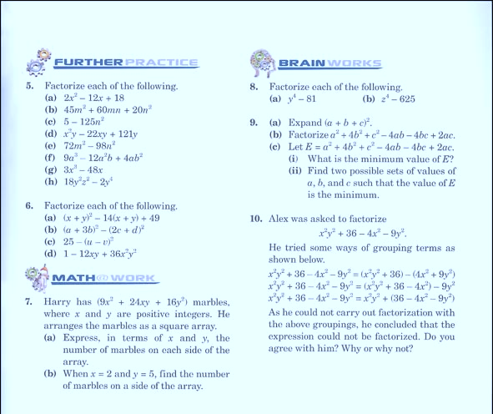
OPPORTUNITIES FOR THINKING |  | OPTIMAL PRACTICES FOR THINKING
1 | problems
2 | how we give the problem
3 | how we answer questions
4 | room organization
5 | how groups are formed
6 | student work space
7 | autonomy
8 | how we give notes
9 | what homework looks like
10 | hints and extensions
11 | how we level
12 | formative assessment
13 | summative assessment
14 | reporting out

Slide 15
OPPORTUNITIES FOR THINKING |  | OPTIMAL PRACTICES FOR THINKING
1 | problems | begin lesson with good problems
2 | how we give the problem
3 | how we answer questions
4 | room organization
5 | how groups are formed
6 | student work space
7 | autonomy
8 | how we give notes
9 | what homework looks like
10 | hints and extensions
11 | how we level
12 | formative assessment
13 | summative assessment
14 | reporting out

Slide 16
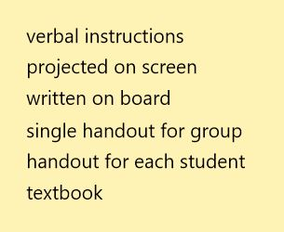
OPPORTUNITIES FOR THINKING |  | OPTIMAL PRACTICES FOR THINKING
1 | problems | begin lessons with good problems
2 | how we give the problem
3 | how we answer questions
4 | room organization
5 | how groups are formed
6 | student work space
7 | autonomy
8 | how we give notes
9 | what homework looks like
10 | hints and extensions
11 | how we level
12 | formative assessment
13 | summative assessment
14 | reporting out

Slide 17
OPPORTUNITIES FOR THINKING |  | OPTIMAL PRACTICES FOR THINKING
1 | problems | begin lessons with good problems
2 | how we give the problem | use verbal instructions
3 | how we answer questions
4 | room organization
5 | how groups are formed
6 | student work space
7 | autonomy
8 | how we give notes
9 | what homework looks like
10 | hints and extensions
11 | how we level
12 | formative assessment
13 | summative assessment
14 | reporting out

Slide 18
OPPORTUNITIES FOR THINKING |  | OPTIMAL PRACTICES FOR THINKING
1 | problems | begin lessons with good problems
2 | how we give the problem | use verbal instructions
3 | how we answer questions
4 | room organization
5 | how groups are formed
6 | student work space
7 | autonomy
8 | how we give notes
9 | what homework looks like
10 | hints and extensions
11 | how we level
12 | formative assessment
13 | summative assessment
14 | reporting out
PROXIMITY QUESTIONS
STOP THINKING QUESTIONS
KEEP THINKING QUESTIONS

Slide 19
OPPORTUNITIES FOR THINKING |  | OPTIMAL PRACTICES FOR THINKING
1 | problems | begin lessons with good problems
2 | how we give the problem | use verbal instructions
3 | how we answer questions
4 | room organization
5 | how groups are formed
6 | student work space
7 | autonomy
8 | how we give notes
9 | what homework looks like
10 | hints and extensions
11 | how we level
12 | formative assessment
13 | summative assessment
14 | reporting out
PROXIMITY QUESTIONS
STOP THINKING QUESTIONS
KEEP THINKING QUESTIONS

Slide 20
OPPORTUNITIES FOR THINKING |  | OPTIMAL PRACTICES FOR THINKING
1 | problems | begin lessons with good problems
2 | how we give the problem | use verbal instructions
3 | how we answer questions | answer only keep thinking questions
4 | room organization
5 | how groups are formed
6 | student work space
7 | autonomy
8 | how we give notes
9 | what homework looks like
10 | hints and extensions
11 | how we level
12 | formative assessment
13 | summative assessment
14 | reporting out

Slide 21
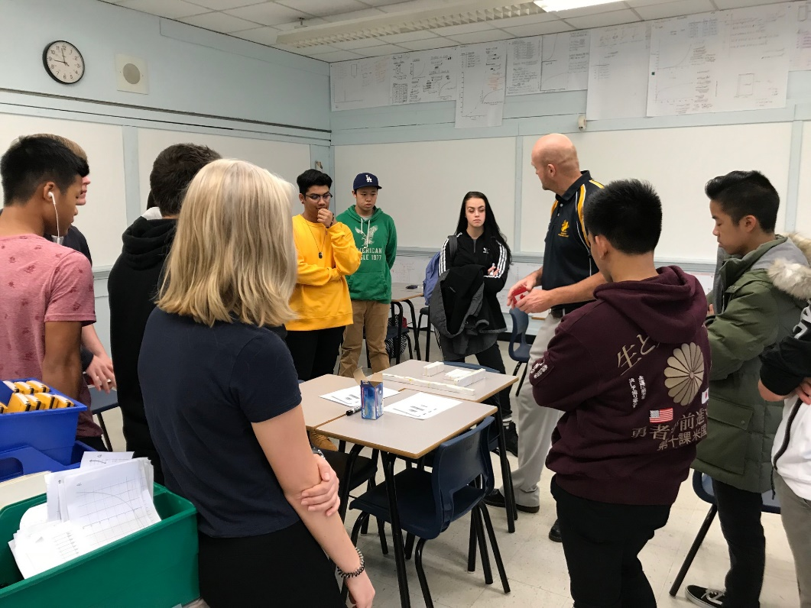
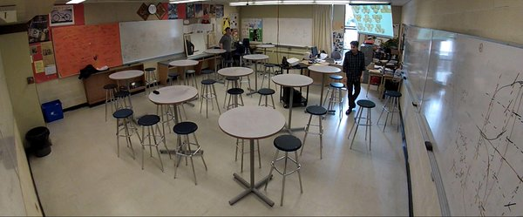
OPPORTUNITIES FOR THINKING |  | OPTIMAL PRACTICES FOR THINKING
1 | problems | begin lessons with good problems
2 | how we give the problem | use verbal instructions
3 | how we answer questions | answer only keep thinking questions
4 | room organization
5 | how groups are formed
6 | student work space
7 | autonomy
8 | how we give notes
9 | what homework looks like
10 | hints and extensions
11 | how we level
12 | formative assessment
13 | summative assessment
14 | reporting out

Slide 22
OPPORTUNITIES FOR THINKING |  | OPTIMAL PRACTICES FOR THINKING
1 | problems | begin lessons with good problems
2 | how we give the problem | use verbal instructions
3 | how we answer questions | answer only keep thinking questions
4 | room organization | defront the classroom
5 | how groups are formed
6 | student work space
7 | autonomy
8 | how we give notes
9 | what homework looks like
10 | hints and extensions
11 | how we level
12 | formative assessment
13 | summative assessment
14 | reporting out

Slide 23
OPPORTUNITIES FOR THINKING |  | OPTIMAL PRACTICES FOR THINKING
1 | problems | begin lessons with good problems
2 | how we give the problem | use verbal instructions
3 | how we answer questions | answer only keep thinking questions
4 | room organization | defront the classroom
5 | how groups are formed
6 | student work space
7 | autonomy
8 | how we give notes
9 | what homework looks like
10 | hints and extensions
11 | how we level
12 | formative assessment
13 | summative assessment
14 | reporting out

Slide 24
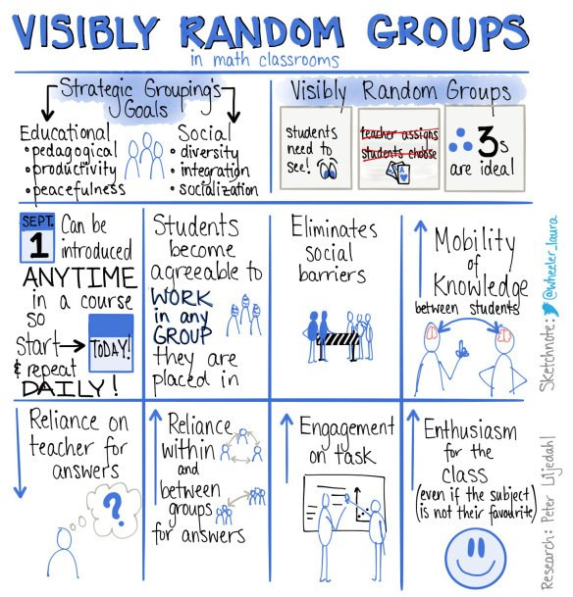
OPPORTUNITIES FOR THINKING |  | OPTIMAL PRACTICES FOR THINKING
1 | problems | begin lessons with good problems
2 | how we give the problem | use verbal instructions
3 | how we answer questions | answer only keep thinking questions
4 | room organization | defront the classroom
5 | how groups are formed | form visibly random groups
6 | student work space
7 | autonomy
8 | how we give notes
9 | what homework looks like
10 | hints and extensions
11 | how we level
12 | formative assessment
13 | summative assessment
14 | reporting out

Slide 25
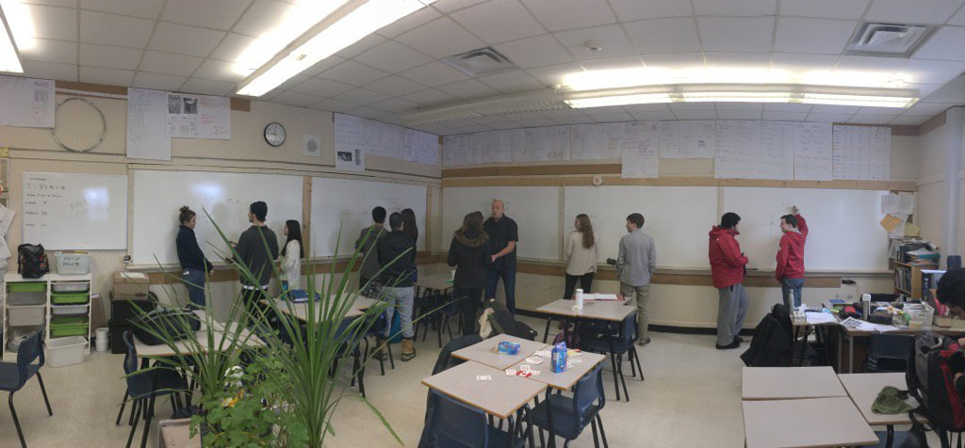
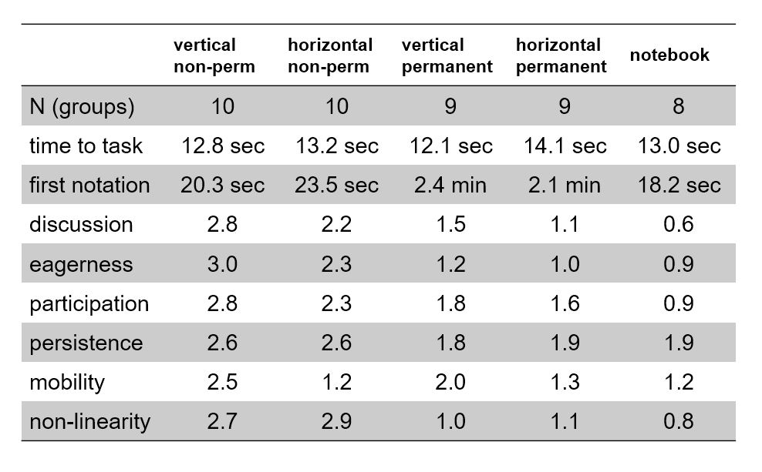
OPPORTUNITIES FOR THINKING |  | OPTIMAL PRACTICES FOR THINKING
1 | problems | begin lessons with good problems
2 | how we give the problem | use verbal instructions
3 | how we answer questions | answer only keep thinking questions
4 | room organization | defront the classroom
5 | how groups are formed | form visibly random groups
6 | student work space
7 | autonomy
8 | how we give notes
9 | what homework looks like
10 | hints and extensions
11 | how we level
12 | formative assessment
13 | summative assessment
14 | reporting out

Slide 26
OPPORTUNITIES FOR THINKING |  | OPTIMAL PRACTICES FOR THINKING
1 | problems | begin lessons with good problems
2 | how we give the problem | use verbal instructions
3 | how we answer questions | answer only keep thinking questions
4 | room organization | defront the classroom
5 | how groups are formed | form visibly random groups
6 | student work space | use vertical non-permanent surfaces
7 | autonomy
8 | how we give notes
9 | what homework looks like
10 | hints and extensions
11 | how we level
12 | formative assessment
13 | summative assessment
14 | reporting out

Slide 27
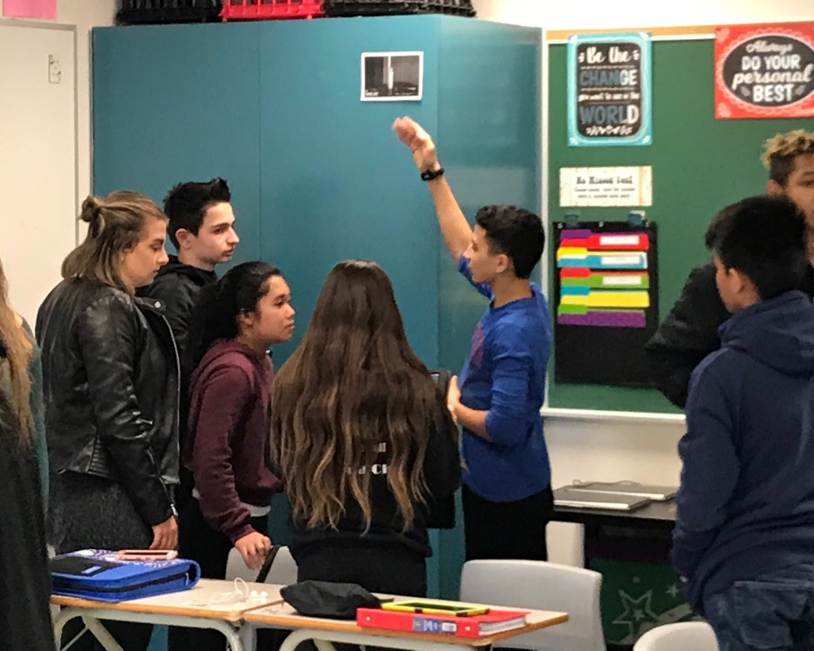
OPPORTUNITIES FOR THINKING |  | OPTIMAL PRACTICES FOR THINKING
1 | problems | begin lessons with good problems
2 | how we give the problem | use verbal instructions
3 | how we answer questions | answer only keep thinking questions
4 | room organization | defront the classroom
5 | how groups are formed | form visibly random groups
6 | student work space | use vertical non-permanent surfaces
7 | autonomy
8 | how we give notes
9 | what homework looks like
10 | hints and extensions
11 | how we level
12 | formative assessment
13 | summative assessment
14 | reporting out

Slide 28
OPPORTUNITIES FOR THINKING |  | OPTIMAL PRACTICES FOR THINKING
1 | problems | begin lessons with good problems
2 | how we give the problem | use verbal instructions
3 | how we answer questions | answer only keep thinking questions
4 | room organization | defront the classroom
5 | how groups are formed | form visibly random groups
6 | student work space | use vertical non-permanent surfaces
7 | autonomy | foster autonomous actions
8 | how we give notes
9 | what homework looks like
10 | hints and extensions
11 | how we level
12 | formative assessment
13 | summative assessment
14 | reporting out

Slide 29
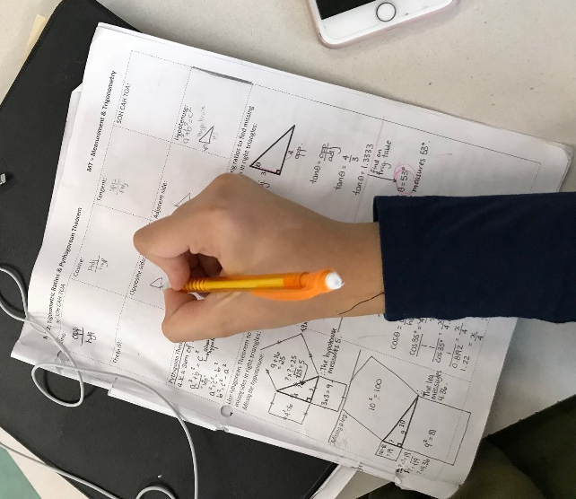
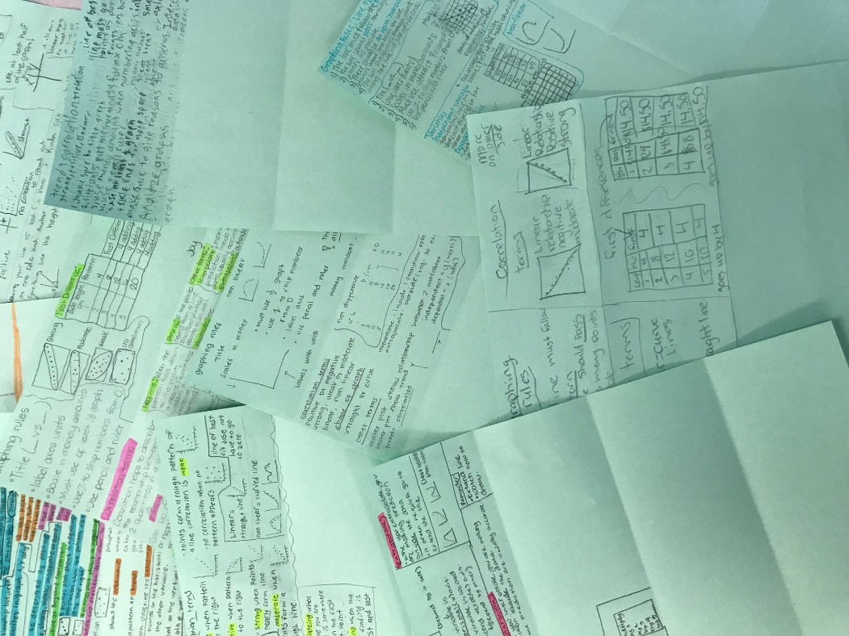
OPPORTUNITIES FOR THINKING |  | OPTIMAL PRACTICES FOR THINKING
1 | problems | begin lessons with good problems
2 | how we give the problem | use verbal instructions
3 | how we answer questions | answer only keep thinking questions
4 | room organization | defront the classroom
5 | how groups are formed | form visibly random groups
6 | student work space | use vertical non-permanent surfaces
7 | autonomy | foster autonomous actions
8 | how we give notes
9 | what homework looks like
10 | hints and extensions
11 | how we level
12 | formative assessment
13 | summative assessment
14 | reporting out

Slide 30
OPPORTUNITIES FOR THINKING |  | OPTIMAL PRACTICES FOR THINKING
1 | problems | begin lessons with good problems
2 | how we give the problem | use verbal instructions
3 | how we answer questions | answer only keep thinking questions
4 | room organization | defront the classroom
5 | how groups are formed | form visibly random groups
6 | student work space | use vertical non-permanent surfaces
7 | autonomy | foster autonomous actions
8 | how we give notes | have students do meaningful notes
9 | what homework looks like
10 | hints and extensions
11 | how we level
12 | formative assessment
13 | summative assessment
14 | reporting out

Slide 31
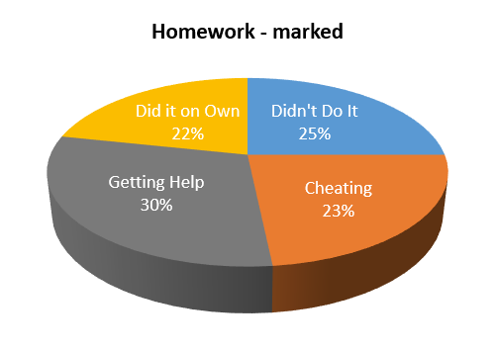
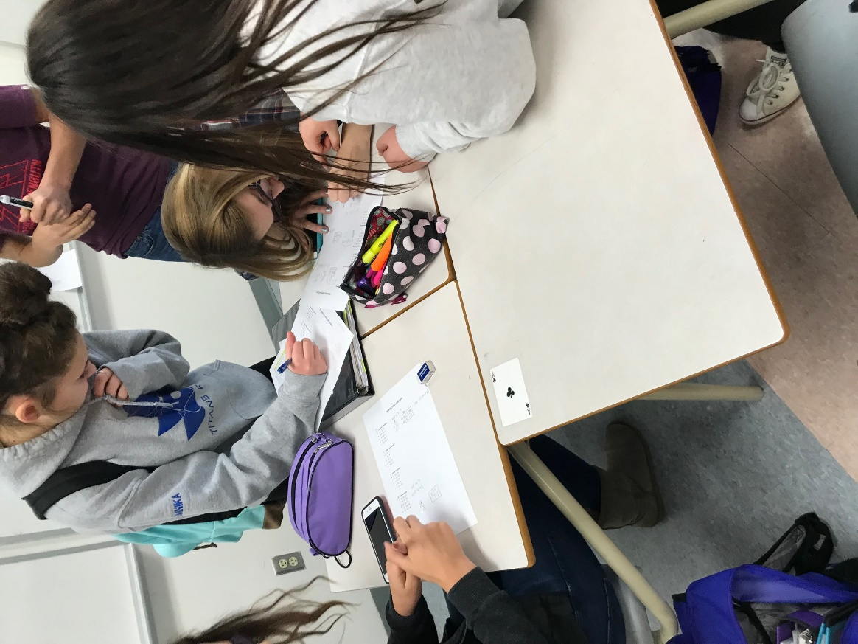
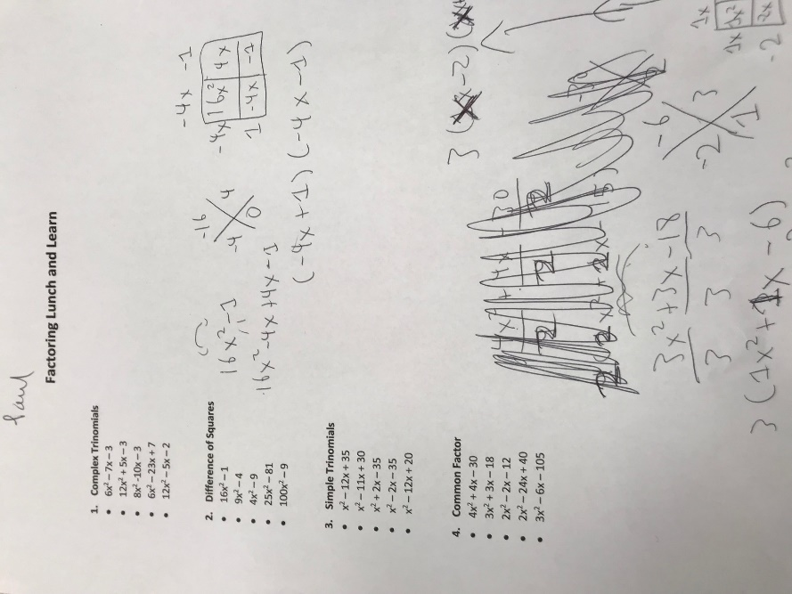
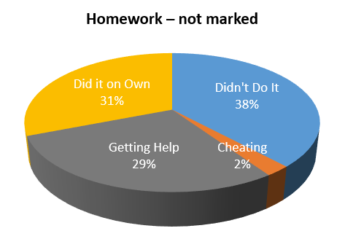
OPPORTUNITIES FOR THINKING |  | OPTIMAL PRACTICES FOR THINKING
1 | problems | begin lessons with good problems
2 | how we give the problem | use verbal instructions
3 | how we answer questions | answer only keep thinking questions
4 | room organization | defront the classroom
5 | how groups are formed | form visibly random groups
6 | student work space | use vertical non-permanent surfaces
7 | autonomy | foster autonomous actions
8 | how we give notes | have students do meaningful notes
9 | what homework looks like
10 | hints and extensions
11 | how we level
12 | formative assessment
13 | summative assessment
14 | reporting out

Slide 32
OPPORTUNITIES FOR THINKING |  | OPTIMAL PRACTICES FOR THINKING
1 | problems | begin lessons with good problems
2 | how we give the problem | use verbal instructions
3 | how we answer questions | answer only keep thinking questions
4 | room organization | defront the classroom
5 | how groups are formed | form visibly random groups
6 | student work space | use vertical non-permanent surfaces
7 | autonomy | foster autonomous actions
8 | how we give notes | have students do meaningful notes
9 | what homework looks like | use check your understanding questions
10 | hints and extensions
11 | how we level
12 | formative assessment
13 | summative assessment
14 | reporting out

Slide 33
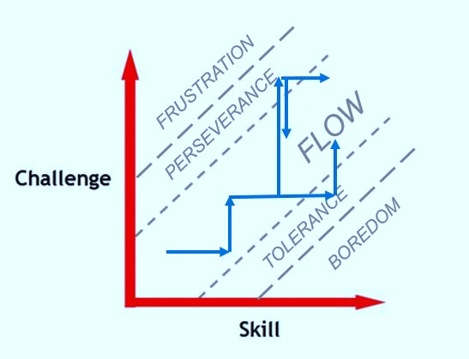
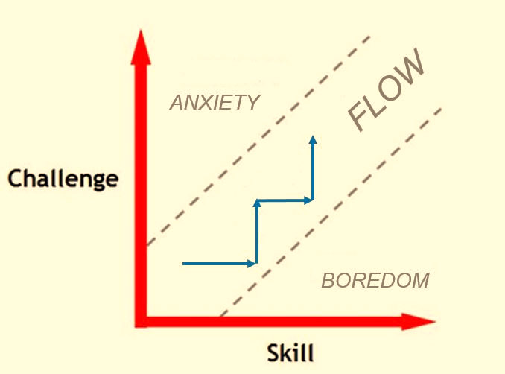
OPPORTUNITIES FOR THINKING |  | OPTIMAL PRACTICES FOR THINKING
1 | problems | begin lessons with good problems
2 | how we give the problem | use verbal instructions
3 | how we answer questions | answer only keep thinking questions
4 | room organization | defront the classroom
5 | how groups are formed | form visibly random groups
6 | student work space | use vertical non-permanent surfaces
7 | autonomy | foster autonomous actions
8 | how we give notes | have students do meaningful notes
9 | what homework looks like | use check your understanding questions
10 | hints and extensions
11 | how we level
12 | formative assessment
13 | summative assessment
14 | reporting out

Slide 34
OPPORTUNITIES FOR THINKING |  | OPTIMAL PRACTICES FOR THINKING
1 | problems | begin lessons with good problems
2 | how we give the problem | use verbal instructions
3 | how we answer questions | answer only keep thinking questions
4 | room organization | defront the classroom
5 | how groups are formed | form visibly random groups
6 | student work space | use vertical non-permanent surfaces
7 | autonomy | foster autonomous actions
8 | how we give notes | have students do meaningful notes
9 | what homework looks like | use check your understanding questions
10 | hints and extensions | manage flow
11 | how we level
12 | formative assessment
13 | summative assessment
14 | reporting out

Slide 35
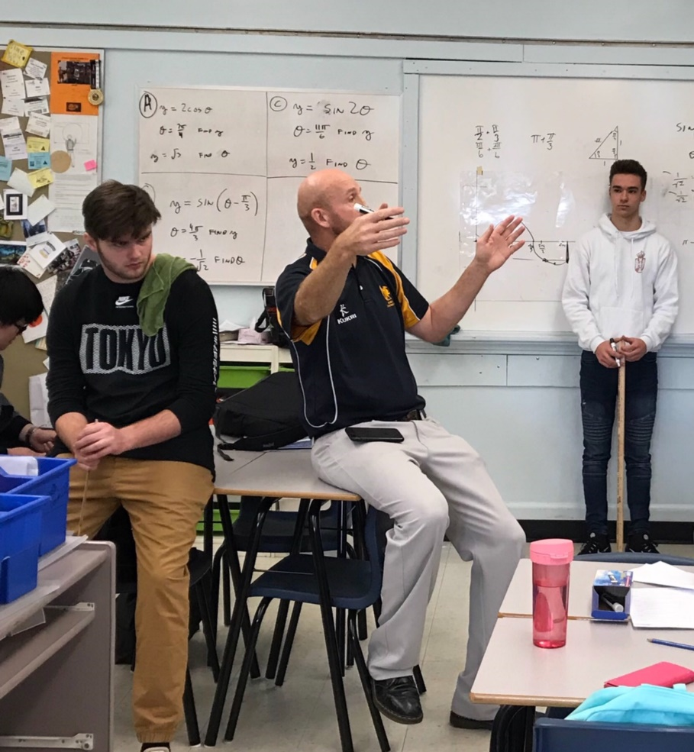
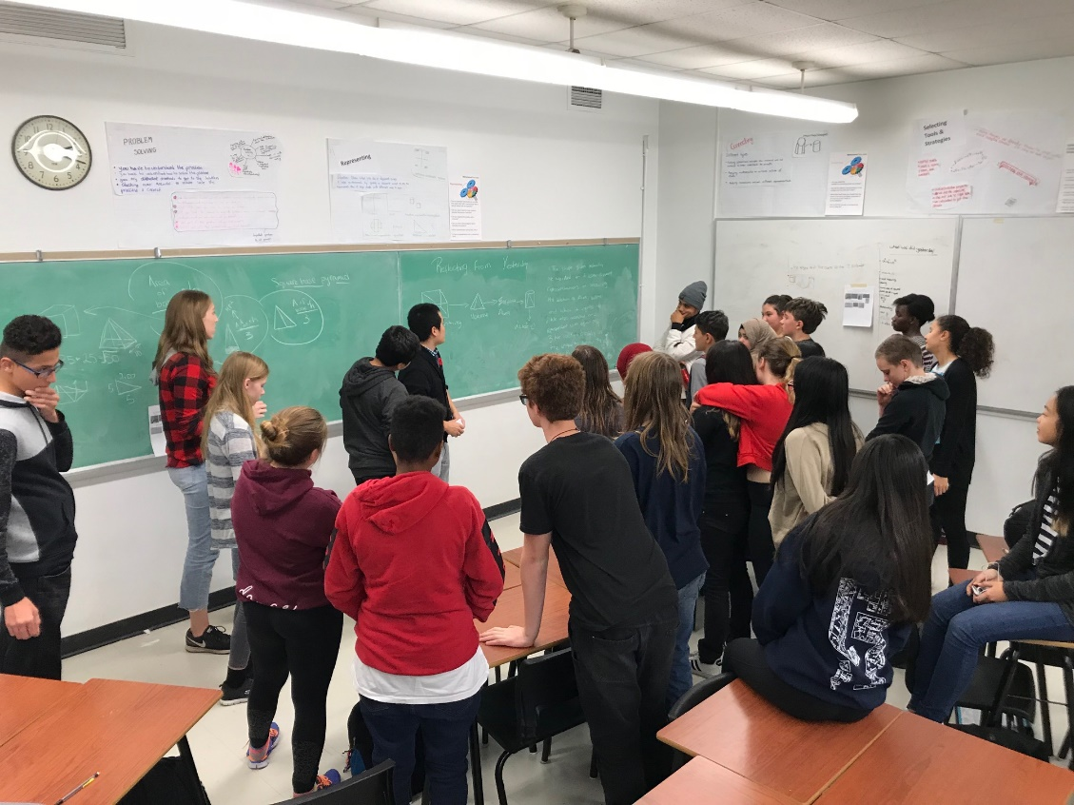
OPPORTUNITIES FOR THINKING |  | OPTIMAL PRACTICES FOR THINKING
1 | problems | begin lessons with good problems
2 | how we give the problem | use verbal instructions
3 | how we answer questions | answer only keep thinking questions
4 | room organization | defront the classroom
5 | how groups are formed | form visibly random groups
6 | student work space | use vertical non-permanent surfaces
7 | autonomy | foster autonomous actions
8 | how we give notes | have students do meaningful notes
9 | what homework looks like | use check your understanding questions
10 | hints and extensions | manage flow
11 | how we level
12 | formative assessment
13 | summative assessment
14 | reporting out

Slide 36
OPPORTUNITIES FOR THINKING |  | OPTIMAL PRACTICES FOR THINKING
1 | problems | begin lessons with good problems
2 | how we give the problem | use verbal instructions
3 | how we answer questions | answer only keep thinking questions
4 | room organization | defront the classroom
5 | how groups are formed | form visibly random groups
6 | student work space | use vertical non-permanent surfaces
7 | autonomy | foster autonomous actions
8 | how we give notes | have students do meaningful notes
9 | what homework looks like | use check your understanding questions
10 | hints and extensions | manage flow
11 | how we level | level to the bottom
12 | formative assessment
13 | summative assessment
14 | reporting out

Slide 37
OPPORTUNITIES FOR THINKING |  | OPTIMAL PRACTICES FOR THINKING
1 | problems | begin lessons with good problems
2 | how we give the problem | use verbal instructions
3 | how we answer questions | answer only keep thinking questions
4 | room organization | defront the classroom
5 | how groups are formed | form visibly random groups
6 | student work space | use vertical non-permanent surfaces
7 | autonomy | foster autonomous actions
8 | how we give notes | have students do meaningful notes
9 | what homework looks like | use check your understanding questions
10 | hints and extensions | manage flow
11 | how we level | level to the bottom
12 | formative assessment
13 | summative assessment
14 | reporting out

Slide 38
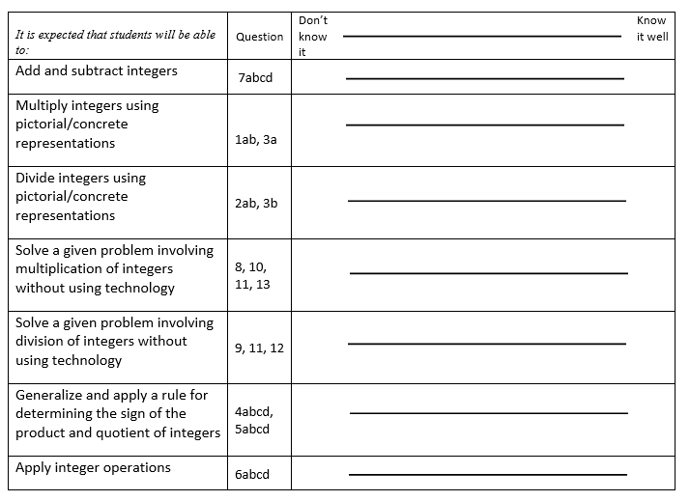
OPPORTUNITIES FOR THINKING |  | OPTIMAL PRACTICES FOR THINKING
1 | problems | begin lessons with good problems
2 | how we give the problem | use verbal instructions
3 | how we answer questions | answer only keep thinking questions
4 | room organization | defront the classroom
5 | how groups are formed | form visibly random groups
6 | student work space | use vertical non-permanent surfaces
7 | autonomy | foster autonomous actions
8 | how we give notes | have students do meaningful notes
9 | what homework looks like | use check your understanding questions
10 | hints and extensions | manage flow
11 | how we level | level to the bottom
12 | formative assessment
13 | summative assessment
14 | reporting out

Slide 39
OPPORTUNITIES FOR THINKING |  | OPTIMAL PRACTICES FOR THINKING
1 | problems | begin lessons with good problems
2 | how we give the problem | use verbal instructions
3 | how we answer questions | answer only keep thinking questions
4 | room organization | defront the classroom
5 | how groups are formed | form visibly random groups
6 | student work space | use vertical non-permanent surfaces
7 | autonomy | foster autonomous actions
8 | how we give notes | have students do meaningful notes
9 | what homework looks like | use check your understanding questions
10 | hints and extensions | manage flow
11 | how we level | level to the bottom
12 | formative assessment | show where they are and where they are going
13 | summative assessment
14 | reporting out

Slide 40
OPPORTUNITIES FOR THINKING |  | OPTIMAL PRACTICES FOR THINKING
1 | problems | begin lessons with good problems
2 | how we give the problem | use verbal instructions
3 | how we answer questions | answer only keep thinking questions
4 | room organization | defront the classroom
5 | how groups are formed | form visibly random groups
6 | student work space | use vertical non-permanent surfaces
7 | autonomy | foster autonomous actions
8 | how we give notes | have students do meaningful notes
9 | what homework looks like | use check your understanding questions
10 | hints and extensions | manage flow
11 | how we level | level to the bottom
12 | formative assessment | show where they are and where they are going
13 | summative assessment
14 | reporting out

Slide 41
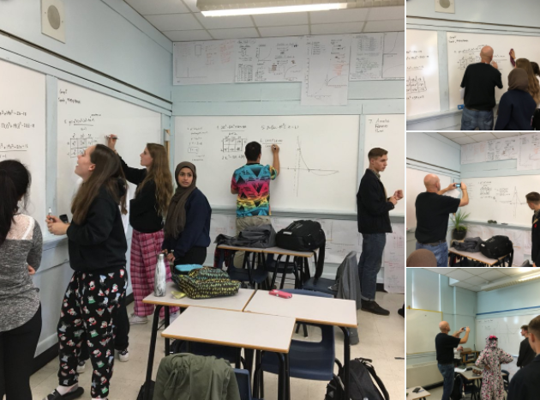
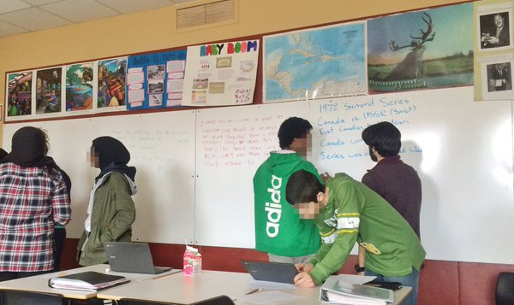
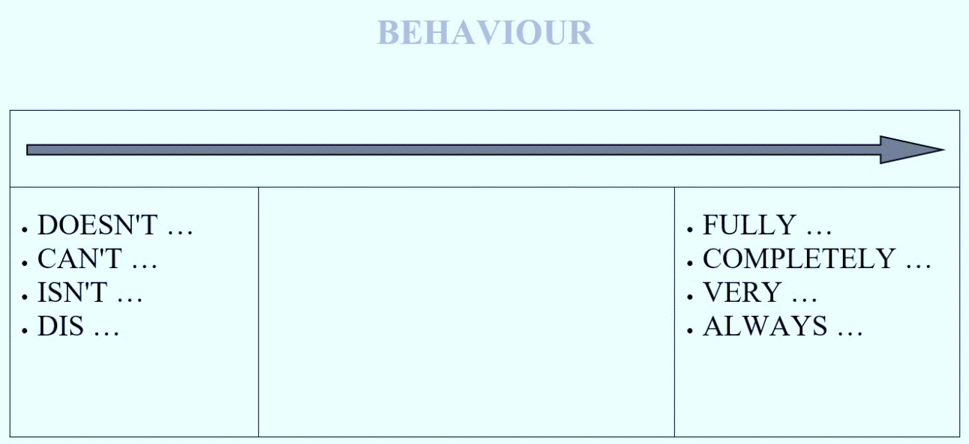
OPPORTUNITIES FOR THINKING |  | OPTIMAL PRACTICES FOR THINKING
1 | problems | begin lessons with good problems
2 | how we give the problem | use verbal instructions
3 | how we answer questions | answer only keep thinking questions
4 | room organization | defront the classroom
5 | how groups are formed | form visibly random groups
6 | student work space | use vertical non-permanent surfaces
7 | autonomy | foster autonomous actions
8 | how we give notes | have students do meaningful notes
9 | what homework looks like | use check your understanding questions
10 | hints and extensions | manage flow
11 | how we level | level to the bottom
12 | formative assessment | show where they are and where they are going
13 | summative assessment | evaluate what you value
14 | reporting out

Slide 42
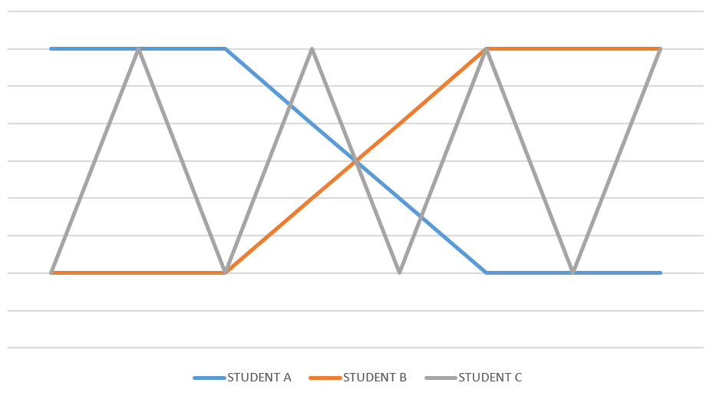
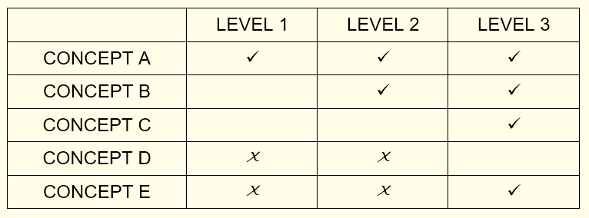
OPPORTUNITIES FOR THINKING |  | OPTIMAL PRACTICES FOR THINKING
1 | problems | begin lessons with good problems
2 | how we give the problem | use verbal instructions
3 | how we answer questions | answer only keep thinking questions
4 | room organization | defront the classroom
5 | how groups are formed | form visibly random groups
6 | student work space | use vertical non-permanent surfaces
7 | autonomy | foster autonomous actions
8 | how we give notes | have students do meaningful notes
9 | what homework looks like | use check your understanding questions
10 | hints and extensions | manage flow
11 | how we level | level to the bottom
12 | formative assessment | show where they are and where they are going
13 | summative assessment | evaluate what you value
14 | reporting out

Slide 43
OPPORTUNITIES FOR THINKING |  | OPTIMAL PRACTICES FOR THINKING
1 | problems | begin lessons with good problems
2 | how we give the problem | use verbal instructions
3 | how we answer questions | answer only keep thinking questions
4 | room organization | defront the classroom
5 | how groups are formed | form visibly random groups
6 | student work space | use vertical non-permanent surfaces
7 | autonomy | foster autonomous actions
8 | how we give notes | have students do meaningful notes
9 | what homework looks like | use check your understanding questions
10 | hints and extensions | manage flow
11 | how we level | level to the bottom
12 | formative assessment | show where they are and where they are going
13 | summative assessment | evaluate what you value
14 | reporting out | report out based on data (not points)

Slide 44
OPPORTUNITIES FOR THINKING |  | OPTIMAL PRACTICES FOR THINKING
1 | problems | begin lessons with good problems
2 | how we give the problem | use verbal instructions
3 | how we answer questions | answer only keep thinking questions
4 | room organization | defront the classroom
5 | how groups are formed | form visibly random groups
6 | student work space | use vertical non-permanent surfaces
7 | autonomy | foster autonomous actions
8 | how we give notes | have students do meaningful notes
9 | what homework looks like | use check your understanding questions
10 | hints and extensions | manage flow
11 | how we level | level to the bottom
12 | formative assessment | show where they are and where they are going
13 | summative assessment | evaluate what you value
14 | reporting out | report out based on data (not points)

Slide 45
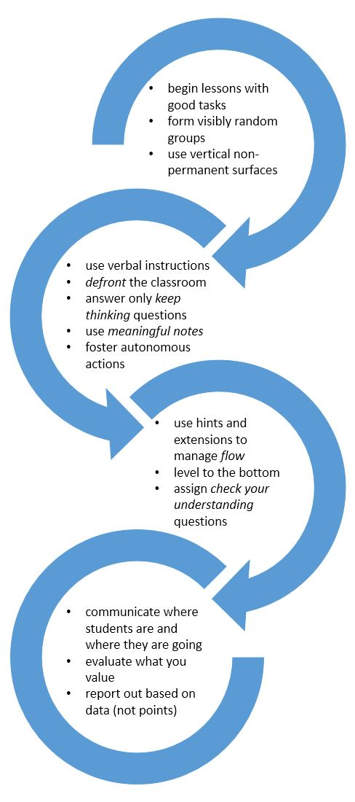
HIERARCHY OF IMPLEMENTATION

Slide 46
begin lessons with good problems
form visibly random groups
use vertical non-permanent surfaces

Slide 47
use verbal instructions
defront the classroom
answer only keep thinking questions
use meaningful notes
foster autonomous actions

Slide 48
use hints and extensions to manage flow
level to the bottom
assign check your understanding questions

Slide 49
communicate where students are and where they are going
evaluate what you value
report out based on data (not points)

Slide 50
BUILDING THINKING CLASSROOMS
(year 1)

Slide 51
begin with good problems
use vertical non-permanent surfaces
form visibly random groups
use verbal instructions
defront the classroom
answer only keep thinking questions
build autonomy
level to the bottom
use hints and extensions to manage flow
BUILDING THINKING CLASSROOMS
(year 2+)
give check your understanding questions
use mindful notes
communicate where a student is and where they are going
evaluate what you value
report out based on data (not points)

Slide 52
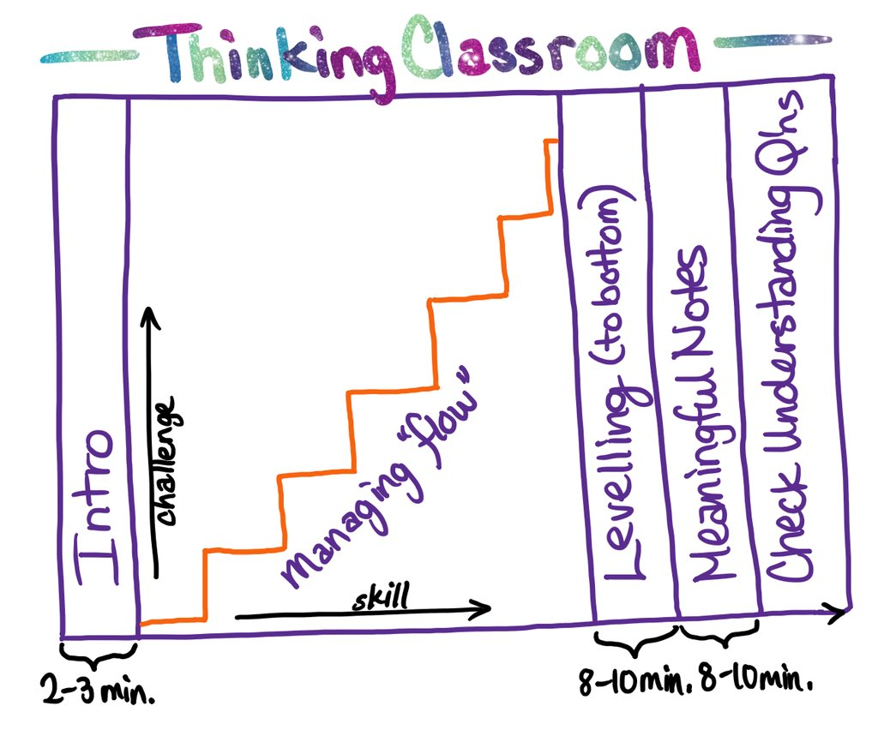

Slide 53
THANK YOU!
liljedahl@sfu.ca
www.peterliljedahl.com/presentations
@pgliljedahl | #vnps | #thinkingclassroom
Global Math Department

