Slide 1
Responsible
Curious
Self-directed
Challenges the teacher
Sees school as an opportunity
Critical thinkers
Risk takers
Hard working
Reflective
Self awareness
Good sense of humour
Basic human kindness
Passion drive to succeed
Elicits discussion
Good work ethic
Works well with others
Thinkers
Good communicators

Slide 2
CONCEPTUALIZING AND ACTUALIZING THE NEW CURRICULUM
Peter Liljedahl

Slide 3
BC Curriculum Revisions
1968ish → what
1976ish → what
1984ish → what + how
1994ish → what + how
2003ish → what + how
2008ish → what + how
2015ish → how+ what

Slide 4
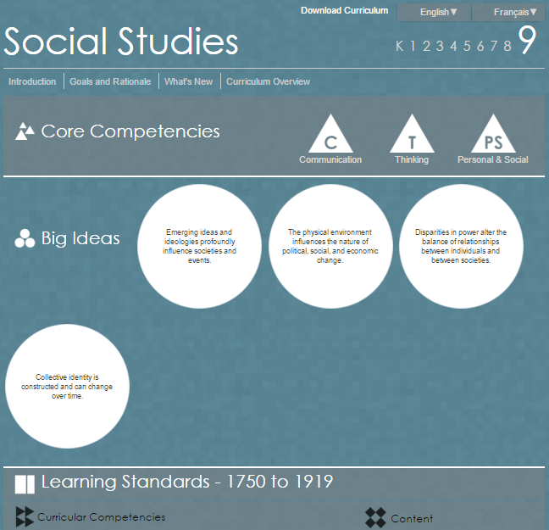

Slide 6
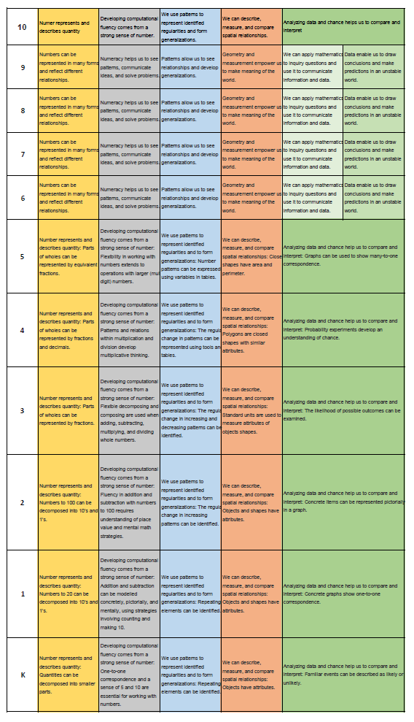

Slide 8
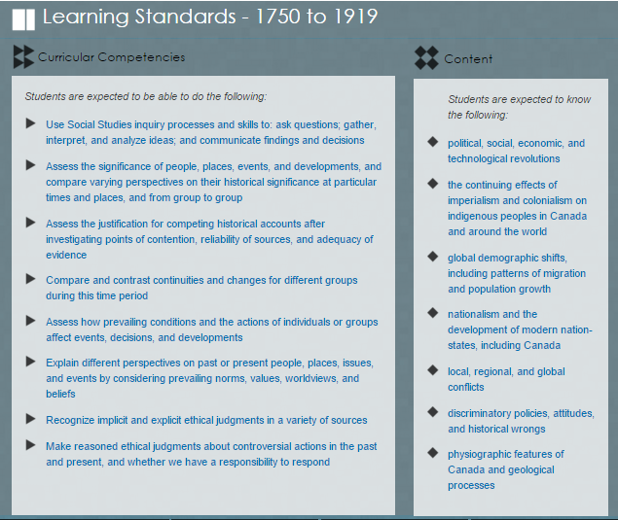

Slide 9
MATHEMATICS 1 Foundations and Pre-Calculus
Reasoning and analyzing
Inductively and deductively reason and use logic to explore, make connections, predict, analyze, generalize, and make conclusions
Estimate
Develop and apply mental math strategies
Use tools {appropriate technology) to explore and create patterns, examine relationships, and test conjectures
Understanding and solving
Implement multiple strategies to solve problems in both abstract and real-life situations using different cultural perspectives
Develop, construct, and apply mathematical understanding through play, inquiry, and problem solving
Communicating and representing
Use mathematical vocabulary and language to contribute to mathematical discussions
Communicate in a variety of ways
Explain, clarify, and justify mathematical ideas
Develop mathematical understanding through concrete, pictorial, and symbolic representations
Use technology appropriately to record, communicate, and represent thinking
Connecting and reflecting
Visualize and describe mathematical concepts
Explore, apply, and connect mathematical concepts to each other and make mathematical connections to other disciplines and the real world
Use dynamic visualizations to explore geometric and graphical relationships
Use mathematical arguments to support personal choices and recognize the consequences
Apply cultural perspectives of First Peoples to the concepts of locating, measuring, and numbering
strategies to solve puzzles and win games
primary trigonometric ratios
metric and imperial measurement conversions
analysis of measures of central tendency, including outliers
experimental probability
income, including taxes and deductions
savings and compound interest
area and volume
relations among data, graphs, and situations
powers with integral exponents
multiplication of polynomial expressions
common factors and trinomial factoring
linear equations with rational coefficients
linear relations

Slide 10
SCIENCE 9
Questioning and predicting
Demonstrate a sustained intellectual curiosity about a scientific topic or problem of personal interest
Make observations aimed at identifying their own questions, including increasingly abstract ones, about the natural world
Formulate multiple hypotheses and predict multiple outcomes
Planning and conducting
Collaboratively and personally plan, select, and use appropriate investigation methods, including field work and lab experiments, to collect reliable data (qualitative and quantitative)
Assess risks and address ethical issues associated with their proposed methods
Select and use appropriate equipment, including digital technologies, to systematically and accurately collect and record data
Processing and analyzing data and information
Experience and interpret the local environment
Seek and analyze patterns, trends, and connections in data, including describing relationships between variables and identifying inconsistencies
Use knowledge of scientific concepts to draw conclusions that are consistent with evidence
Analyze cause-and-effect relationships
Evaluating
Evaluate their methods and experimental conditions, including identifying sources of error or uncertainty, confounding variables, and possible alternative explanations and conclusions
Describe specific ways to improve their investigation methods and the quality of the data
Evaluate the validity of and limitations of a model or analogy in relation to the phenomenon modelled
Demonstrate an awareness of assumptions, question information given, and identify bias in their own work and secondary sources
Consider the changes in knowledge over time as tools and technologies have developed
Exercise a healthy, informed skepticism and use scientific knowledge and findings to form their own investigations to evaluate claims in secondary sources
Consider social, ethical, and environmental implications of the findings from their own and others’ investigations
Critically analyze the validity of information in secondary sources and evaluate the approaches used to solve problems
Applying and innovating
Contribute to care for self, others, community, and world through personal or collaborative approaches
Co-operatively design projects with local and/or global connections and applications
Transfer and apply learning to new situations
Generate and introduce new or refined ideas when problem solving
Contribute to finding solutions to problems at a local and/or global level through inquiry
Communicating
Formulate physical or mental theoretical models to describe a phenomenon
Communicate scientific ideas, information, and perhaps a suggested course of action for a specific purpose and audience, constructing evidence-based arguments and using appropriate scientific language, conventions, and representations
Express and reflect on a variety of experiences, perspectives, and worldviews of place
asexual reproduction:mitosis
different forms
sexual reproduction:meiosis
human sexual reproduction
element properties as organized in the periodic table
an element’s properties are related to the arrangement and energy of its electrons and to its atomic size
circuits — must be complete for electrons to flow
voltage, current, and resistance
effects of solar radiationon the cycling of matter and energy
matter cycles within biotic and abiotic components of ecosystems
sustainability of systems and First Peoples’ principles ofinterconnectedness

Slide 11
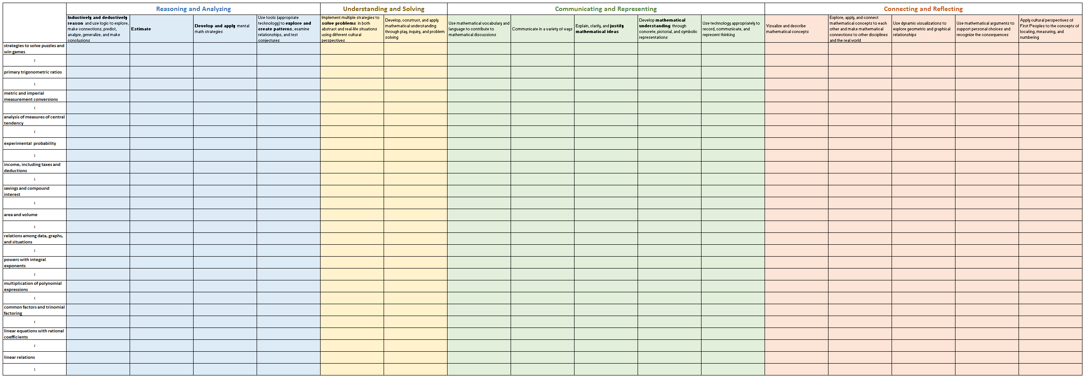
THINKOLOGY & LEARNIFICATION 9

Slide 12
TEACHING AT THE INTERSECTIONS Unintended Consequences

Slide 13
GOOD ACTIVITIES Then and Now

Slide 14
GOOD ACTIVITIES Then and Now

Slide 15
GOOD ACTIVITIES Then and Now

Slide 16
GOOD ACTIVITIES Then and Now
How did you estimate..?
Explain how the referent helped you…?
Is the total closer to 5 or 10?
When might you need to partition numbers?
What strategies did you use to solve the problem?
How would you justify your solution?
_________________________________________________________________
When you explored ways to …, how can you prove that you have the same ….?
When might you need to …?
How many ways..? Show your strategies.
How might you apply what you learned...?
Why did you choose a specific strategy?
_________________________________________________________________
What did you notice?
How could you represent you thinking (concretely, pictorially, symbolically)?
How would you explain the strategy you used?
Explain how you solved the problem.
Explain what you learned.
Draw a picture to show your thinking.
How would you describe your solution?
How would you model the concept and explain your thinking to others?
Describe and compare…
How would you interpret the relationships…?
Explain how you know… Why does this make sense?
Explore representing and describing … What did you notice?
How did you use technology to explore…?
How did you use technology to solve the problem?
How did you use technology to communicate and represent your thinking?
Express your thoughts about your discoveries.
_________________________________________________________________
How did you visualize to help solve the problem?
Describe what you visualized when you were solving the problem.
When might you use what you have learned?
How might this connect to other mathematical concepts?
How might you apply what you have learned?
Demonstrate how you know this can be applied to other situations.
How is this problem like something you solved before?

Slide 17
GOOD ACTIVITIES Then and Now
What did you notice?
How could you represent you thinking (concretely, pictorially, symbolically)?
How would you explain the strategy you used?
Explain how you solved the problem.
Explain what you learned.
Draw a picture to show your thinking.
How would you describe your solution?
How would you model the concept and explain your thinking to others?
Describe and compare…
How would you interpret the relationships…?
Explain how you know… Why does this make sense?
Explore representing and describing … What did you notice?
How did you use technology to explore…?
How did you use technology to solve the problem?
How did you use technology to communicate and represent your thinking?
Express your thoughts about your discoveries.

Slide 18
ASSESSMENT Then and Now

Slide 19
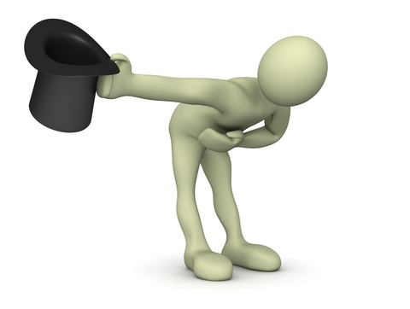
THANK YOU!
liljedahl@sfu.ca
www.peterliljedahl.com/presentations

