Slide 1
building thinking classrooms
- Peter Liljedahl & Mike Pruner

Slide 2
CULMINATION … SO FAR
Liljedahl, P. & Allan, D. (2013). Studenting: The case of "now you try one". Proceedings of the 37th Conference of the PME, Vol. 3, pp. 257-264. Kiel, Germany: PME.
Liljedahl, P. & Allan, D. (2013). Studenting: The Case of Homework. Proceedings of the 35th Conference for PME-NA. Chicago, USA.
Liljedahl, P. (in press). Building thinking classrooms: Conditions for problem solving. In P. Felmer, J. Kilpatrick, & E. Pekhonen (eds.) Posing and Solving Mathematical Problems: Advances and New Perspectives. New York, NY: Springer.
Liljedahl, P. (2014). The affordances of using visually random groups in a mathematics classroom. In Y. Li, E. Silver, & S. Li (eds.) Transforming Mathematics Instruction: Multiple Approaches and Practices. New York, NY: Springer.
[..]

Slide 3
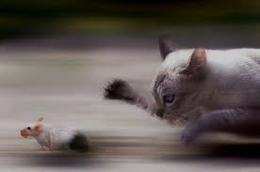
MS. AHN’S CLASS (2003)
If 6 cats can kill 6 rats in 6 minutes, how many cats are required to kill 100 rats in 50 minutes?
- Lewis Carroll

Slide 4
MS. AHN’S CLASS (2003)
If 6 cats can kill 6 rats in 6 minutes, how many cats are required to kill 100 rats in 50 minutes?
- Lewis Carroll
NOTHING!

Slide 5
CONTEXT OF RESEARCH
NOW YOU TRY ONE
HOMEWORK
TAKING NOTES
REVIEW
GROUP WORK
LECTURE
STATIONS

Slide 6
NOW YOU TRY ONE
n=32
STUDENTING
catching up on notes (n=0)

Slide 7
TAKING NOTES (n=30)
don’t keep up
n=16
don’t
n=3
yes
n=3
don’t use notes
n=27
USE NOTES TO STUDY

Slide 8
EARLY EFFORTS
just do it
teaching with problem solving
TASKS
teaching problem solving

Slide 9
EARLY EFFORTS
just do it
teaching with problem solving
some were able to do it
they needed a lot of help
they loved it
they don’t know how to work together
they got it quickly and didn't want to do any more
they gave up early
FILTERED THROUGH STUDENTS
TASKS
assessing problem solving

Slide 10
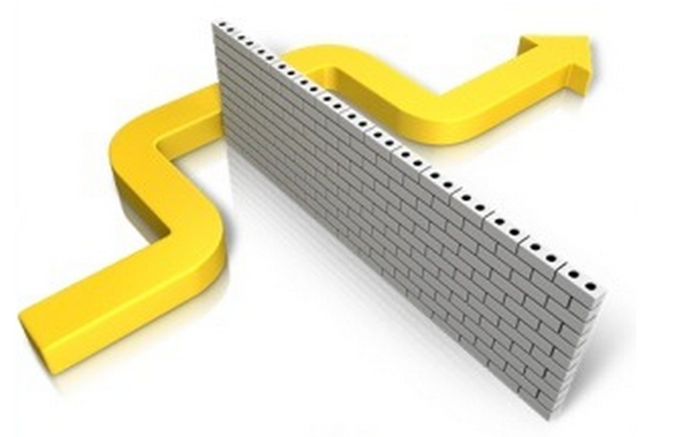
REALIZATION
STUDENT NORMS

Slide 11
REALIZATION
CLASSROOM NORMS

Slide 12
REALIZATION
INSTITUTIONAL NORMS

Slide 13
CASTING ABOUT (n = 300+)

Slide 14
THINGS I (WE) TRIED
tasks
hints and extensions
how we give the problem
how we answer questions
how we level
room organization
how groups are formed
student work space
how we give notes
assessment
…

Slide 15
FINDINGS
VARIABLE | POSITIVE EFFECT
tasks | good tasks
hints and extensions | managing flow
how we give the problem | oral vs. written
how we answer questions | 3 types of questions
how we level | level to the bottom
room organization | defronting the room
how groups are formed | visibly random groups
student work space | vertical non-permanent surfaces
how we give notes | don't
assessment | 3 purposes

Slide 16
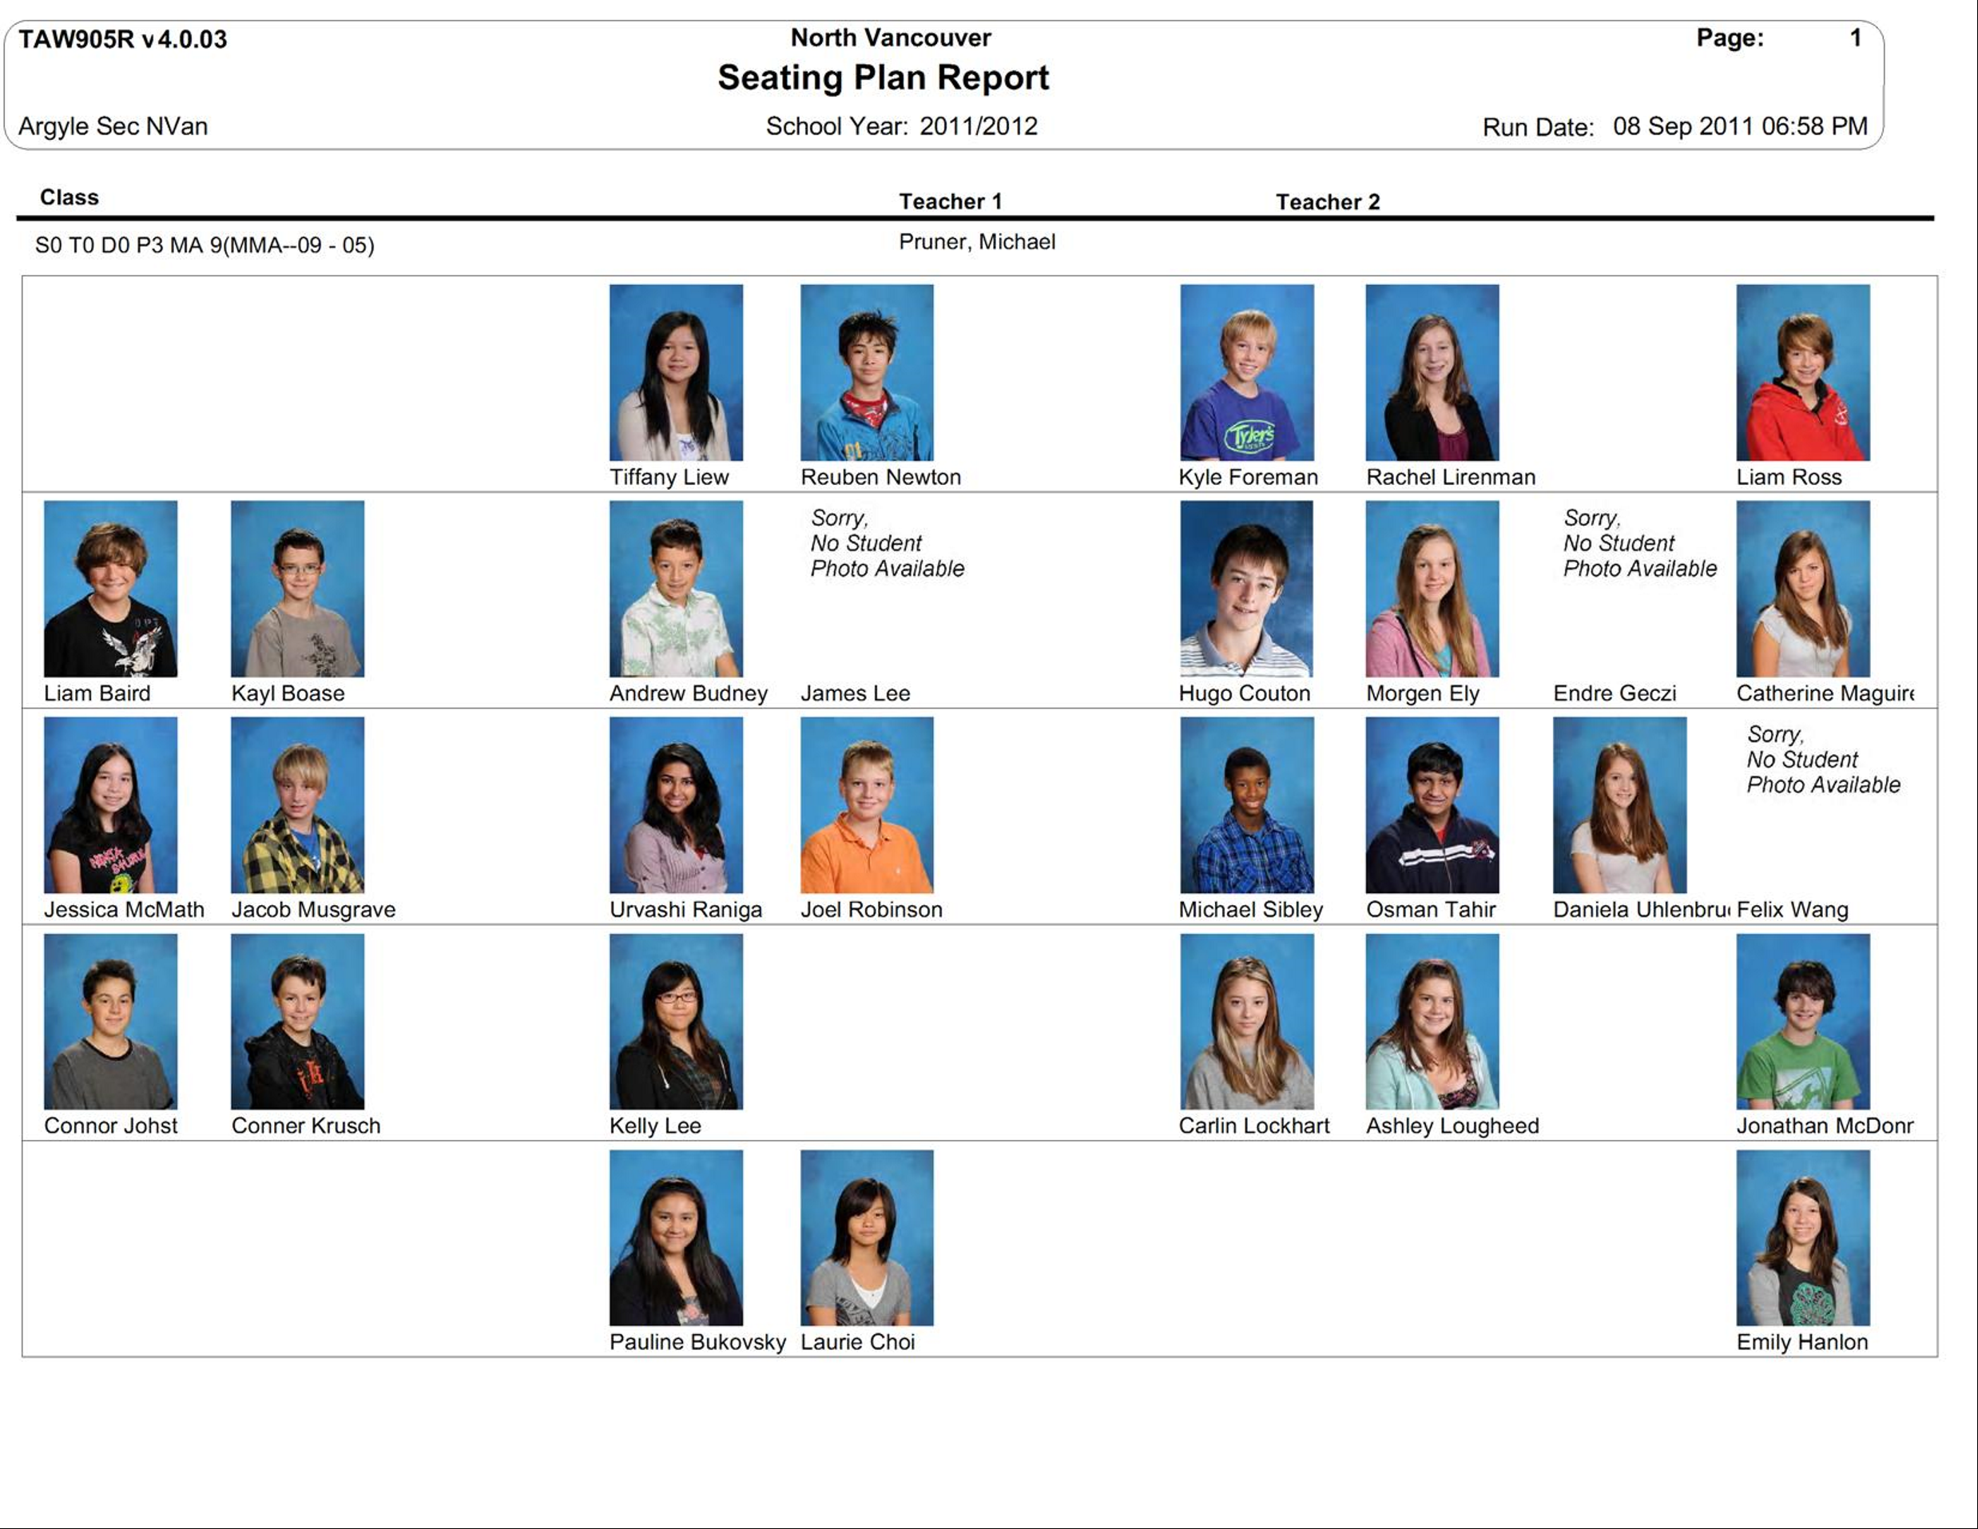

Slide 17
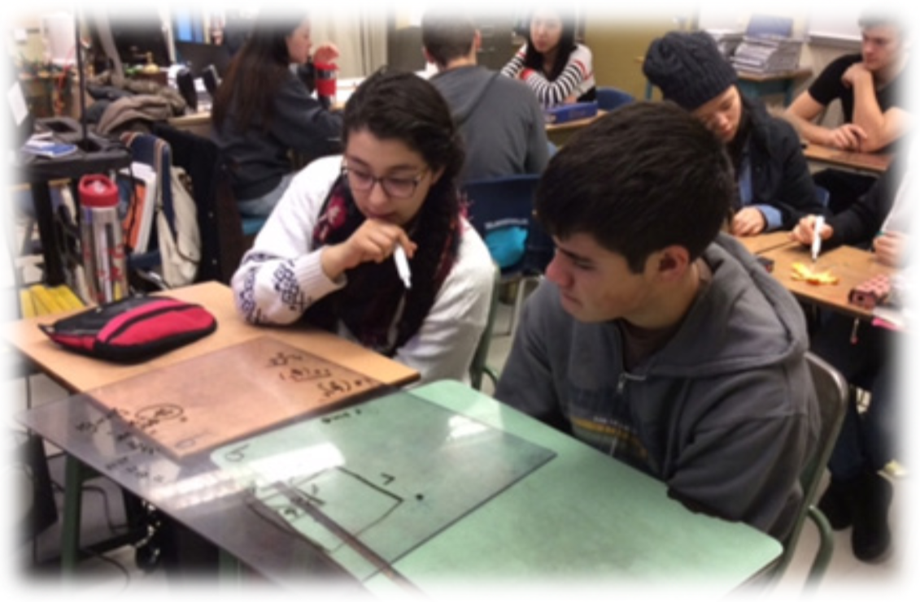
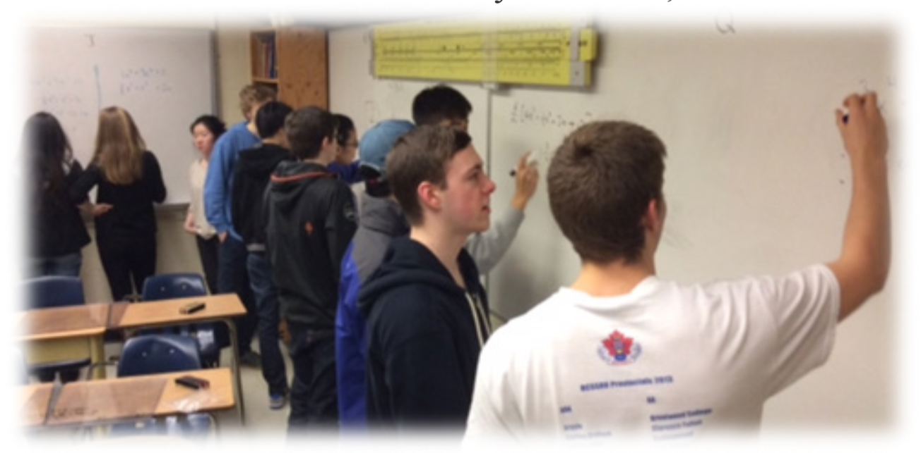

Slide 18
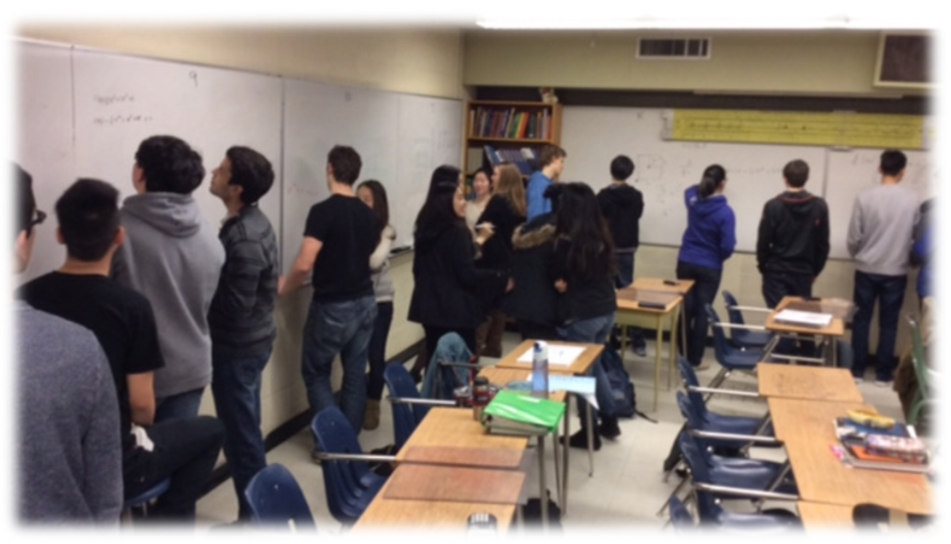

Slide 19
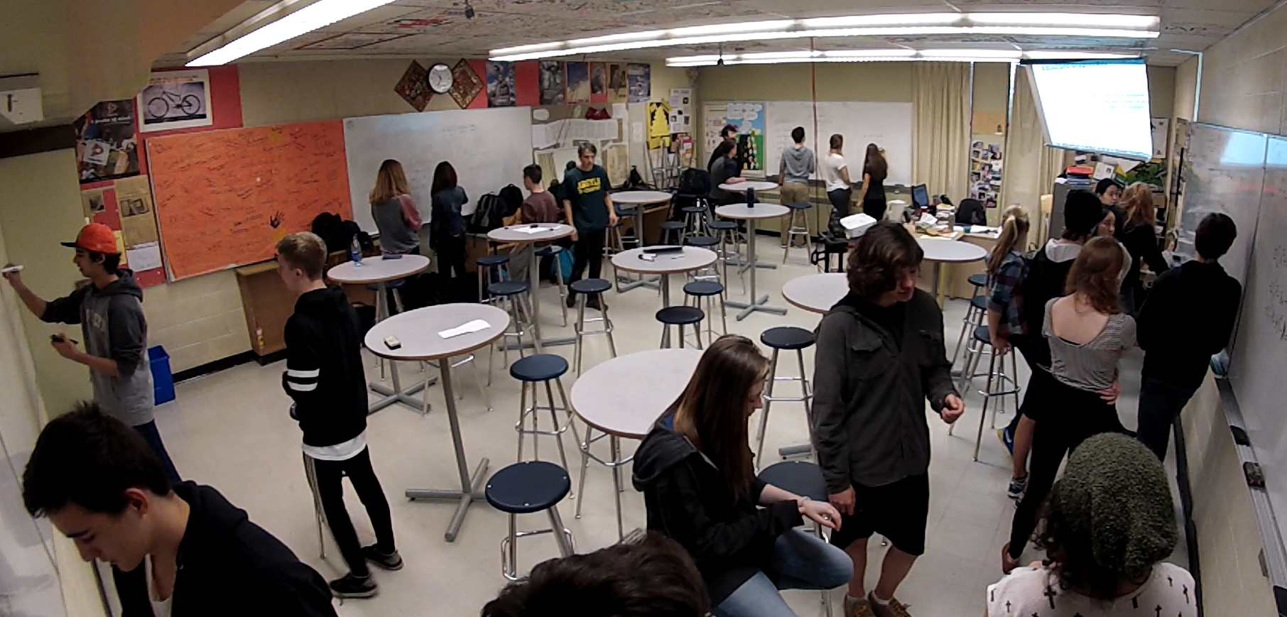

Slide 20
FINDINGS – BIGGEST IMPACT
levelling
assessment
flow
answering questions
oral instructions
defronting the room
good tasks
vertical non-permanent surfaces
visibly random groups

Slide 21
FINDINGS – BIGGEST IMPACT
levelling
assessment
flow
answering questions
oral instructions
defronting the room
good tasks
vertical non-permanent surfaces
visibly random groups

Slide 22
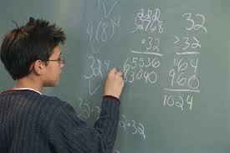
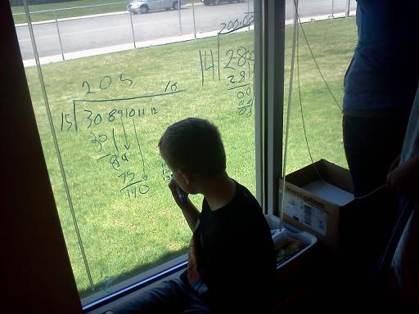
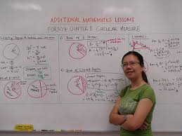
VERTICAL NON-PERMANENT SURFACES (VNPS)

Slide 23
EFFECT ON STUDENTS
PROXIES FOR ENGAGEMENT
time to task
time to first mathematical notation
amount of discussion
eagerness to start
participation
persistence
knowledge mobility
non-linearity of work
0 - 3

Slide 24
EFFECT ON STUDENTS
 | vertical non-perm | horizontal non-perm | vertical permanent | horizontal permanent | notebook
N (groups) | 10 | 10 | 9 | 9 | 8
time to task | 12.8 sec | 13.2 sec | 12.1 sec | 14.1 sec | 13.0 sec
first notation | 20.3 sec | 23.5 sec | 2.4 min | 2.1 min | 18.2 sec
discussion | 2.8 | 2.2 | 1.5 | 1.1 | 0.6
eagerness | 3.0 | 2.3 | 1.2 | 1.0 | 0.9
participation | 2.8 | 2.3 | 1.8 | 1.6 | 0.9
persistence | 2.6 | 2.6 | 1.8 | 1.9 | 1.9
mobility | 2.5 | 1.2 | 2.0 | 1.3 | 1.2
non-linearity | 2.7 | 2.9 | 1.0 | 1.1 | 0.8

Slide 25
EFFECT ON STUDENTS
 | vertical non-perm | horizontal non-perm | vertical permanent | horizontal permanent | notebook
N (groups) | 10 | 10 | 9 | 9 | 8
time to task | 12.8 sec | 13.2 sec | 12.1 sec | 14.1 sec | 13.0 sec
first notation | 20.3 sec | 23.5 sec | 2.4 min | 2.1 min | 18.2 sec
discussion | 2.8 | 2.2 | 1.5 | 1.1 | 0.6
eagerness | 3.0 | 2.3 | 1.2 | 1.0 | 0.9
participation | 2.8 | 2.3 | 1.8 | 1.6 | 0.9
persistence | 2.6 | 2.6 | 1.8 | 1.9 | 1.9
mobility | 2.5 | 1.2 | 2.0 | 1.3 | 1.2
non-linearity | 2.7 | 2.9 | 1.0 | 1.1 | 0.8

Slide 26
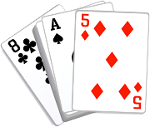
VISIBLY RANDOM GROUPS (VRG)

Slide 27
EFFECT ON STUDENTS
students become agreeable to work in any group they are placed in
there is an elimination of social barriers within the classroom
mobility of knowledge between students increases
reliance on co-constructed intra- and inter-group answers increases
reliance on the teacher for answers decreases
engagement in classroom tasks increase
students become more enthusiastic about mathematics class

Slide 28
TOGETHER

Slide 29
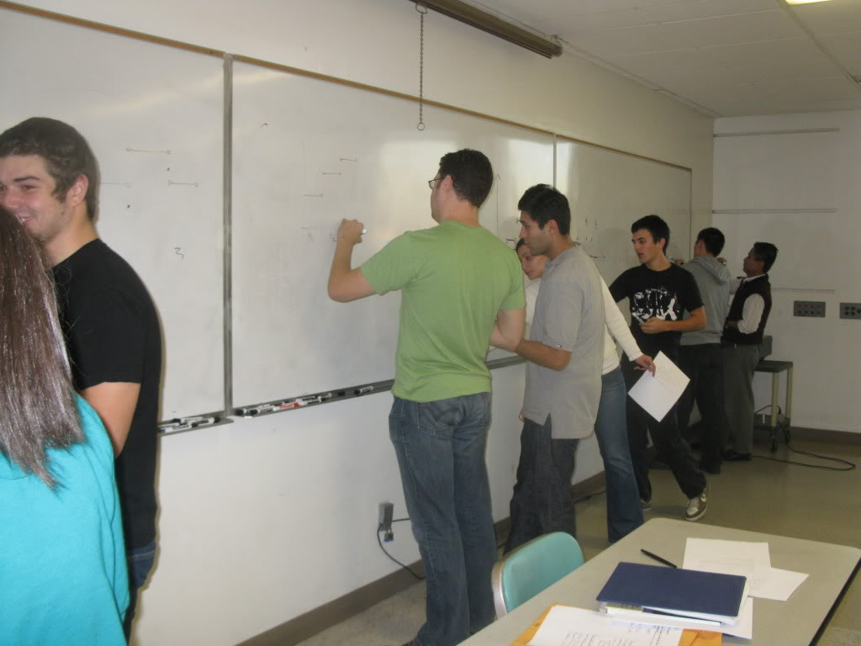
EFFECT ON STUDENTS

Slide 30
WHAT NEXT?
levelling
assessment
flow
answering questions
oral instructions
defronting the room
good tasks
vertical non-permanent surfaces
visibly random groups

Slide 31
WHAT NEXT?
assessment
PART 1 of 3
levelling
flow
answering questions
oral instructions
defronting the room
good tasks
vertical non-permanent surfaces
visibly random groups

Slide 32
THANK YOU!
liljedahl@sfu.ca mpruner@sd44.ca
www.peterliljedahl.com/presentations
#VNPS @cafedepruner

