Slide 1
POLITECNICO di MILANO PhD COURSE session II

Slide 2
http://www.peterliljedahl.com/courses/politecnicodimilano

Slide 3
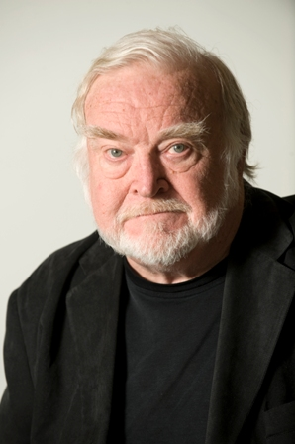
MIHALY CSÍKSZENTMIHÁLYI

Slide 4
FLOW EXPERIENCE
There are clear goals every step of the way.
There is immediate feedback on one’s actions.
There is a balance between challenges and skills.
Attention is focused on one’s actions.
Distractions are excluded from consciousness.
There is no worry of failure.
Self-consciousness disappears.
The sense of time becomes distorted.
The activity becomes satisfying in its own right.
- Csíkszentmihályi (1990)

Slide 5
FLOW EXPERIENCE - internal
There are clear goals every step of the way.
There is immediate feedback on one’s actions.
There is a balance between challenges and skills.
Attention is focused on one’s actions.
Distractions are excluded from consciousness.
There is no worry of failure.
Self-consciousness disappears.
The sense of time becomes distorted.
The activity becomes satisfying in its own right.
- Csíkszentmihályi (1990)

Slide 6
FLOW EXPERIENCE - external
There are clear goals every step of the way.
There is immediate feedback on one’s actions.
There is a balance between challenges and skills.
Attention is focused on one’s actions.
Distractions are excluded from consciousness.
There is no worry of failure.
Self-consciousness disappears.
The sense of time becomes distorted.
The activity becomes satisfying in its own right.
- Csíkszentmihályi (1990)

Slide 7
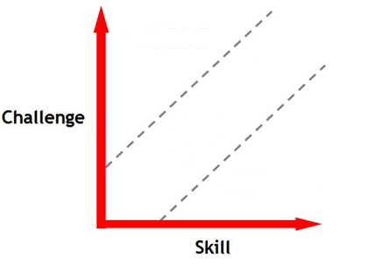
FLOW EXPERIENCE
There are clear goals every step of the way.
There is immediate feedback on one’s actions.
There is a balance between challenges and skills.
ANXIETY
FLOW
BOREDOM

Slide 8
FLOW EXPERIENCE
There are clear goals every step of the way.
There is immediate feedback on one’s actions.
There is a balance between challenges and skills.
ANXIETY
FLOW
= ENGAGEMENT
BOREDOM

Slide 9
FLOW EXPERIENCE
There are clear goals every step of the way.
There is immediate feedback on one’s actions.
There is a balance between challenges and skills.
- CREATING FLOW -

Slide 10
CREATING FLOW
FLOW
ANXIETY
BOREDOM

Slide 11
MANAGING FLOW
Give extension
Introduce doubt
Pair with another group
FLOW
ANXIETY
Remove a member of the group
Pair with another group
BOREDOM

Slide 12
MANAGING FLOW
Give hint
Join the group
Pair with a stronger group
FLOW
ANXIETY
Give an easier task
Answer some of the task
Give a hint
BOREDOM

Slide 13
STUDENTS SELF-MANAGING FLOW
FLOW
ANXIETY
BOREDOM

Slide 14
THEORIES OF LEARNING
meta-cognition
multiple intelligences (Gardner)
transfer
analogical reasoning (Novick)
critical incidents (Tripp)
variation theory (Mortens)
creeping determinism (Fischoff)
discourse
tensions (Berry)
thickening (Geertz)
empirical (Liljedahl)
affect / meta-affect (Goldin)
illumination (Liljedahl)
surprise (Adler)
flow (Csíkszentmihályi)
counter culture/norms (Liljedahl)
problem posing (Brown & Walters)
modelling
RME
learner generated examples (Watson & Mason)
problem solving

Slide 15
THEORIES OF LEARNING
meta-cognition
multiple intelligences (Gardner)
transfer
analogical reasoning (Novick)
critical incidents (Tripp)
variation theory (Mortens)
creeping determinism (Fischoff)
discourse
tensions (Berry)
thickening (Geertz)
empirical (Liljedahl) *
affect / meta-affect (Goldin)
illumination (Liljedahl)
surprise (Adler)
flow (Csíkszentmihályi) *
counter culture/norms (Liljedahl) *
problem posing (Brown & Walters) ←
modelling ←
RME ←
learner generated examples (Watson & Mason) * ←
problem solving (Polya) *
l * I will demonstrate
← theory for
l suitable for large classes
l well suited for teacher ed.

Slide 16
DIVERSE WORKSHOP OUTCOMES
POSSIBLE WORKSHOP OUTCOMES:
enjoy the learning experience
learn some things about teaching
convert a theory of learning into a theory for teaching
extract a theory for teaching from empirical work
define requirements of a theory for teaching
WORKSHOP EXPECTATION:
you will achieve at least two of the above outcomes
quick and dirty presentation on Wednesday afternoon

Slide 17
QUICK AND DIRTY PRESENTATION
N groups of 2-4
200/N minutes each
give a presentation on one of the following:
teach a lesson using interesting mathematics demonstrating your use of one of the theories for teaching demonstrated in the workshop thus far
teach a lesson on any topic by converting one of the theories of learning listed (or a different theory of learning) into a theory for teaching
present a new theory for teaching from some empirical work you may have done or data you may have access to
in the case of a) a brief introduction as to why you chose that theories for teaching is warranted
in the case of b) and c) a brief introduction to the theory of learning or theory of teaching (who, when what, etc. ) is warranted

Slide 18
http://www.peterliljedahl.com/courses/politecnicodimilano

