Slide 1
POLITECNICO di MILANO PhD COURSE session III

Slide 2
THEORIES OF LEARNING
meta-cognition
multiple intelligences (Gardner)
transfer
analogical reasoning (Novick)
critical incidents (Tripp)
variation theory (Mortens)
creeping determinism (Fischoff)
discourse
tensions (Berry)
thickening (Geertz)
empirical (Liljedahl) *
affect / meta-affect (Goldin)
illumination (Liljedahl)
surprise (Adler)
flow (Csíkszentmihályi) *
counter culture/norms (Liljedahl) *
problem posing (Brown & Walters) ←
modelling ←
RME ←
learner generated examples (Watson & Mason) * ←
etc.
l * I will demonstrate
← theory for
l suitable for large classes

Slide 3
COUNTER CULTURE railing against norms

Slide 4
CULMINATION … SO FAR
Liljedahl, P. & Allan, D. (2013). Studenting: The case of "now you try one". Proceedings of the 37th Conference of the PME, Vol. 3, pp. 257-264. Kiel, Germany: PME.
Liljedahl, P. & Allan, D. (2013). Studenting: The Case of Homework. Proceedings of the 35th Conference for PME-NA. Chicago, USA.
Liljedahl, P. (in press). Building thinking classrooms: Conditions for problem solving. In P. Felmer, J. Kilpatrick, & E. Pekhonen (eds.) Posing and Solving Mathematical Problems: Advances and New Perspectives. New York, NY: Springer.
Liljedahl, P. (2014). The affordances of using visually random groups in a mathematics classroom. In Y. Li, E. Silver, & S. Li (eds.) Transforming Mathematics Instruction: Multiple Approaches and Practices. New York, NY: Springer.
Liljedahl, P. (under review). Flow: A framework for discussing teaching. Proceedings of the 40th Conference of the PME.
[..]

Slide 5
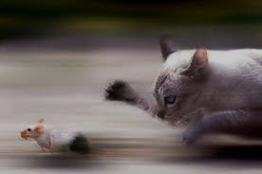
MS. AHN’S CLASS (2003)
If 6 cats can kill 6 rats in 6 minutes, how many cats are required to kill 100 rats in 50 minutes?
- Lewis Carroll

Slide 6
MS. AHN’S CLASS (2003)
If 6 cats can kill 6 rats in 6 minutes, how many cats are required to kill 100 rats in 50 minutes?
- Lewis Carroll
NOTHING!

Slide 7
12 YEARS OF RESEARCH
MS. AHN’S CLASSROOM
UNDERSTANDING NON-THINKING CLASSROOMS
BUILDING THINKING CLASSROOMS

Slide 8
UNDERSTANDING NON-THINKING CLASSROOMS

Slide 9
CONTEXT OF RESEARCH
NOW YOU TRY ONE
HOMEWORK
TAKING NOTES
REVIEW
GROUP WORK
LECTURE
STATIONS

Slide 10
TYPOLOGY BUILDING
Observation Phase
Typology Building
Typology Testing

Slide 11
NOW YOU TRY ONE
n=32
STUDENTING
catching up on notes (n=0)

Slide 12
STUDENTING
The concept of studenting or pupiling is far and away the more parallel concept to that of teaching. [..] there is much more to studenting than learning how to learn. In the school setting, studenting includes getting along with one’s teachers, coping with one’s peers, dealing with one’s parents about being a student, and handling the non-academic aspects of school life.
(Fenstermacher, 1986, p. 39)
D
Notes:
Studenting. This term was coined by Gary Fenstermacher in 1986. This is an excerpt from it’s earliest mention.
Studenting is a parallel concept to that of teaching: just as teaching consists of much more than planning and delivering lessons, facilitating groupwork, monitoring student progress and behaviour, assessment and evaluation, managing the classroom, communicating with parents, paperwork, ….
As you can see, it appears to be an optimistic view - these are things that all support learning

Slide 13
STUDENTING
[T]hings that students do such as ‘psyching out’ teachers, figuring out how to get certain grades, ‘beating the system’, dealing with boredom so that it is not obvious to teachers, negotiating the best deals on reading and writing assignments, threading the right line between curricular and extra-curricular activities, and determining what is likely to be on the test and what is not.
(Fenstermacher, 1994, p. 1)
D
Notes:
Later, in 1994, Fenstermacher added some further aspects of studenting.

Slide 14
STUDENTING
identifies autonomous actions of students that may or may not align with the intentions of the teacher
extends constructs such as the didactic contract (Brousseau, 1997) and classroom norms (Cobb, Wood, & Yackel, 1991; Yackel & Cobb, 1996) to encompass behaviours that are not predicated on an assumption of shared intent to learn

Slide 15
NOW YOU TRY ONE
n=32
STUDENTING
catching up on notes (n=0)

Slide 16
NOW YOU TRY ONE
n=32
Liljedahl, P. & Allan, D. (2013). Studenting: The case of "now you try one". Proceedings of the 37th Conference of the PME, Vol. 3, pp. 257-264. Kiel, Germany: PME.

Slide 17
FRAMEWORK OF GAMING
GAMING
WITH FAÇADE
(intentional)
NO FAÇADE
(unintentional)
ALTERNATE IDEAS
BEATING THE SYSTEM
wrong objective
preferred learning style
teacher is wrong
avoidance
economy of action
doing being
wrong rules
practical rationality
institutional norms
…

Slide 18
THEORIZING ABOUT STUDENTS
doing being … a student (Sacks)
practical rationality (Aaron)
law of least effort (Kahnemann)
motivation and avoidance (Hannula)
didactic tension (Mason)
goal regulation (Hannula)
self-determination theory (Deci & Ryan)
institutional norms (Liu & Liljedahl)
avoidance (Hannula)
activity theory (Leont’ev, Engström)

Slide 19
BUILDING THINKING CLASSROOMS

Slide 20
EARLY EFFORTS
just do it
teaching with problem solving
some were able to do it
they needed a lot of help
they loved it
they don’t know how to work together
they got it quickly and didn't want to do any more
they gave up early
FILTERED THROUGH STUDENTS
TASKS
teaching problem solving

Slide 21
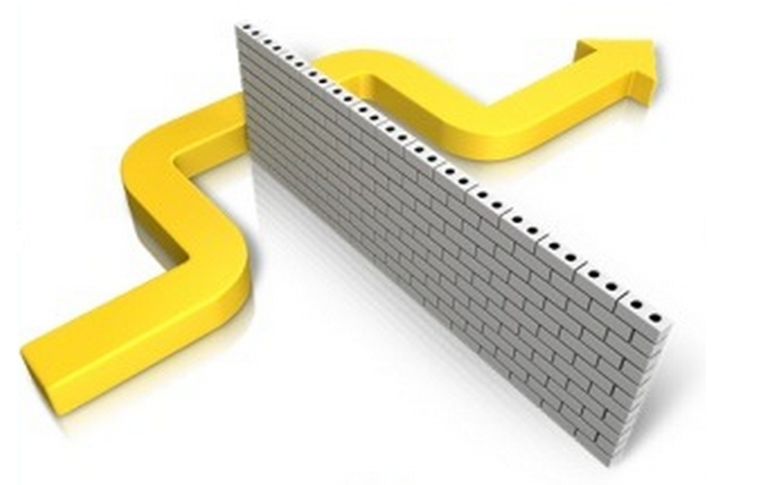
REALIZATION
STUDENT NORMS

Slide 22
REALIZATION
CLASSROOM NORMS

Slide 23
REALIZATION
INSTITUTIONAL NORMS

Slide 24
CASTING ABOUT (n = 300+)

Slide 25
THINGS I (WE) TRIED
tasks
hints and extensions
how we give the problem
how we answer questions
how we level
room organization
how groups are formed
student work space
how we give notes
assessment
…

Slide 26
FINDINGS
VARIABLE | POSITIVE EFFECT
tasks | good tasks
hints and extensions | managing flow
how we give the problem | oral vs. written
how we answer questions | 3 types of questions
how we level | level to the bottom
room organization | defronting the room
how groups are formed | visibly random groups
student work space | vertical non-permanent surfaces
how we give notes | don't
assessment | 4 purposes
…

Slide 27
FINDINGS
levelling
assessment
flow
answering questions
oral instructions
defronting the room
good tasks
vertical non-permanent surfaces
visibly random groups

Slide 28
liljedahl@sfu.ca
#VNPS

