Slide 1
TOP 10 THINGS TO CONSIDER IF YOU WANT TO GET PUBLISHED IN IJSME (OR ELSEWHERE)
Peter Liljedahl

Slide 2
www.peterliljedahl.com/presentations
liljedahl@sfu.ca
@pgliljedahl

Slide 3
IJSME
The objective of this journal is to publish original, fully peer-reviewed articles on a variety of topics and research methods in both science and mathematics education. The journal welcomes articles that address common issues in mathematics and science education and cross-curricular dimensions more widely. Specific attention will be paid to manuscripts written by authors whose native language is not English and the editors have made arrangements for support in re-writing where appropriate.

Slide 4
Submissions by Country and Comparison
2011-2015
2011-2016

Slide 5
Acceptance by Country and Comparison
2011-2016

Slide 6
Downloads (as of Aug 2015)

Slide 7
MORE THAN IJSME
IJSME (editor since 2012)
ESM (editorial board since 2011)
JMTE (editorial board since 2011)
MERJ (editorial board since 2014)
MTL (editorial board since 2008)
CJSMTE (editorial board since 2010)
FMEJ (editorial board since 2014)

Slide 8
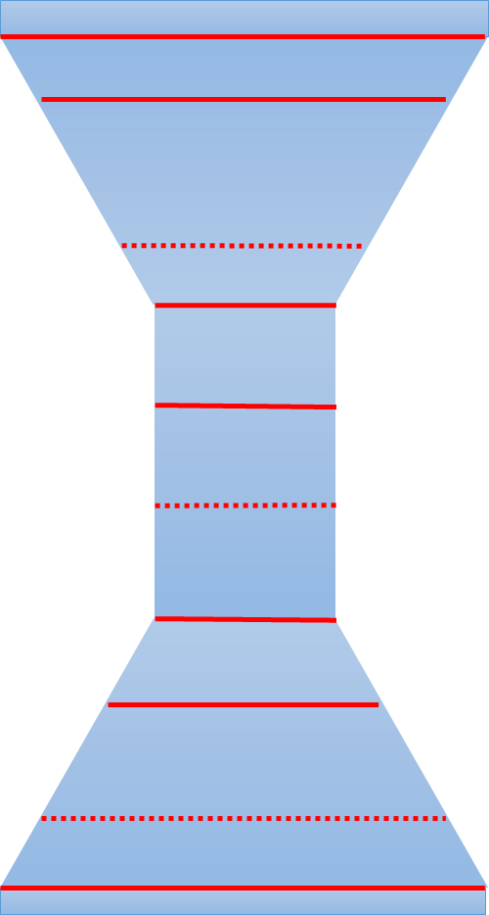
STRUCTURE OF A GOOD ARTICLE
TITLE + ABSTRACT
INTRODUCTION (PHENOMENON OF INTEREST)
LITERATURE REVIEW (AND THEORY)
RESEARCH QUESTION
METHODOLOGY
RESULTS
DISCUSION
CONCLUSION
RELEVANCE TO LITERATURE
RELEVANCE TO PHENOMENON OF INTEREST
REFERENCES

Slide 9
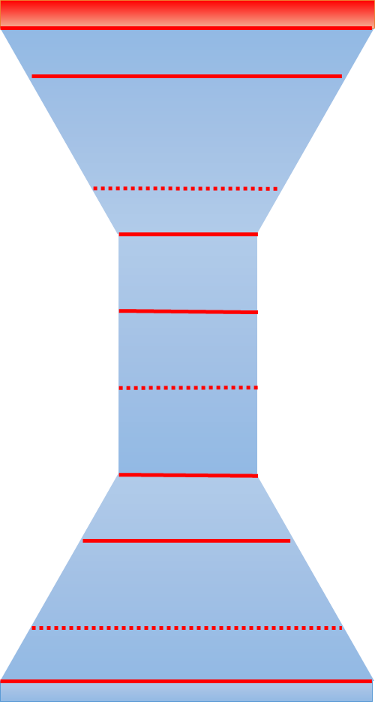
1. TITLE
try to have a clever title that says something memorable about the article
NEVER put the country where you did your research in the title:
it narrows the interest in your paper.
country can be mentioned in methodology
EXCEPTION: international comparisons

Slide 10
2. ABSTRACT
the abstract is advertising: it should motivate a reader to want to read it
entice them with your results: but phrase them for a lay reader
NEVER put a reference in an abstract

Slide 11
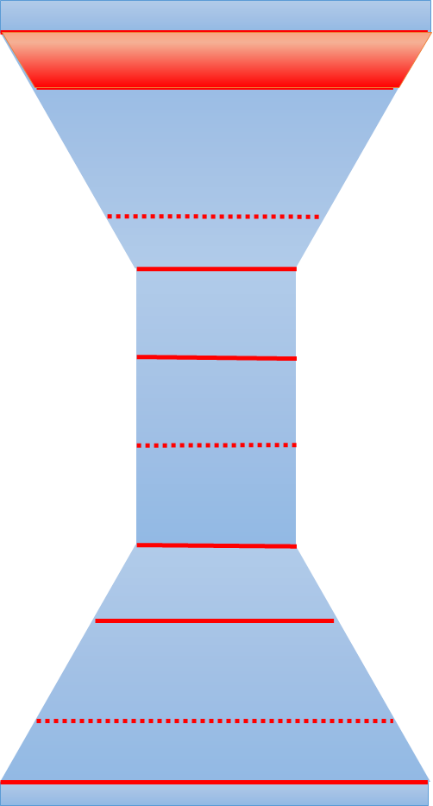
3. INTRODUCTION
The introduction should tell a reader:
how you came to this research.
what is the phenomenon of interest.
why you care about this research.
why the reader should care about the research.
The introduction should finish with lay research question.
Do not underestimate the value of narrative for this section.

Slide 12
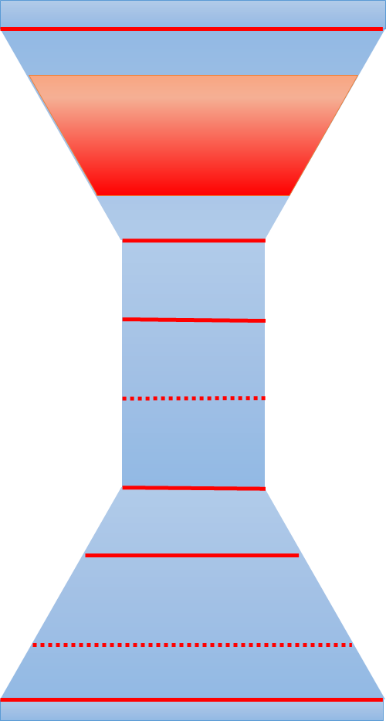
4. LITERATURE REVIEW
The literature review is not a place where you tell the reader the results of every research paper related to your research. It should:
be linked and intertwined.
illuminate in more detail the hole that your RQ is going to fill.
present a vocabulary that you will use.
potentially introduce us to the theoretical framework (but may not be explicit about it).

Slide 13
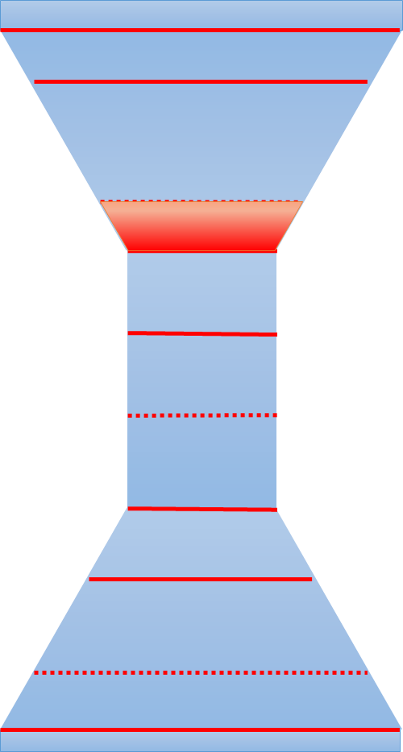
5. RESEARCH QUESTION(S)
The research question should emerge naturally out the literature review.
The reader should say of course upon seeing it.
The research question should:
fill a gap in the research.
apply existing theory in a new context
look at a phenomenon from a new perspective.
not be answerable with a yes/no response.

Slide 14
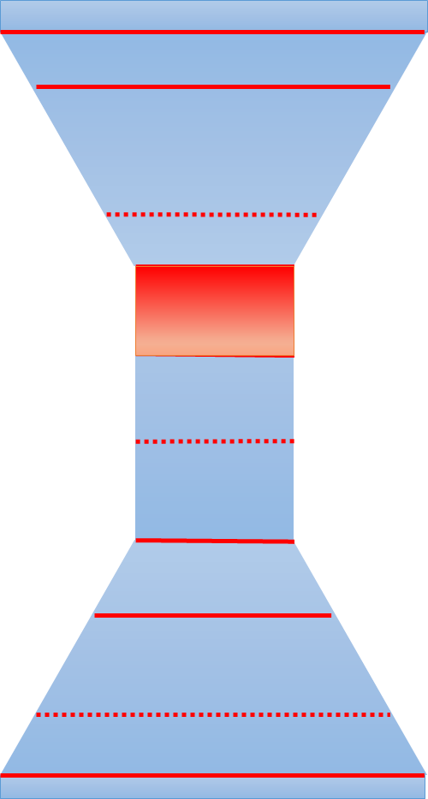
6. METHODOLOGY
The methodology should have enough details that a reader can either make sense of your results within their own setting or recreate the research. It should:
tell us the setting (including country).
tell us who the participants are.
tell us about your instruments.
tell us what the data will be.
tell us how you will analyse the data (this is where you can reveal the theoretical framework).

Slide 15
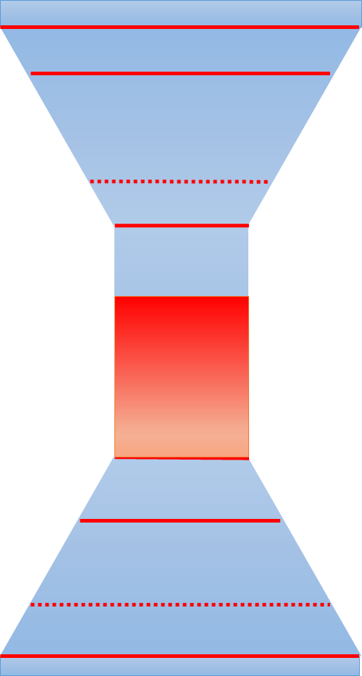
7+8. RESULTS and DISCUSSION
If you are doing a qualitative study I recommend that you put results and discussion together in one section and intertwine them.
If you are doing a quantitative study I recommend that you put your results in a table then discuss them. DO NOT narrate the contents of the table.

Slide 16
Use your theoretical framework in transparent ways.
DO NOT use a complex framework to see/say simple things.
DO NOT be to shallow in your analysis.
There is a difference between DOING research and WRITING research.
Know the difference between grounded theory and constant comparative method.
If you are truly writing in grounded theory I suggest you send it to a journal that specializes in this.
7+8. RESULTS and DISCUSSION

Slide 17
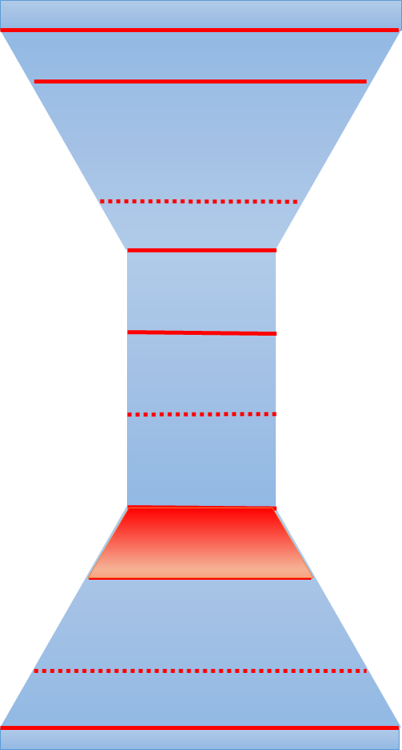
9. CONCLUSIONS
Remind the reader what the questions were. DO NOT cut and paste.
Answer your research question.

Slide 18
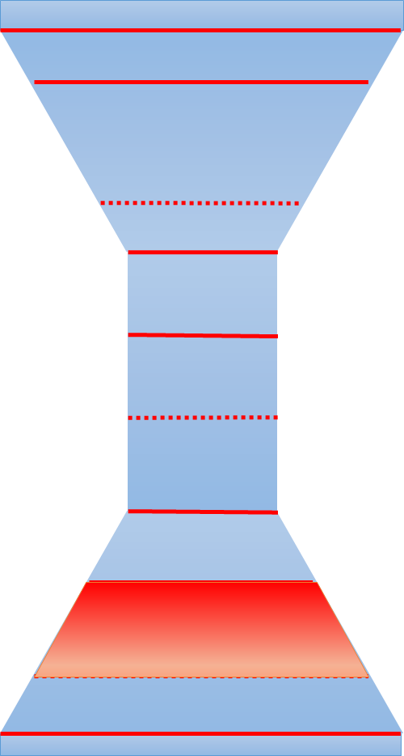
10. RELEVANCE TO LITERATURE
Talk back to your literature. How do your findings contribute to the existing work in this field?
What extensions or adaptations do you propose?
What parts of the literature mapped well onto your context?

Slide 19
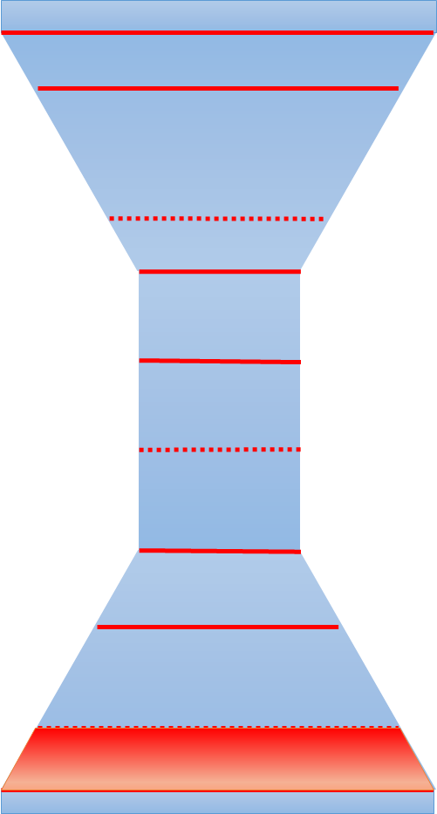
11. RELEVANCE TO THE PHENOMENON OF INTEREST
Talk back to the thing that motivated you to do your research.
What have you learned that furthers your agenda?
What have you learned that furthers the agenda of mathematics education?
DO NOT be flippant with implications (better to leave them out).

Slide 20
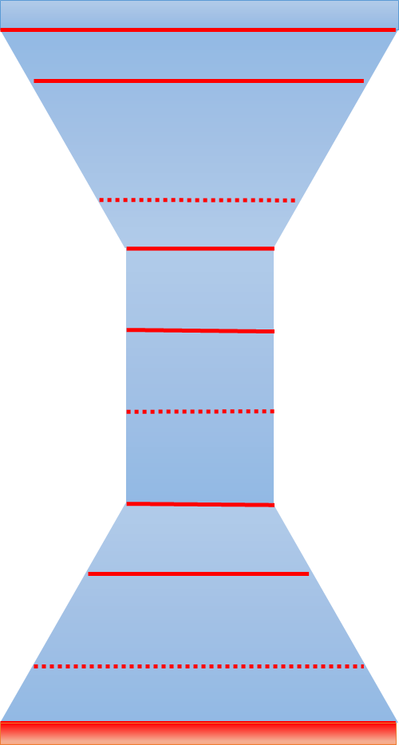
12. REFERENCES
Follow the format specified by the journal.
Make sure that ALL references follow the same format – be careful with cut and paste.

Slide 21
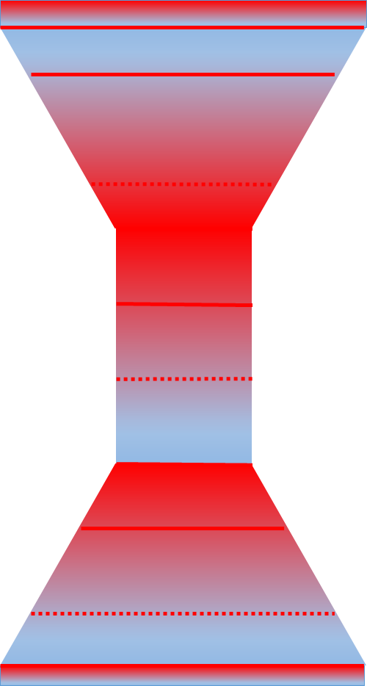
13. JOURNAL SUBMISSION
READ your paper.
Get it proofread if needed.
Follow the instructions!
BLIND your paper!
If you are asked for name, title, and abstract in meta-data DO NOT include it in the paper.
PREVIEW the file that is created.

Slide 22
14. RESPOND TO YOUR REVIEWERS
DO what they have asked – or NOT.
Either way write a well organized letter or a table back to the reviewers detailing how you responded to their comments (or not).

Slide 23
STRUCTURE OF A GOOD ARTICLE
TITLE + ABSTRACT
INTRODUCTION (PHENOMENON OF INTEREST)
LITERATURE REVIEW (AND THEORY)
RESEARCH QUESTION
METHODOLOGY
RESULTS
DISCUSION
CONCLUSION
RELEVANCE TO LITERATURE
RELEVANCE TO PHENOMENON OF INTEREST
REFERENCES

Slide 24
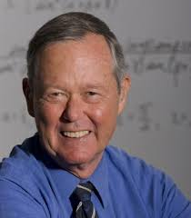
JEREMY KILPATRICK (JRME, volume 16, issue 3)

Slide 25
Editors and reviewers are reputed to be busy people, but that is a fiction. The JRME editors and reviewers lead dreary lives of unremitting sloth. If you plan to submit a manuscript to the JRME, here are several easy ways that you can bring stimulation and challenge to some idle minds.

Slide 26
First, do not bother to read the journal itself and pay no attention to what the Publication Manual of the American Psychological Association (Third Edition) has to say about preparing a manuscript. Be a free spirit. Try to convey the impression that you are not a person to be bothered with petty details of style and format.

Slide 27
Second, see if you can give your manuscript the portentous tone of a dissertation or project report. Start with the title; it should be as long as possible. Mention every variable you studied, along with the names of the instruments you used. If the title still seems too short, try adding" A Report of a Study Designed in an Attempt to Investigate Various Factors That Might Be Associated With .... "If that is not enough, add the name of the institution and the city where you did the study.

Slide 28
Either omit the abstract altogether (you're a busy person, right?) or, better, stretch it out to at least 250 words so that you can allude to results that are not included in the body of the report, thereby providing the reviewers with more of a challenge. In setting up tables and figures, just remember that they should not be easily interpreted on their own. Verbatim copies of computer printouts usually make wonderful tables. If a table seems too stark, you can add a dozen or so cryptic footnotes. Most tables should be discussed entry-by-entry in the text, but the virtuoso writer will include at least one table or figure that is not 'cited anywhere.

Slide 29
Third, do not let the organization be obvious. Avoid headings or subheadings that might reveal too much. Use Introduction at the beginning and put Results somewhere in the middle, if you wish, but report the results all the way to the end, as they occur to you. Aim at a stream-of-consciousness effect. If you want to give the purpose of the study, follow Agatha Christie's style and tell your secret at the end. You can, however, give the manuscript a nice absurdist touch by omitting any statement of purpose.

Slide 30
Finally, do not let anyone else read your manuscript before you submit it. After all, who are you writing for if not yourself? Proofreading the manuscript carefully and letting colleagues look it over might suggest that you were eager to have it published. If you follow the simple suggestions above, you will not need to worry about publication. And you can know the satisfaction of having given some extra work to the editors and reviewers.
JEREMY KILPATRICK (JRME, volume 16, issue 3)

Slide 31
THANK YOU
www.peterliljedahl.com/presentations
liljedahl@sfu.ca
@pgliljedahl

