Slide 1
CONCEPTUALIZING AND ACTUALIZING THE NEW CURRICULUM
Peter Liljedahl

Slide 2
BC Curriculum Revisions
1968 → what
1976 → what
1984 → what + how
1994 → what + how
2003 → what + how
2008 → what + how
2015 → how + what

Slide 5
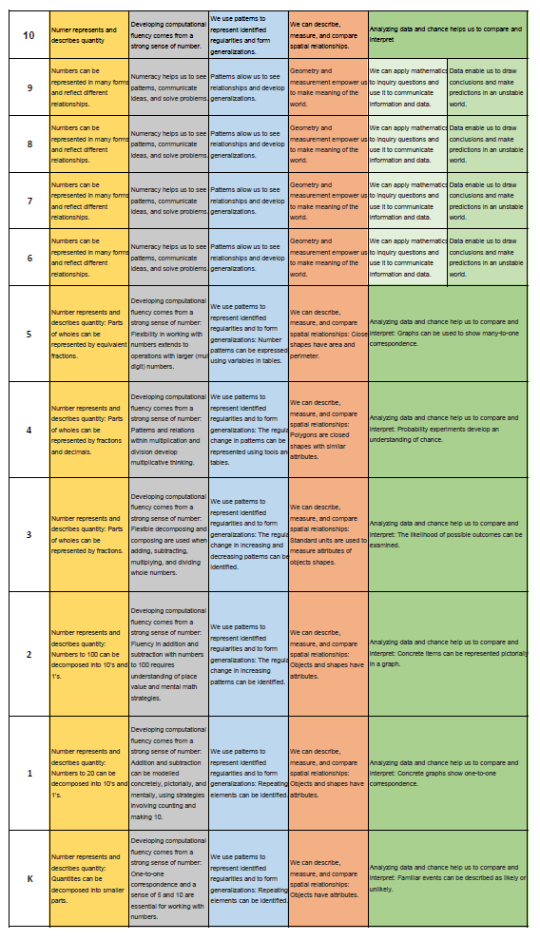

Slide 7
MATHEMATICS 1 Foundations and Pre-Calculus
Reasoning and analyzing
Inductively and deductively reason and use logic to explore, make connections, predict, analyze, generalize, and make conclusions
Estimate
Develop and apply mental math strategies
Use tools {appropriate technology) to explore and create patterns, examine relationships, and test conjectures
Understanding and solving
Implement multiple strategies to solve problems in both abstract and real-life situations using different cultural perspectives
Develop, construct, and apply mathematical understanding through play, inquiry, and problem solving
Communicating and representing
Use mathematical vocabulary and language to contribute to mathematical discussions
Communicate in a variety of ways
Explain, clarify, and justify mathematical ideas
Develop mathematical understanding through concrete, pictorial, and symbolic representations
Use technology appropriately to record, communicate, and represent thinking
Connecting and reflecting
Visualize and describe mathematical concepts
Explore, apply, and connect mathematical concepts to each other and make mathematical connections to other disciplines and the real world
Use dynamic visualizations to explore geometric and graphical relationships
Use mathematical arguments to support personal choices and recognize the consequences
Apply cultural perspectives of First Peoples to the concepts of locating, measuring, and numbering
strategies to solve puzzles and win games
primary trigonometric ratios
metric and imperial measurement conversions
analysis of measures of central tendency, including outliers
experimental probability
income, including taxes and deductions
savings and compound interest
area and volume
relations among data, graphs, and situations
powers with integral exponents
multiplication of polynomial expressions
common factors and trinomial factoring
linear equations with rational coefficients
linear relations

Slide 8
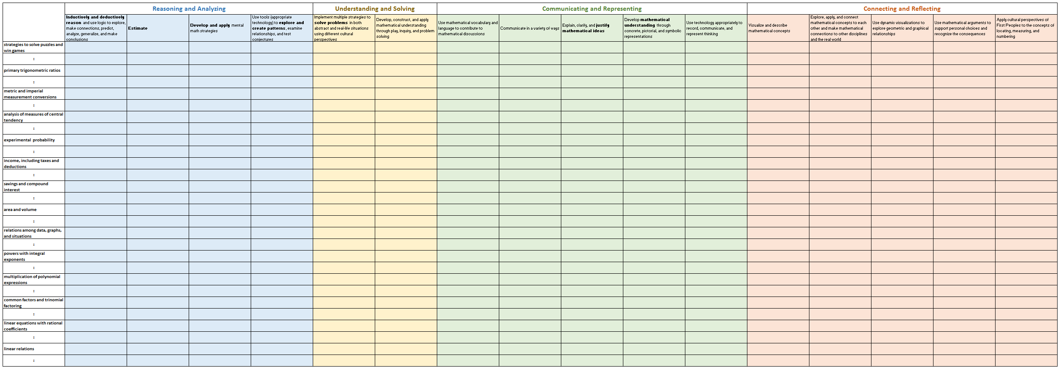
MATHEMATICS 1 Foundations and Pre-Calculus

Slide 9
TEACHING AT THE INTERSECTIONS Unintended Consequences

Slide 10
GOOD PROBLEMS Then and Now

Slide 11
GOOD PROBLEMS Then and Now
How did you estimate..?
Explain how the referent helped you…?
Is the total closer to 5 or 10?
When might you need to partition numbers?
What strategies did you use to solve the problem?
How would you justify your solution?
_________________________________________________________________
When you explored ways to …, how can you prove that you have the same ….?
When might you need to …?
How many ways..? Show your strategies.
How might you apply what you learned...?
Why did you choose a specific strategy?
_________________________________________________________________
What did you notice?
How could you represent you thinking (concretely, pictorially, symbolically)?
How would you explain the strategy you used?
Explain how you solved the problem.
Explain what you learned.
Draw a picture to show your thinking.
How would you describe your solution?
How would you model the concept and explain your thinking to others?
Describe and compare…
How would you interpret the relationships…?
Explain how you know… Why does this make sense?
Explore representing and describing … What did you notice?
How did you use technology to explore…?
How did you use technology to solve the problem?
How did you use technology to communicate and represent your thinking?
Express your thoughts about your discoveries.
_________________________________________________________________
How did you visualize to help solve the problem?
Describe what you visualized when you were solving the problem.
When might you use what you have learned?
How might this connect to other mathematical concepts?
How might you apply what you have learned?
Demonstrate how you know this can be applied to other situations.
How is this problem like something you solved before?

Slide 12
GOOD PROBLEMS Then and Now
What did you notice?
How could you represent you thinking (concretely, pictorially, symbolically)?
How would you explain the strategy you used?
Explain how you solved the problem.
Explain what you learned.
Draw a picture to show your thinking.
How would you describe your solution?
How would you model the concept and explain your thinking to others?
Describe and compare…
How would you interpret the relationships…?
Explain how you know… Why does this make sense?
Explore representing and describing … What did you notice?
How did you use technology to explore…?
How did you use technology to solve the problem?
How did you use technology to communicate and represent your thinking?
Express your thoughts about your discoveries.

Slide 13
ASSESSMENT Then and Now

Slide 14
THANK YOU!
liljedahl@sfu.ca
www.peterliljedahl.com/presentations

