Slide 1
building thinking classrooms
- Peter Liljedahl

Slide 2
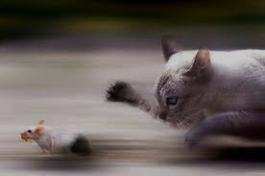
MS. AHN’S CLASS (2003)
If 6 cats can kill 6 rats in 6 minutes, how many cats are required to kill 100 rats in 50 minutes?
- Lewis Carroll

Slide 3
MS. AHN’S CLASS (2003)
If 6 cats can kill 6 rats in 6 minutes, how many cats are required to kill 100 rats in 50 minutes?
- Lewis Carroll
NOTHING!

Slide 4
12 YEARS OF RESEARCH
MS. AHN’S CLASSROOM
UNDERSTANDING NON-THINKING CLASSROOMS
BUILDING THINKING CLASSROOMS

Slide 5
UNDERSTANDING NON-THINKING CLASSROOMS

Slide 6
CONTEXT OF RESEARCH
NOW YOU TRY ONE
HOMEWORK
TAKING NOTES

Slide 7
TYPOLOGY BUILDING
Observation Phase
Typology Building
Typology Testing

Slide 8
NOW YOU TRY ONE
n=32
STUDENTING
catching up on notes (n=0)

Slide 9
NOW YOU TRY ONE
n=32
Liljedahl, P. & Allan, D. (2013). Studenting: The case of "now you try one". Proceedings of the 37th Conference of the PME, Vol. 3, pp. 257-264. Kiel, Germany: PME.

Slide 10
HOMEWORK
 | Marked (n=60) | Not Marked (n=40) |  |  | Marked (n=60) | Not Marked (n=40)
Didn't Do It | 15 | 16 |  | Got Help | 18 | 12
I forgot | 5 | 3 |  | Felt they would fail quiz | 6 | 1
I was busy | 4 | 2 |  | Felt they would pass quiz | 3 | 3
I tried, but I couldn't do it | 3 | 3 |  | Felt they would excel | 9 | 8
I took a chance | 3 | 0 |  | Did it On Their Own | 13 | 11
It wasn't worth marks | 0 | 8 |  | Mimicked from notes | 4 | 5
Cheated | 14 | 1 |  | Did not mimic from notes | 6 | 6
Copied | 7 | 1 |  | Mimicked but completed | 3 | 0
Faked | 5 | 0
Half homework risk | 2 | 0

Slide 11
HOMEWORK
 | Marked (n=60) | Not Marked (n=40) |  |  | Marked (n=60) | Not Marked (n=40)
Didn't Do It | 15 | 16 |  | Got Help | 18 | 12
I forgot | 5 | 3 |  | Felt they would fail quiz | 6 | 1
I was busy | 4 | 2 |  | Felt they would pass quiz | 3 | 3
I tried, but I couldn't do it | 3 | 3 |  | Felt they would excel | 9 | 8
I took a chance | 3 | 0 |  | Did it On Their Own | 13 | 11
It wasn't worth marks | 0 | 8 |  | Mimicked from notes | 4 | 5
Cheated | 14 | 1 |  | Did not mimic from notes | 6 | 6
Copied | 7 | 1 |  | Mimicked but completed | 3 | 0
Faked | 5 | 0
Half homework risk | 2 | 0

Slide 12
HOMEWORK
Liljedahl, P. & Allan, D. (2013). Studenting: The Case of Homework. Proceedings of the 35th Conference for PME-NA. Chicago, USA.

Slide 13
TAKING NOTES (n=30)
don’t keep up
n=16
don’t
n=3
yes
n=3
don’t use notes
n=27
USE NOTES TO STUDY

Slide 14
TAKING NOTES (n=30)
GAMING
63%
GAMING
90%
USE NOTES TO STUDY

Slide 15
BUILDING THINKING CLASSROOMS

Slide 16
EARLY EFFORTS
just do it
teaching with problem solving
TASKS
teaching problem solving

Slide 17
EARLY EFFORTS
just do it
teaching with problem solving
some were able to do it
they needed a lot of help
they loved it
they don’t know how to work together
they got it quickly and didn't want to do any more
they gave up early
FILTERED THROUGH STUDENTS
TASKS
assessing problem solving

Slide 18
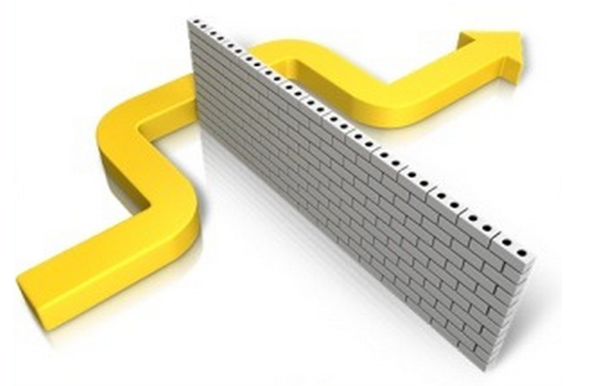
REALIZATION
STUDENT NORMS

Slide 19
CASTING ABOUT (n = 300+)
INSERVICE TEACHERS
⬥ learning teams
⬥ workshops
⬥ master's students
MY OWN TEACHING
⬥ undergraduate courses
⬥ graduate courses
⬥ guest teaching

Slide 20
THINGS I (WE) TRIED
tasks
hints and extensions
how we give the problem
how we answer questions
how we level
room organization
how groups are formed
student work space
how we give notes
assessment
…

Slide 21
FINDINGS
VARIABLE | POSITIVE EFFECT
tasks | good tasks
hints and extensions | managing flow
how we give the problem | oral vs. written
how we answer questions | 3 types of questions
how we level | level to the bottom
room organization | defronting the room
how groups are formed | visibly random groups
student work space | vertical non-permanent surfaces
how we give notes | don't
assessment | 4 purposes
…

Slide 22
FINDINGS
VARIABLE | POSITIVE EFFECT
tasks | good tasks
hints and extensions | managing flow
how we give the problem | oral vs. written
how we answer questions | 3 types of questions
how we level | level to the bottom
room organization | defronting the room
how groups are formed | visibly random groups
student work space | vertical non-permanent surfaces
how we give notes | don't
assessment | 4 purposes
…

Slide 23
FINDINGS – BIGGEST IMPACT
levelling
assessment
flow
answering questions
oral instructions
defronting the room
good tasks
vertical non-permanent surfaces
visibly random groups

Slide 24
FINDINGS – BIGGEST IMPACT
levelling
assessment
flow
answering questions
oral instructions
defronting the room
good tasks
vertical non-permanent surfaces
visibly random groups

Slide 25
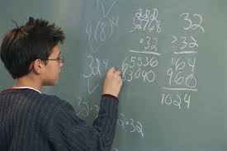
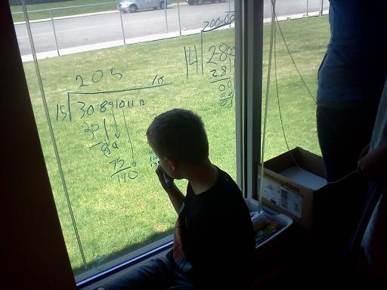
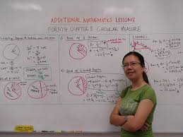
VERTICAL NON-PERMANENT SURFACES

Slide 26
EFFECT ON STUDENTS
PROXIES FOR ENGAGEMENT
time to task
time on task
time to first mathematical notation
amount of discussion
eagerness to start
participation
persistence
knowledge mobility
non-linearity of work
0 - 3

Slide 27
EFFECT ON STUDENTS
 | vertical non-perm | horizontal non-perm | vertical permanent | horizontal permanent | notebook
N (groups) | 10 | 10 | 9 | 9 | 8
time to task | 12.8 sec | 13.2 sec | 12.1 sec | 14.1 sec | 13.0 sec
time on task | 7.1 min | 4.6 min | 3.0 min | 3.1 min | 3.4 min
first notation | 20.3 sec | 23.5 sec | 2.4 min | 2.1 min | 18.2 sec
discussion | 2.8 | 2.2 | 1.5 | 1.1 | 0.6
eagerness | 3.0 | 2.3 | 1.2 | 1.0 | 0.9
participation | 2.8 | 2.3 | 1.8 | 1.6 | 0.9
persistence | 2.6 | 2.6 | 1.8 | 1.9 | 1.9
mobility | 2.5 | 1.2 | 2.0 | 1.3 | 1.2
non-linearity | 2.7 | 2.9 | 1.0 | 1.1 | 0.8

Slide 28
EFFECT ON STUDENTS
 | vertical non-perm | horizontal non-perm | vertical permanent | horizontal permanent | notebook
N (groups) | 10 | 10 | 9 | 9 | 8
time to task | 12.8 sec | 13.2 sec | 12.1 sec | 14.1 sec | 13.0 sec
time on task | 7.1 min | 4.6 min | 3.0 min | 3.1 min | 3.4 min
first notation | 20.3 sec | 23.5 sec | 2.4 min | 2.1 min | 18.2 sec
discussion | 2.8 | 2.2 | 1.5 | 1.1 | 0.6
eagerness | 3.0 | 2.3 | 1.2 | 1.0 | 0.9
participation | 2.8 | 2.3 | 1.8 | 1.6 | 0.9
persistence | 2.6 | 2.6 | 1.8 | 1.9 | 1.9
mobility | 2.5 | 1.2 | 2.0 | 1.3 | 1.2
non-linearity | 2.7 | 2.9 | 1.0 | 1.1 | 0.8

Slide 29
EFFECT ON TEACHERS
This was so great [..] it was so good I felt like I shouldn't be doing it.
I will never go back to just having students work in their desks.
How do I get more whiteboards?
The principal came into my class … now I'm doing a session for the whole staff on Monday.
My grade-partner is even starting to do it.
The kids love it. Especially the windows.
I had one girl come up and ask when it will be her turn on the windows.

Slide 30
EFFECT ON TEACHERS

Slide 31
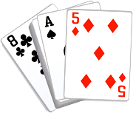
VISIBLY RANDOM GROUPS

Slide 32
EFFECT ON STUDENTS
students become agreeable to work in any group they are placed in
there is an elimination of social barriers within the classroom
mobility of knowledge between students increases
reliance on the teacher for answers decreases
reliance on co-constructed intra- and inter-group answers increases
engagement in classroom tasks increase
students become more enthusiastic about mathematics class
Liljedahl, P. (in press). The affordances of using visually random groups in a mathematics classroom. In Y. Li, E. Silver, & S. Li (eds.) Transforming Mathematics Instruction: Multiple Approaches and Practices. New York, NY: Springer.

Slide 33
EFFECT ON TEACHERS

Slide 34
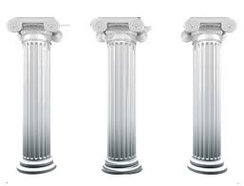
TOGETHER - THREE PILARS
vertical surfaces
random groups
good tasks

Slide 35
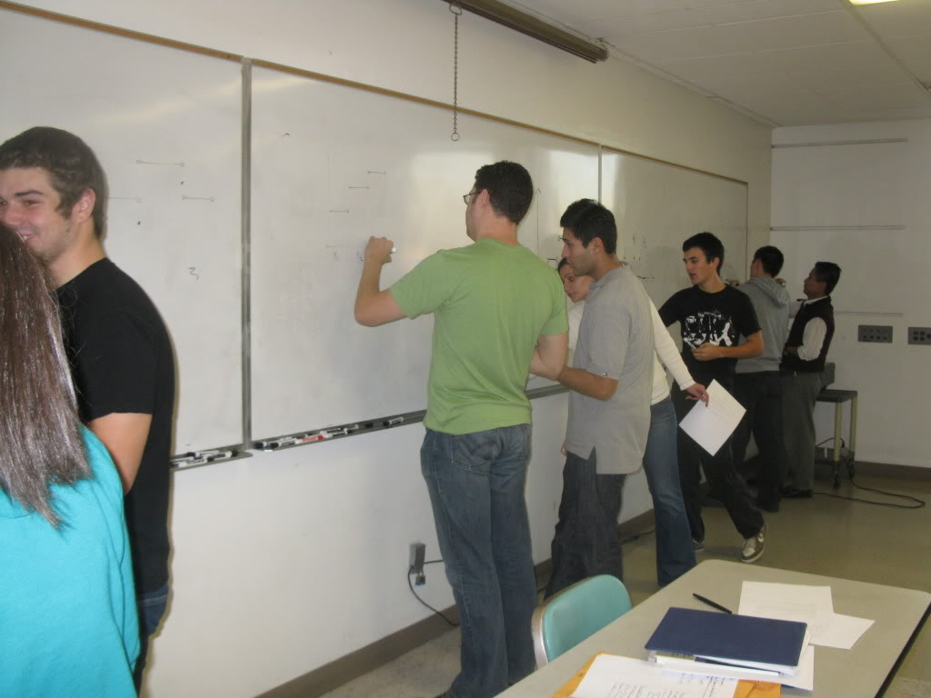
TOGETHER

Slide 36
EFFECT ON TEACHERS
I've never seen my students work like that
they worked the whole class
they want more
how do I keep this up AND work on the curriculum?
how do I assess this?
where do I get more problems?
I don't know how to give hints?

Slide 37
EFFECT ON TEACHERS

Slide 38
WHAT NEXT?
levelling
assessment
flow
answering questions
oral instructions
defronting the room
good tasks
vertical non-permanent surfaces
visibly random groups

Slide 40
THANK YOU!
liljedahl@sfu.ca
www.peterliljedahl.com/presentations

