Slide 1
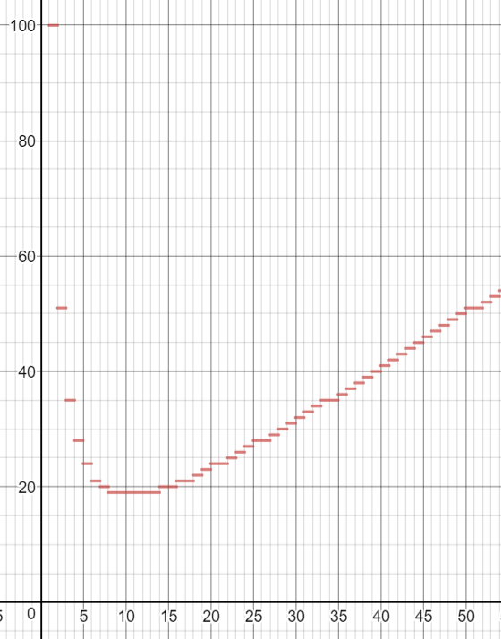

Slide 2
BUILDING THINKING CLASSROOMS THE NARRATIVE BEHIND THE NARRATIVE (part II)
- Peter Liljedahl

Slide 3
PROBLEM

Slide 4
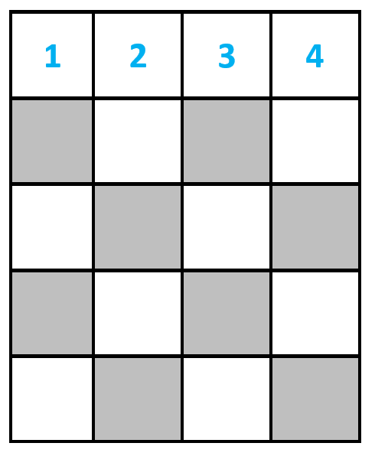
PROBLEM

Slide 5
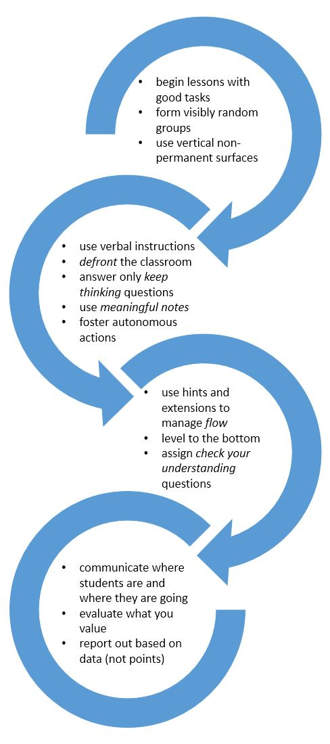
WHAT MAKES THIS SUCH A GOOD FRAMEWORK FOR CHANGING STUDENTS?

Slide 6
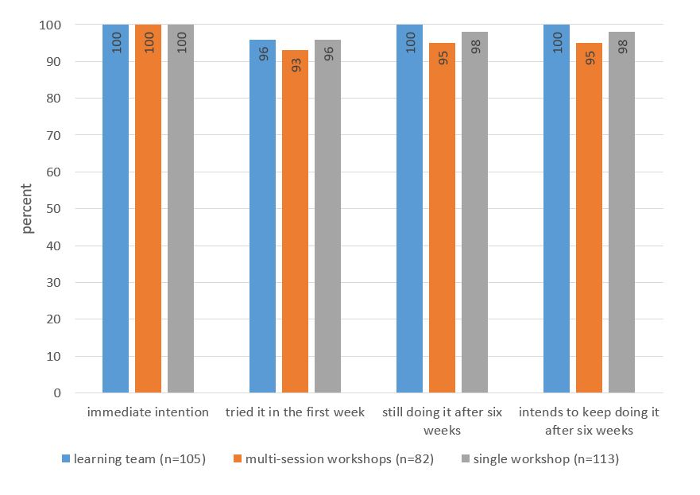
WHAT MAKES THIS SUCH A GOOD FRAMEWORK FOR CHANGING TEACHERS?

Slide 7
WHAT MAKES THIS SUCH A GOOD FRAMEWORK FOR CHANGING TEACHERS?

Slide 8
QUALITIES
Perseverance
Risk taking
Collaboration
Communication
Tolerance for ambiguity
Resourcefulness
Valuing the process
Confidence
Visualization
Some math skills
Flexible
Critical questioning
Mutual respect
Connect representations
Listening skills

Slide 9
QUALITIES
Perseverance
Risk taking
Collaboration
Communication
Tolerance for ambiguity
Resourcefulness
Valuing the process
Confidence
Visualization
Some math skills
Flexible
Critical questioning
Mutual respect
Connect representations
Listening skills
HOW DO WE BUILD A
THINKING CLASSROOM?

Slide 10
QUALITIES
Perseverance
Risk taking
Collaboration
Communication
Tolerance for ambiguity
Resourcefulness
Valuing the process
Confidence
Visualization
Some math skills
Flexible
Critical questioning
Mutual respect
Connect representations
Listening skills
WHAT ELSE COULD WE HAVE DONE?

Slide 11
QUALITIES
What else could we have done?
Is it your job as a teacher to wait for students with these qualities to come to you, or is it your job as a teacher to develop these qualities?
If these are what you consider to be THE most valuable qualities … how are you going to evaluate them?
Given that this was a numeracy task then these are the qualities of a numerate student. So, what is the definition of numeracy?
These qualities can also be called competencies. If the ministry would have asked you what the competencies should be then this is the list that would emerge.

Slide 12
QUALITIES
What else could we have done?
Is it your job as a teacher to wait for students with these qualities to come to you, or is it your job as a teacher to develop these qualities?
If these are what you consider to be THE most valuable qualities … how are you going to evaluate them?
Given that this was a numeracy task then these are the qualities of a numerate student. So, what is the definition of numeracy?
These qualities can also be called competencies. If the ministry would have asked you what the competencies should be then this is the list that would emerge.
PROFESSIONAL DEVELOPMENT MOVES

Slide 13
QUALITIES
What else could we have done?
Is it your job as a teacher to wait for students with these qualities to come to you, or is it your job as a teacher to develop these qualities?
If these are what you consider to be THE most valuable qualities … how are you going to evaluate them?
Given that this was a numeracy task then these are the qualities of a numerate student. So, what is the definition of numeracy?
These qualities can also be called competencies. If the ministry would have asked you what the competencies should be then this is the list that would emerge.
WHY DO WE DO THIS?

Slide 14
QUALITIES
What else could we have done?
Is it your job as a teacher to wait for students with these qualities to come to you, or is it your job as a teacher to develop these qualities?
If these are what you consider to be THE most valuable qualities … how are you going to evaluate them?
Given that this was a numeracy task then these are the qualities of a numerate student. So, what is the definition of numeracy?
These qualities can also be called competencies. If the ministry would have asked you what the competencies should be then this is the list that would emerge.
BECAUSE WE ARE TRYING TO CHANGE TEACHERS

Slide 15
QUALITIES
What else could we have done?
Is it your job as a teacher to wait for students with these qualities to come to you, or is it your job as a teacher to develop these qualities?
If these are what you consider to be THE most valuable qualities … how are you going to evaluate them?
Given that this was a numeracy task then these are the qualities of a numerate student. So, what is the definition of numeracy?
These qualities can also be called competencies. If the ministry would have asked you what the competencies should be then this is the list that would emerge.
DOES IT WORK? IF SO, WHY DOES IT WORK?

Slide 16
LITERATURE
Literature on the professional development of mathematics teachers can be sorted into three main categories:
CONTENT
METHOD
EFFECTIVENESS

Slide 17
LITERATURE
Literature on the professional development of mathematics teachers can be sorted into three main categories:
CONTENT
mathematical knowledge teachers need for teaching (Hill & Ball, 2008; Davis & Simmt, 2006; Hill, Rowan, & Ball, 2005) and how this knowledge can be developed within preservice and inservice teachers
teachers' beliefs about mathematics and the teaching and learning of mathematics and how such beliefs can be changed within the preservice and inservice setting (Liljedahl, 2010, 2007; Liljedahl, Rolka, Rösken, 2007)
knowledge vs. beliefs and their practice (Cooney, 1985; Karaagac & Threlfall, 2004, Wilson & Cooney, 2002)

Slide 18
LITERATURE
Literature on the professional development of mathematics teachers can be sorted into three main categories:
CONTENT
METHOD
action research (Jasper & Taube, 2004)
lesson study (Stigler & Hiebert, 1999)
communities of practice (Little & Horm, 2007; McClain & Cobb, 2004; Wenger, 1998)
collegial discourse about teaching (Lord, 1994)
inquiry (Jaworski, 2005, Kazemi, 2008)
collaboration and collegiality (Middleton, Sawada, Judson, Bloom, & Turley, 2002)

Slide 19
LITERATURE
Literature on the professional development of mathematics teachers can be sorted into three main categories:
CONTENT
METHOD
EFFECTIVENESS
robustness of any changes (Lerman & Zehetmeir, 2008)

Slide 20
LITERATURE
Literature on the professional development of mathematics teachers can be sorted into three main categories:
CONTENT
METHOD
EFFECTIVENESS
SOMEHOW THESE PERSPECTIVE
ARE ALL WRONG!

Slide 21
LITERATURE
what is actually offered within these programs is often based on facilitators (or administrators or policy makers) perceptions of what teachers need as opposed to actual knowledge of what teachers really want (Ball, 2002)
SOMEHOW THESE PERSPECTIVE
ARE ALL WRONG!

Slide 22
LITERATURE
what is actually offered within these programs is often based on facilitators (or administrators or policy makers) perceptions of what teachers need as opposed to actual knowledge of what teachers really want (Ball, 2002)
SO, WHAT DO TEACHERS REALLY WANT?

Slide 23
DATA
Master's Programs
Induction Group
Hillside Middle School
District Learning Teams
Workshops
Interviews
Field notes
Surveys

Slide 24
RESULTS – 5+1 wants
0. Resistance
1. Do Not Disturb
2. Willing to Reorganize
3. Willing to Rethink
4. Inquiry
5. Out With the Old

Slide 25
0. RESISTANCE
That will never work. (Frank)
My students will not participate in that. (Hunter)
I already do problem solving. (Rebecca)
Every few years the ministry comes up with a new idea that we are all supposed to implement. But then, in a few years, its onto something new. So, why bother. (Stanley)
I already do that. (Alicia)

Slide 26
0. RESISTANCE
They do not want to be there.
They are forced to attend by their principal or by circumstance.
Their contribution to the group is often negative, pessimistic, defensive, or challenging in nature.
The have an unhealthy skepticism that can prevent the uptake of good ideas and helpful suggestions.

Slide 27
1. DO NOT DISTURB
I've been teaching for seven years now, and I'm really happy with the way things are going. After the last curriculum revision and with us getting a new textbook I have worked really hard to organize all of my lessons and worksheets in math. I don't want to mess with that. So, please don't tell me anything that is going to mess me up. I really just want to know if there is a lesson that I can do using computers that will be fun and that I can just sort of insert into my area unit. (Samantha)

Slide 28
1. DO NOT DISTURB
I'm happy with the rest of my fractions unit. It's just division of fractions that messes me up. I was hoping that you could show me a better way to explain it. (Lena)
When I started teaching I was fine with math. But when I was given a grade seven class this year I sort of panicked about math. Especially the unit on integers. I had never understood it when I was in school and it took me a long time to teach it to myself. So, I don't really want to learn anything new that will rock the boat for me. (Shona)

Slide 29
1. DO NOT DISTURB
They want to improve their practice but are reluctant to adopt anything that will require too much change.
They are looking for small self-contained strategies, lessons, activities, or resources that can be cleanly inserted into their practice - without disturbing other parts of their practice.
They have a less is more disposition.
They will take small things from big ideas.

Slide 30
2. WILLING TO REORGANIZE
I am looking to redo my unit on trigonometry. I have been following the text up until now, but I think it is time to build a new unit. (Richard)
So, yeah. I'm looking for an improved way to have my students learn how to do problem solving. Right now I do it as a unit in February, but it's not working. I've heard that other teachers do it throughout the whole year and I'm hoping to get some ideas around that. (Chris)

Slide 31
2. WILLING TO REORGANIZE
They want very specific improvements and they are willing to significantly reorganize their teaching and resources to accommodate the necessary changes.
They are open to the consequences that the desired improvements may necessitate.
They are not hampered by anxiety around invalidating existing resources or undoing things learned.

Slide 32
3. WILLING TO RETHINK
I'm pretty open to anything. I mean with respect to differentiated learning. (Charlotte)
I'm looking for new ideas about assessment for differentiated learners. (David)
I'm hoping to introduce the use of rubrics into my teaching and want to get the rubrics I should use as well as instruction how to do it. (Victoria)

Slide 33
3. WILLING TO RETHINK
They wants that fit into this are much broader in scope and often welcome a complete rethinking of significant portions of a teaching practice.
In some cases these teachers are branching out into new territories that will disrupt how they already do things.
They have a rough idea of what it is they want and are willing to rethink their teaching in order to accommodate new ideas.
They do not have the anxieties of disrupting already held knowledge or resources.

Slide 34
4. INQUIRY
I'm not really looking for anything in particular. But, I'm eager to hear about some new ideas on assessment. (Jennifer)
I was at your numeracy workshop last year and I liked it, so I thought I would come and see what else you have to say. (Joan)
I'm piloting a new textbook this year. So, far I'm not that impressed, but it has really opened my eyes to different ways to think about fractions. (Sara)

Slide 35
4. INQUIRY
They have a general desire to acquire new knowledge and ideas about teaching.
They are open to any new ideas and often come to professional learning settings without an agenda.
They are often methodical in their change, pausing to ask exactly "what is it I am doing" and "if it's working".
They want evidence of success, but they want it to come from their own classroom.

Slide 36
5. OUT WITH THE OLD
My kids can't think for themselves in problem solving. I don't know what I'm doing wrong, but it doesn't matter. I just need to start over with a new plan. (Audrey)
I can't stand the way group work has been working in my classroom. Or not working is a better description. I have given up with what I've been doing and am looking to learn something completely different. (Erica)

Slide 37
5. OUT WITH THE OLD
I spent a whole year trying to teach and assess each of the processes [communication, connections, mental mathematics and estimation, problem solving, reasoning, technology, and visualization] that are in the curriculum. In the end my students are no better at estimating or communicating, for example, than they were at the beginning of the year. My approach didn't work. I need a new way to think about this. (Daniel)

Slide 38
5. OUT WITH THE OLD
They have already rejected a significant aspects of their teaching practice.
They are now looking for something to fill the void that is left behind.
They are not looking to integrate new ideas into old practices.
They are often hypercritical of new ideas, but they are not closed minded.

Slide 39
RESULTS – 5+1 wants
0. Resistance
1. Do Not Disturb
2. Willing to Reorganize
3. Willing to Rethink
4. Inquiry
5. Out With the Old

Slide 40
RESULTS – taxonomy
0. Resistance
1. Do Not Disturb
2. Willing to Reorganize
3. Willing to Rethink
4. Inquiry
5. Out With the Old

Slide 41
RESULTS – taxonomy
Do Not Disturb
Willing to Reorganize
Willing to Rethink
Inquiry
everything
pedagogy
unit
lesson

Slide 42
RESULTS – taxonomy
Do Not Disturb
Willing to Reorganize
Willing to Rethink
Inquiry
Out with the Old
Resistance

Slide 43
RESULTS – taxonomy
Do Not Disturb
Willing to Reorganize
Willing to Rethink
Inquiry
Out with the Old
Resistance

Slide 44
RESULTS – erosion of resistance
Do Not Disturb
Willing to Reorganize
Willing to Rethink
Inquiry
Out with the Old
Resistance

Slide 45
RESULTS – new teachers
Do Not Disturb
Willing to Reorganize
Willing to Rethink
Inquiry
New Teachers
Out with the Old
Resistance

Slide 46
RESULTS – reification of resources
Do Not Disturb
Willing to Reorganize
Willing to Rethink
Inquiry
New Teachers
Out with the Old
Resistance

Slide 47
HOW DO WE ACHIEVE THIS?
Do Not Disturb
Willing to Reorganize
Willing to Rethink
Inquiry
Out with the Old
Resistance

Slide 48
HOW DO WE ACHIEVE THIS?
UNDENIABLE TRUTH
DATA WITH VERSIMILITUDE
ACCOMMODATING OUTLIERS
MODELLED PEDAGOGY
REIFICATION
CONCEPTUAL CHANGE
BUILD SOMETHING
1ST PERSON VICARIOUS EXPEREINCE
Do Not Disturb
Willing to Reorganize
Willing to Rethink
Inquiry
Out with the Old
Resistance

Slide 49
UNDENIABLE TRUTH
Assessment is a double edged sword – when we evaluate our students they evaluate us. For what we choose to evaluate tells students what we value. So, evaluate what you value.
What do students know at the beginning of the school year?
Is it your job as a teacher to wait for students with these qualities to come to you, or is it your job as a teacher to develop these qualities?
If students are not thinking they are not learning.

Slide 50
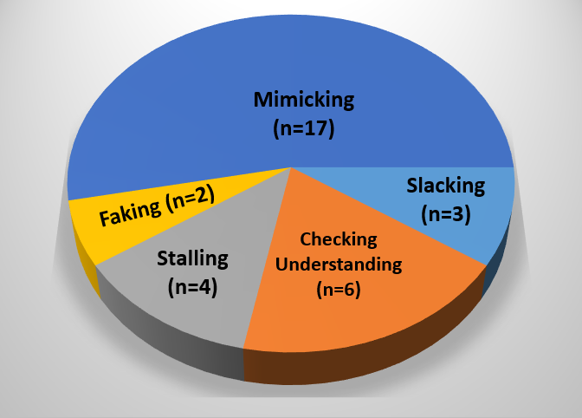
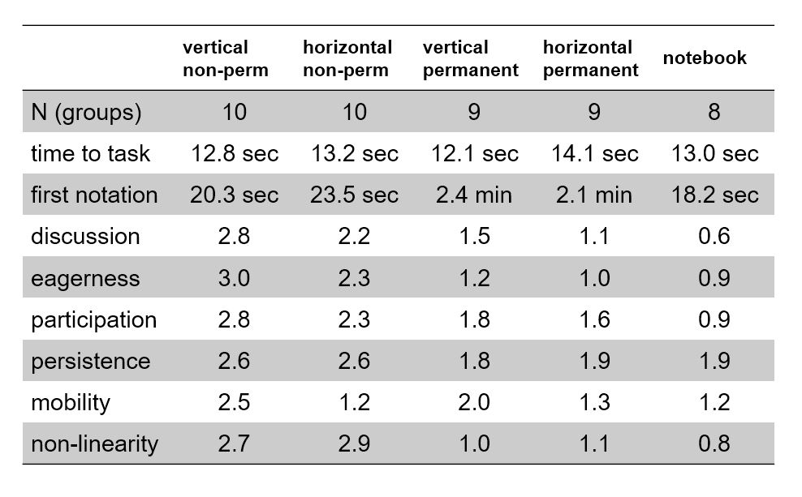
DATA WITH VERSIMILITUDE

Slide 51
ACCOMMODATING OUTLIERS
Think of a very good student from your past. What were the qualities that this student had that made them so good?
Think of a lesson that you do that the students really engage with. What is it that makes it engaging?

Slide 52
REIFICATION
Formative assessment as helping students understand where they are and where they are going.
What are your proxies for thinking?
Processes as content and learning outcomes as context.
What are the proxies for engagement in your classroom?
Power curve.

Slide 53
MODELLED PEDAGOGY
notice pedagogy of facilitator
experience pedagogy as a learner

Slide 54
CONCEPTUAL CHANGE
rejection of
old pedagogy
+
alternative
pedagogy
undeniable truth
data with verisimilitude
undeniable truth
data with verisimilitude
reification
accommodating outliers
modelled pedagogy

Slide 55
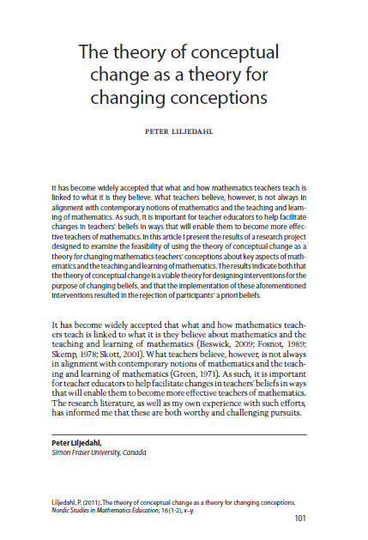
CONCEPTUAL CHANGE
rejection of
old pedagogy
+
alternative
pedagogy

Slide 56
CONCEPTUAL CHANGE
Do Not Disturb
Willing to Rethink
Inquiry
Willing to Reorganize
Out with the Old
Resistance

Slide 57
BUILD SOMETHING
explicit goal to
build something
+
for someone
else
+
pilot testing
undeniable truth
reification
accommodating outliers

Slide 58
BUILD SOMETHING
numeracy definition
numeracy task
Thinking Classroom task
Thinking Classroom rubric
etc.
explicit goal to
build something
+
for someone
else
+
pilot testing
school
family of schools
district

Slide 59
BUILD SOMETHING
Do Not Disturb
Willing to Reorganize
Willing to Rethink
Inquiry
Out with the Old
Resistance

Slide 60
1ST PERSON VICARIOUS EXPERIENCE
someone else's
pedagogy
+
at your
own hand
+
success
modelled pedagogy
undeniable truth

Slide 61
1ST PERSON VICARIOUS EXPERIENCE
someone else's
pedagogy
+
at your
own hand
+
success
begin lessons with good problems
form visibly random groups
use vertical non-permanent surfaces

Slide 62
1ST PERSON VICARIOUS EXPERIENCE
Do Not Disturb
Willing to Reorganize
Willing to Rethink
Inquiry
Out with the Old
Resistance

Slide 63
FINAL THOUGHT
Single workshops are an ineffective means of creating professional growth (Ball, 2002)
… for teachers who are either resistant to change or are only willing to make small changes. This was not true for teachers whose wants coming into the session were more open to change.

Slide 64
SINGLE WORKSHOP
Do Not Disturb
Willing to Reorganize
Willing to Rethink
Inquiry
Out with the Old
Resistance

Slide 65
OPEN QUESTION
LIMITED RESOURCES

Slide 66
THANK YOU!
liljedahl@sfu.ca
www.peterliljedahl.com/presentations
@pgliljedahl | #vnps | #thinkingclassroom
Global Math Department

