Slide 1
WHAT IS THE NATURE OF Illumination?
Peter Liljedahl

Slide 2
Liljedahl, P. (2013). Illumination: An affective experience? ZDM: The International Journal on Mathematics Education, 45(2), 253-265.

Slide 3
Illumination
Perhaps I could best describe my experience of doing mathematics in terms of entering a dark mansion. One goes into the first room, and it's dark, completely dark. One stumbles around bumping into the furniture, and gradually, you learn where each piece of furniture is, and finally, after six months or so, you find the light switch. You turn it on, and suddenly, it's all illuminated. (Andrew Wiles)

Slide 4
Illumination
"sudden clarification" (Pólya, 1965)
"flash of insight" (Davis & Hersh, 1980)
"accompanied by feelings of certainty" (Burton, 1999; Fischbein, 1987)
"with characteristics of brevity, suddenness, and immediate certainty" (Poincaré, 1952)

Slide 5
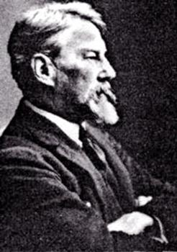
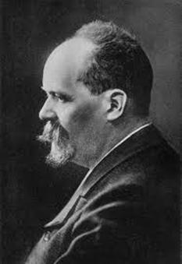
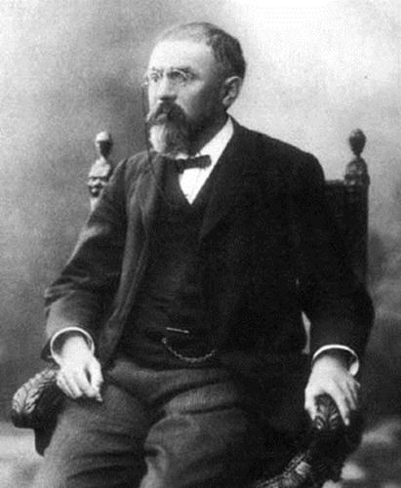
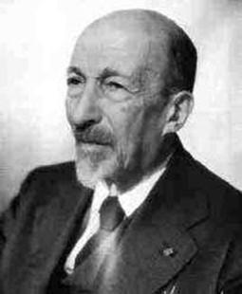
Origins
Édouard Claparède
Théodore Flournoy
Henri Poincaré
Jacques Hadamard

Slide 6
Creative Process
initiation
incubation
illumination
verification
Wallas (1926)

Slide 7
Creative Process
initiation
incubation
illumination
verification
Wallas (1926)

Slide 8
Contemporary Thoughts on Creativity
Person
habit or genius
Ghiselin (1952), Koestler (1964), and Kneller (1965)
Einstein, Poincaré, Van Gogh, D. H. Lawrence, Coleridge, Stravinsky, Mozart, etc.
Product
a product must be forthcoming
absolute creativity (Bailin,1994; Csikszentmihalyi, 1996)
Process
four stages (Wallas 1926, Pincaré, 1952; Hadamard, 1945)
relative creativity
(Liljedahl & Sriraman, 2006)

Slide 9
Research Questions
Given that the phenomenon of illumination is the defining characteristic of creativity, discovery, and invention, then:
what is the defining characteristic of illumination?

Slide 10
Research Questions
Given that the phenomenon of illumination is the defining characteristic of creativity, discovery, and invention, then:
what sets illumination apart from other mathematical processes?

Slide 11
Researching Illumination
First, being a private phenomenon, it is directly accessible only to the experiencing subject. Second, being defined as an experience that happens suddenly and “without warning”, it cannot be captured just when the observer has time and means to observe.
(Sfard, 2004)

Slide 12
Researching Illumination – 2 studies
undergraduate mathematics students (n=73)
Liljedahl, P. (2005). Mathematical discovery and affect: The effect of AHA! experiences on undergraduate mathematics students. International Journal of Mathematical Education in Science and Technology, 36(2-3), 219-236.
research mathematicians (n=25)
Liljedahl, P. (2009). In the words of the creators. In R. Leikin, A. Berman, & B. Koichu (eds.) Mathematical Creativity and the Education of Gifted Children. (pp. 51-70). Rotterdam, NL: Sense Publishers.

Slide 13
STUDY 1
undergraduate mathematics students (n=73)

Slide 14
Study 1 – Cognitive
idea
idea
idea
idea
AHA!
idea
idea
stuck

Slide 15
Study 1 – Cognitive
idea
idea
idea
idea
AHA!
idea
idea
stuck
UNREMARKABLE

Slide 16
Study 1 – Affective
emotions - It felt great.
self-efficacy - Knowing that I could stare at a problem and in time I would understand, gave me more confidence that I could be successful in math.
motivation – I felt inspired to do more if these types of problems.
beliefs - I used to think that if you couldn't get it right away you didn't know how to do it.
attitudes - Also, I enjoy math now. I feel like this success stimulated more success. Now I have raised my expectations in math.

Slide 17
Study 1 – Affective
emotions - It felt great.
self-efficacy - Knowing that I could stare at a problem and in time I would understand, gave me more confidence that I could be successful in math.
motivation – I felt inspired to do more if these types of problems.
beliefs - I used to think that if you couldn't get it right away you didn't know how to do it.
attitudes - Also, I enjoy math now. I feel like this success stimulated more success. Now I have raised my expectations in math.
REMARKABLE

Slide 18
Study 1 – Discussion
Illumination is (in part) an AFFECTIVE experience AND the affective part is the REMARKABLE part.

Slide 19
STUDY 2
research mathematicians (n=25)

Slide 20
Study 2 – Context
It may have been in the shower that it just occurred to me that the work of some of the classical authors could be generalized in a certain way [..] I can be talking to a colleague or my wife or eating breakfast and suddenly, like a voice from the blue, I get told what to do.
(Jerry Marsden)

Slide 21
Study 2 – Chance
In my wandering life between concrete fields and problems, chance is continually important in two ways. A chance reading or encounter has often brought an awareness of existing mathematical tools that were new to me and allowed me to return to old problems I was previously obliged to leave aside. In other cases, a chance encounter suggested that old tools could have new uses that helped them expand.
(Benoit B. Mandelbrot)

Slide 22
Study 2 – Significance
What I think you mean by an AHA! experience comes at the moment when something mathematically significant falls into place.
(Wendell Fleming)

Slide 23
Study 2 – Sense of Significance
What I think you mean by an AHA! experience comes at the moment when something mathematically significant falls into place.
(Wendell Fleming)

Slide 24
Study 2 – Prolonged Conscious Work
The harder and more prolonged the prior work, and/or the more sudden and unexpected the insight, the more intense is the AHA! experience.
(Connor)

Slide 25
Study 2 – Discussion
ILLUMINATION
intense work → release
unexpected arrival
POSITIVE EMOTIONS
encode the experience
sense of significance

Slide 26
Conclusions
ILLUMINATION DEFINED BY AFFECT
cognitive experience is unremarkable
affective experience is remarkable

Slide 27
THANK YOU!
liljedahl@sfu.ca
http://www.peterliljedahl.com/presentations

