Slide 1
building thinking classrooms
- Peter Liljedahl

Slide 2
CULMINATION … SO FAR
Liljedahl, P. & Allan, D. (2013). Studenting: The case of "now you try one". Proceedings of the 37th Conference of the PME, Vol. 3, pp. 257-264. Kiel, Germany: PME.
Liljedahl, P. & Allan, D. (2013). Studenting: The Case of Homework. Proceedings of the 35th Conference for PME-NA. Chicago, USA.
Liljedahl, P. (in press). Building thinking classrooms: Conditions for problem solving. In P. Felmer, J. Kilpatrick, & E. Pekhonen (eds.) Posing and Solving Mathematical Problems: Advances and New Perspectives. New York, NY: Springer.
Liljedahl, P. (2014). The affordances of using visually random groups in a mathematics classroom. In Y. Li, E. Silver, & S. Li (eds.) Transforming Mathematics Instruction: Multiple Approaches and Practices. New York, NY: Springer.
Liljedahl, P. (accepted). Classroom practices for supporting problem solving. ICME 13. Hamburg, Germany.
Liljedahl, P. (under review). Flow: A framework for discussing teaching. Proceedings of the 40th Conference of the PME.
[..]

Slide 3
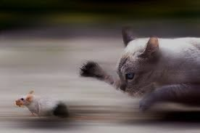
JANE’S CLASS (2003)
If 6 cats can kill 6 rats in 6 minutes, how many cats are required to kill 100 rats in 50 minutes?
- Lewis Carroll

Slide 4
MS. AHN’S CLASS (2003)
If 6 cats can kill 6 rats in 6 minutes, how many cats are required to kill 100 rats in 50 minutes?
- Lewis Carroll
NOTHING!

Slide 5
12 YEARS OF RESEARCH
MS. AHN’S CLASSROOM
UNDERSTANDING NON-THINKING CLASSROOMS
BUILDING THINKING CLASSROOMS

Slide 6
UNDERSTANDING NON-THINKING CLASSROOMS

Slide 7
CONTEXT OF RESEARCH
NOW YOU TRY ONE
HOMEWORK
TAKING NOTES
REVIEW
GROUP WORK
LECTURE
STATIONS

Slide 8
TYPOLOGY BUILDING
Observation Phase
Typology Building
Typology Testing

Slide 9
NOW YOU TRY ONE
n=32
STUDENTING
catching up on notes (n=0)

Slide 10
STUDENTING
[T]hings that students do such as ‘psyching out’ teachers, figuring out how to get certain grades, ‘beating the system’, dealing with boredom so that it is not obvious to teachers, negotiating the best deals on reading and writing assignments, threading the right line between curricular and extra-curricular activities, and determining what is likely to be on the test and what is not.
Fenstermacher (1994, p.1)

Slide 11
STUDENTING
identifies autonomous actions of students that may or may not align with the intentions of the teacher
extends constructs such as the didactic contract (Brousseau, 1997) and classroom norms (Cobb, Wood, & Yackel, 1991; Yackel & Cobb, 1996) to encompass behaviours that are not predicated on an assumption of shared intent to learn

Slide 12
NOW YOU TRY ONE
n=32
STUDENTING
catching up on notes (n=0)

Slide 13
NOW YOU TRY ONE
n=32
Liljedahl, P. & Allan, D. (2013). Studenting: The case of "now you try one". Proceedings of the 37th Conference of the PME, Vol. 3, pp. 257-264. Kiel, Germany: PME.

Slide 14

FRAMEWORK OF GAMING
GAMING
WITH FAÇADE
(intentional)
NO FAÇADE
(unintentional)
ALTERNATE IDEAS
BEATING THE SYSTEM
wrong objective
preferred learning style
teacher is wrong
avoidance
economy of action
doing being
wrong rules
practical rationality
institutional norms
…

Slide 15
THEORIZING ABOUT STUDENTS
doing being … a student (Sacks)
practical rationality (Aaron)
law of least effort (Kahnemann)
motivation and avoidance (Hannula)
didactic tension (Mason)
goal regulation (Hannula)
self-determination theory (Deci & Ryan)
institutional norms (Liu & Liljedahl)
avoidance (Hannula)
activity theory (Leont’ev, Engström)

Slide 16
BUILDING THINKING CLASSROOMS

Slide 17
EARLY EFFORTS
just do it
teaching with problem solving
some were able to do it
they needed a lot of help
they loved it
they don’t know how to work together
they got it quickly and didn't want to do any more
they gave up early
FILTERED THROUGH STUDENTS
TASKS
teaching problem solving

Slide 18

REALIZATION
STUDENT NORMS

Slide 19
REALIZATION
CLASSROOM NORMS

Slide 20
REALIZATION
INSTITUTIONAL NORMS

Slide 21

CASTING ABOUT (n = 300+)

Slide 22
THINGS I (WE) TRIED
tasks
hints and extensions
how we give the problem
how we answer questions
how we level
room organization
how groups are formed
student work space
how we give notes
assessment
…

Slide 23
FINDINGS
VARIABLE | POSITIVE EFFECT
tasks | good tasks
hints and extensions | managing flow
how we give the problem | oral vs. written
how we answer questions | 3 types of questions
how we level | level to the bottom
room organization | defronting the room
how groups are formed | visibly random groups
student work space | vertical non-permanent surfaces
how we give notes | don't
assessment | 4 purposes
…

Slide 24
FINDINGS – BIGGEST IMPACT
levelling
assessment
flow
answering questions
oral instructions
defronting the room
good tasks
vertical non-permanent surfaces
visibly random groups

Slide 25
FINDINGS – BIGGEST IMPACT
levelling
assessment
flow
answering questions
oral instructions
defronting the room
good tasks
vertical non-permanent surfaces
visibly random groups

Slide 26

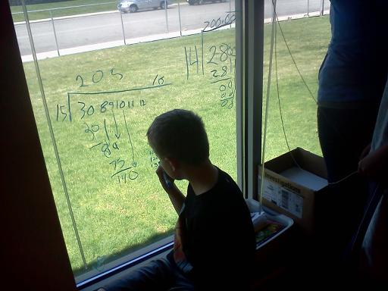
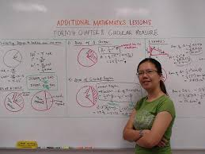
VERTICAL NON-PERMANENT SURFACES

Slide 27
EFFECT ON STUDENTS
five high school classrooms
  two grade 12 (n=31, 30)
  two grade 11 (n=32, 31)
  one grade 10 (n=31)
students were put into groups of two to four
assigned to one of five work surfaces
  vertical non-permanent surface (whiteboard, blackboard)
  horizontal non-permanent surface (whiteboard)
  vertical permanent surface (flipchart paper)
  horizontal permanent surface (flipchart paper)
  notebook

Slide 28
EFFECT ON STUDENTS
PROXIES FOR ENGAGEMENT
time to task
time to first mathematical notation
amount of discussion
eagerness to start
participation
persistence
knowledge mobility
non-linearity of work
0 - 3

Slide 29
EFFECT ON STUDENTS
 | vertical non-perm | horizontal non-perm | vertical permanent | horizontal permanent | notebook
N (groups) | 10 | 10 | 9 | 9 | 8
time to task | 12.8 sec | 13.2 sec | 12.1 sec | 14.1 sec | 13.0 sec
first notation | 20.3 sec | 23.5 sec | 2.4 min | 2.1 min | 18.2 sec
discussion | 2.8 | 2.2 | 1.5 | 1.1 | 0.6
eagerness | 3.0 | 2.3 | 1.2 | 1.0 | 0.9
participation | 2.8 | 2.3 | 1.8 | 1.6 | 0.9
persistence | 2.6 | 2.6 | 1.8 | 1.9 | 1.9
mobility | 2.5 | 1.2 | 2.0 | 1.3 | 1.2
non-linearity | 2.7 | 2.9 | 1.0 | 1.1 | 0.8
Liljedahl, P. (accepted). Classroom practices for supporting problem solving. ICME 13. Hamburg, Germany.

Slide 30
EFFECT ON TEACHERS
 | elementary | middle | secondary | TOTALS
learning teams | 21 | 43 | 41 | 105
multi-session workshops | 12 | 28 | 42 | 82
single workshops | 35 | 24 | 54 | 113
TOTALS | 68 | 95 | 137 | 300
2007-2011

Slide 31
EFFECT ON TEACHERS
This was so great [..] it was so good I felt like I shouldn't be doing it.
I will never go back to just having students work in their desks.
How do I get more whiteboards?
The principal came into my class … now I'm doing a session for the whole staff on Monday.
My grade-partner is even starting to do it.
The kids love it. Especially the windows.
I had one girl come up and ask when it will be her turn on the windows.

Slide 32
EFFECT ON TEACHERS

Slide 33


VISIBLY RANDOM GROUPS

Slide 34
EFFECT ON STUDENTS
grade 10
90% Asian or Caucasian
February – April (linear system Sept - June)
field notes
  observations
  interactions
  conversations
interviews
  teacher
  students

Slide 35
EFFECT ON STUDENTS
students become agreeable to work in any group they are placed in
there is an elimination of social barriers within the classroom
mobility of knowledge between students increases
reliance on co-constructed intra- and inter-group answers increases
reliance on the teacher for answers decreases
engagement in classroom tasks increase
students become more enthusiastic about mathematics class
Liljedahl, P. (in press). The affordances of using visually random groups in a mathematics classroom. In Y. Li, E. Silver, & S. Li (eds.) Transforming Mathematics Instruction: Multiple Approaches and Practices. New York, NY: Springer.

Slide 36
EFFECT ON TEACHERS
 | elementary | middle | secondary | TOTALS
learning team | 15 | 22 | 31 | 68
multi-session workshops | 25 | 19 | 14 | 58
single workshops | 10 | 25 | 39 | 74
TOTALS | 50 | 66 | 84 | 200
2009-2011

Slide 37
EFFECT ON TEACHERS

Slide 38
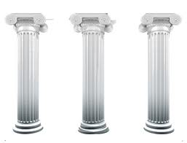
TOGETHER - THREE PILLARS
vertical surfaces
random groups
good tasks

Slide 39
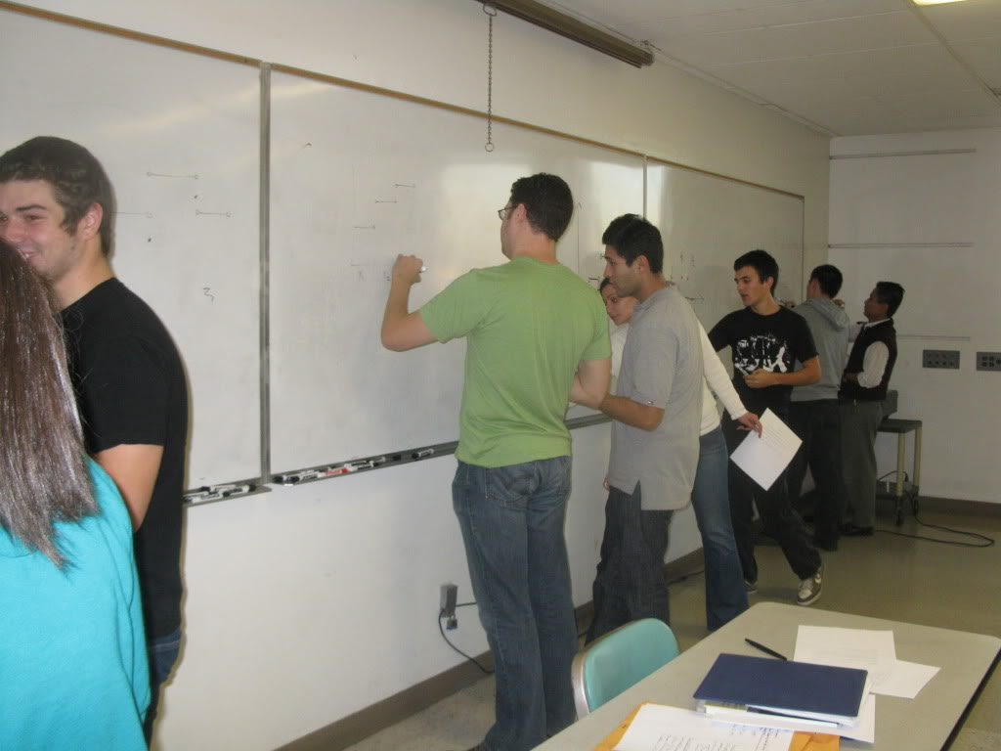
TOGETHER

Slide 40
EFFECT ON TEACHERS
I've never seen my students work like that
they worked the whole class
they want more
how do I keep this up AND work on the curriculum?
how do I assess this?
where do I get more problems?
I don't know how to give hints?

Slide 41
EFFECT ON TEACHERS

Slide 42
WHAT NEXT?
levelling
assessment
flow
answering questions
oral instructions
defronting the room
good tasks
vertical non-permanent surfaces
visibly random groups

Slide 43


`
THANK YOU!
liljedahl@sfu.ca
www.peterliljedahl.com/presentations
#VNPS

